Slide 1
WW2 #1: How does it start?
What were the main components of the Treaty of Versailles?
What countries were Germany, Italy, and Japan invading in the 1930s?

Slide 2
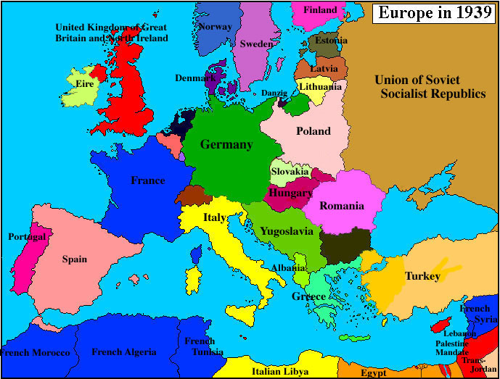
Italy
1922: 1st fascist nation – Mussolini
Fascist: nationalism, authoritarian, strong military
1935: Takes over Ethiopia – LofN does nothing
1939: Takes over Albania

Slide 3
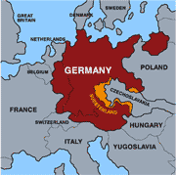
Germany
1933: Hitler & Nazi party gain power 1st through an election then manipulation
Rearms – breaks TofV
1936: Sends troops to Rhineland – breaks TofV
Mar 1938: Annexes Austria
*League of Nations does nothing to stop all this

Slide 4
Germany
Sept 38: Munich Conference: Br/Fr give Hitler the Sudetenland as long he promises not to want anything else / appeasement
1939: Takes all of Czech
Nazi-Soviet Non-Agression Pact: promise not to fight & to share Poland

Slide 5
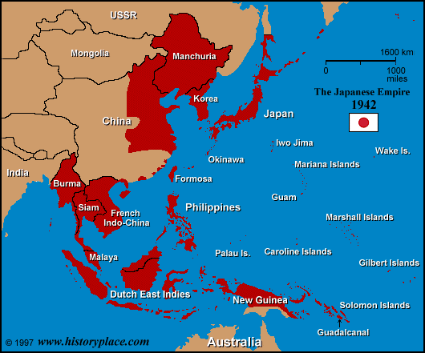
Japan
Emperor Hirohito & Hideki Tojo
1931: Invade Manchuria
1937: Invade China – brutal!
LofN does nothing

Slide 6
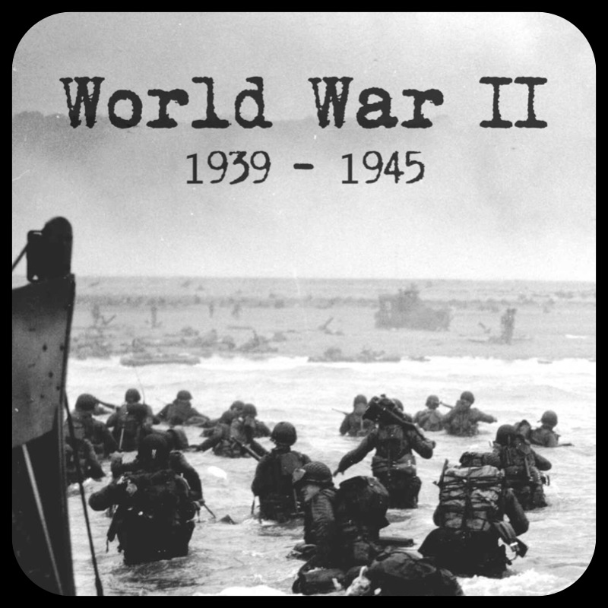
WW2 Begins
Ger invades Poland on Sept 1, 1939
Br & Fr declare war
Allies vs. Axis Powers
US stays neutral

