Slide 1
What’s left: Extra Credit!
5/7 | 5/8 | 5/9 #10 DUE | 5/10 | 5/11 1960s Test
5/14 | 5/15 | 5/16 | 5/17 | 5/18
5/21 | 5/22 Return textbooks | 5/23 Return textbooks | 5/24 | 5/25
5/28 – NO School | 5/29 P. 1-6 | 5/30 Finals P. 3 & 4 | 5/31 Finals P. 5 & 6 | 6/1 Finals P. 1 & 2

Slide 2
1960s #12: Watergate
DUE: #10
Test, Timeline & Notebook = Thursday

Slide 3
Executive Privilege
Allows President to keep certain things secret from the public

Slide 4
Impeachment: Charged w/ treason, bribery, and other high crimes and misdemeanors

Slide 5
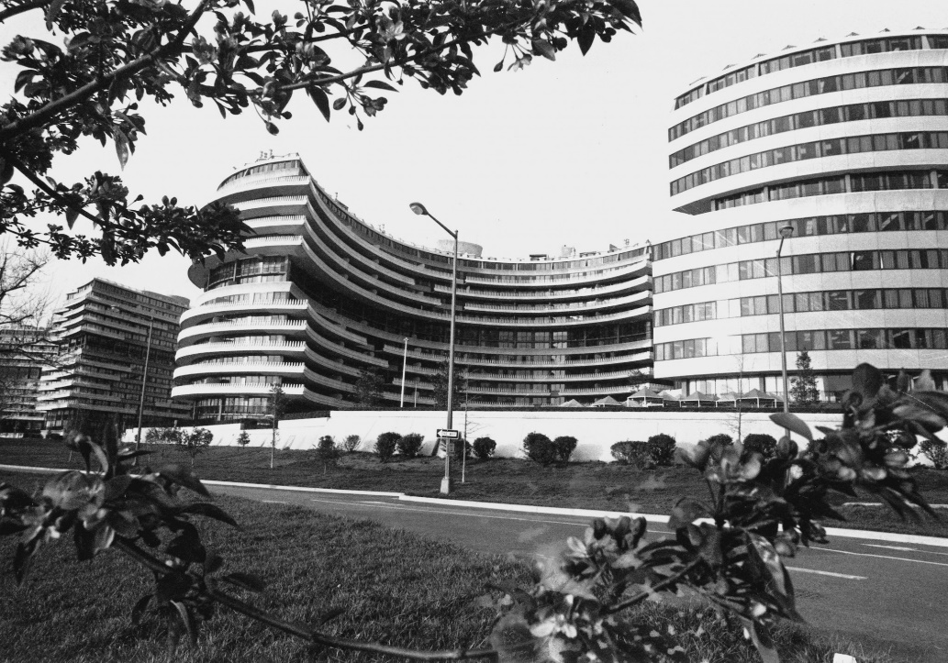
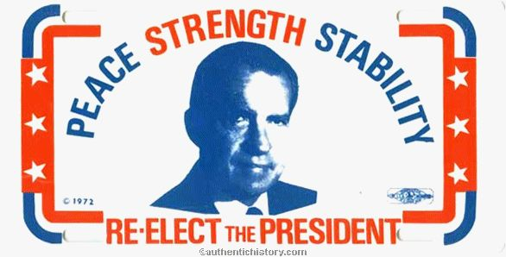
June 1972 (summer before pres election)
Watergate Hotel in DC: HQ for Dems
5 men arrested for breaking
Men connected to Committee to Reelect the President (Nixon)

Slide 6
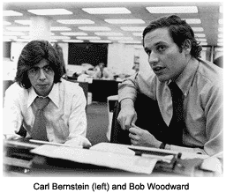
WH interferes with FBI investigation
CRP gives $450K to 5 –
Washington Post investigates
Deep Throat: secret source
FBI

Slide 7
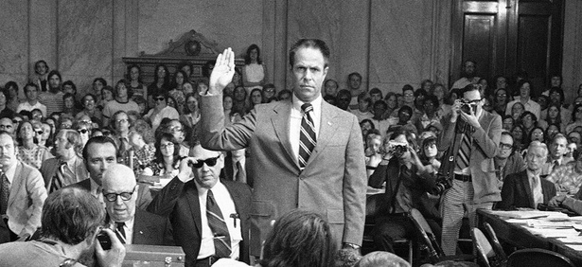
Jan 73: Trial begins of 5 ….was WH involved?
Nixon denies it & appoints special prosecutor to investigate (Now: Robert Mueller is special counsel looking into Russia collusion)
Senate also investigate
“What did the President know and when did he know it?”
Aide implies Nixon knew
TAPES of WH conversations

Slide 8
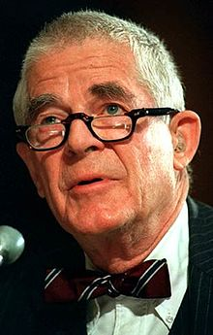
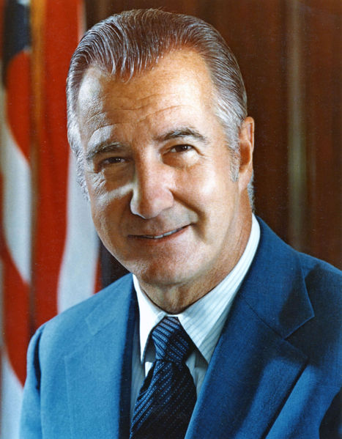
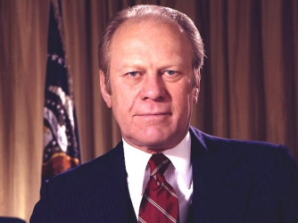
Saturday Night Massacre
Court orders N to release tapes, says NO
N orders Atty General to fire special prosecutor, Archibald Cox
He says NO, and was fired
#2 says NO, fired
#3 says OK, fires SP
VP, Spiro Agnew, resigns due to possible bribes
New VP = Gerald Ford

Slide 9
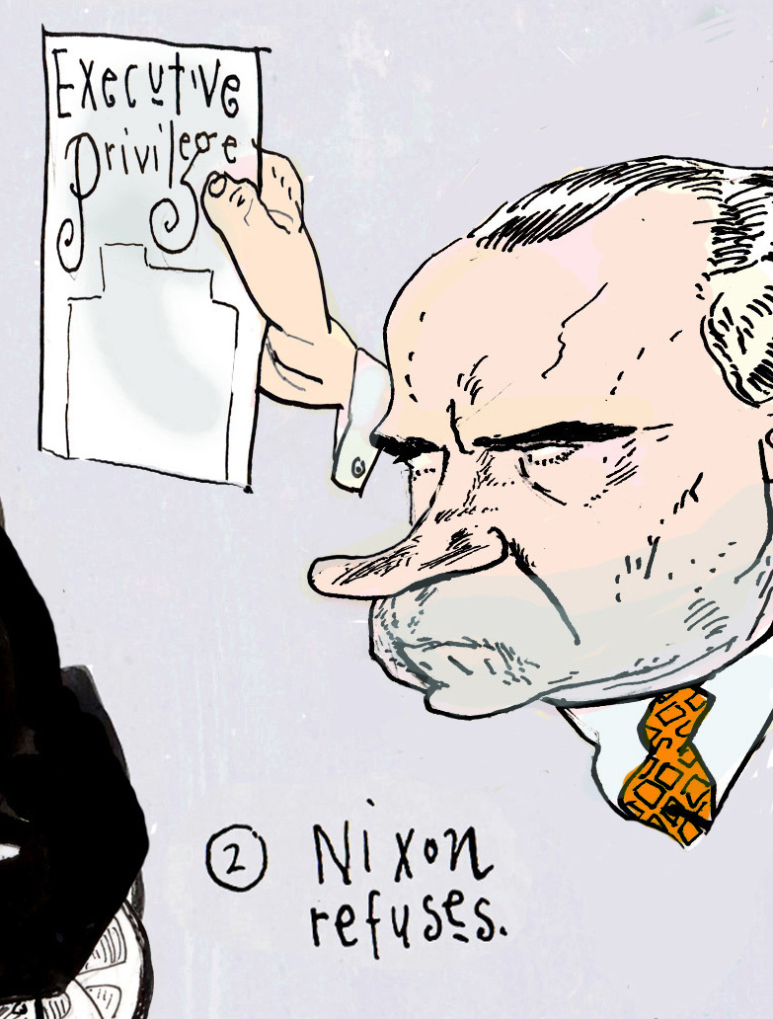
The tapes
Edited tapes are released
Want rest, N says no
Executive privilege: implied power that conversation in WH are secret
US vs. Nixon: Sup Ct says – unanimously – release all tapes:
Pres do have EP but not absolutely
Nat’l security, military more likely to be EP

Slide 10
“. . . Absent a claim of need to protect military, diplomatic, or sensitive national security secrets, we find it difficult to accept the . . . [absolute] confidentiality of presidential communications." — Chief Justice Warren Burger

Slide 11
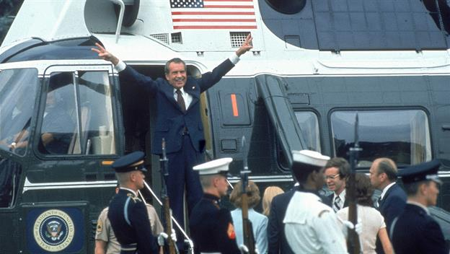
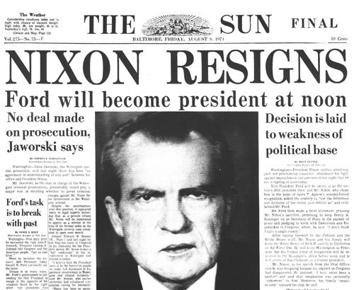
July – House is beginning impeachment process
Aug 5 – N. releases tapes – with some holes
Tape shows that N knew about Watergate 6 days after and wanted it covered up
Aug 8 – resigns
1st pres to resign

Slide 12
Does Trump have the right to claim executive privilege in the Mueller probe?
Subpoena

Slide 13
Donald J. Trump‏Verified account @realDonaldTrump
James Comey better hope that there are no "tapes" of our conversations before he starts leaking to the press!

Slide 14
Comic Strip
List 8 events and have me check them

Slide 15
Quiz Review
LBJ declared a war on poverty in his program he called…..?
Name one program LBJ created.
What did the Civil Rights Act do?
What did the Voting Rights Act do?
What happened at the March on Selma?
Event that began the Vietnam War.
How does the Vietnam War end?
Which president had a “secret plan” for ending the war?

