Slide 1
Imp #4: Mobilizing for War
What were the 2 reasons that the U.S. entered WW1?

Slide 2
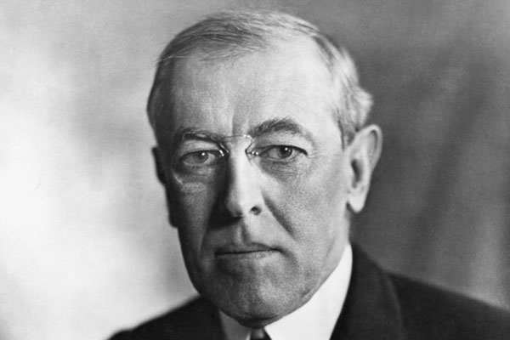
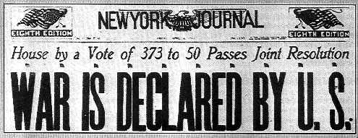
“War to End All Wars”
Wilson elected on promise, “He keeps us out of war” BUT:
Sinking of the Lusitania (boat) by German u-boat, Americans die
Zimmerman Note: Ger offer Mexico US land if help in war
Bring US into WW1: April 1917 – 2 ½ years after it starts

Slide 3
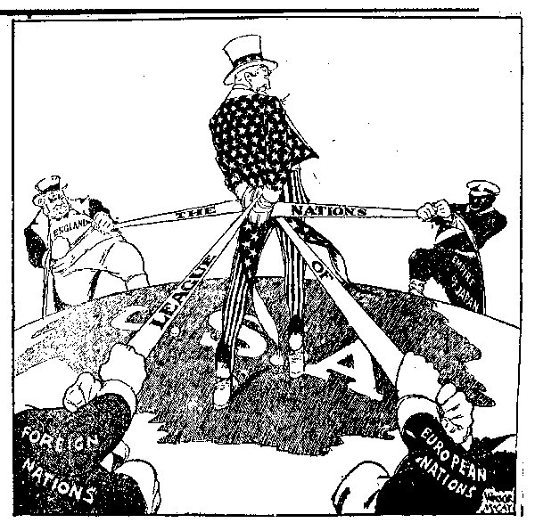
Wilson wants to “make the world safe for democracy”
14 Points: (1918)
End secret treaties
Freedom of the seas
Allow people to choose their own countries: self-determination
League of Nations

Slide 4
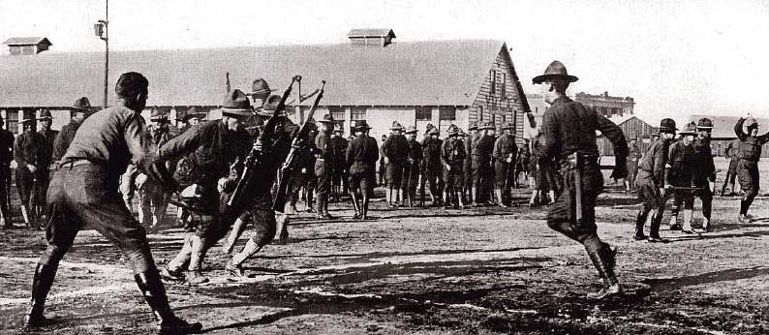
Raising an Army
Selective Service Act: men must register with gov in order to be chosen for the draft / conscription (required military service)
300,000 men enlist / 2 million were drafted
13,000 Women enlist (join willingly) – nurses & secretaries

Slide 5
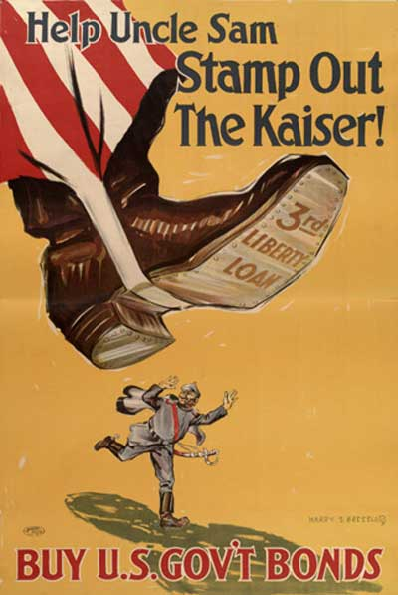
Propaganda
Committee on Public Information
Convince Americans to participate in war effort

Slide 6
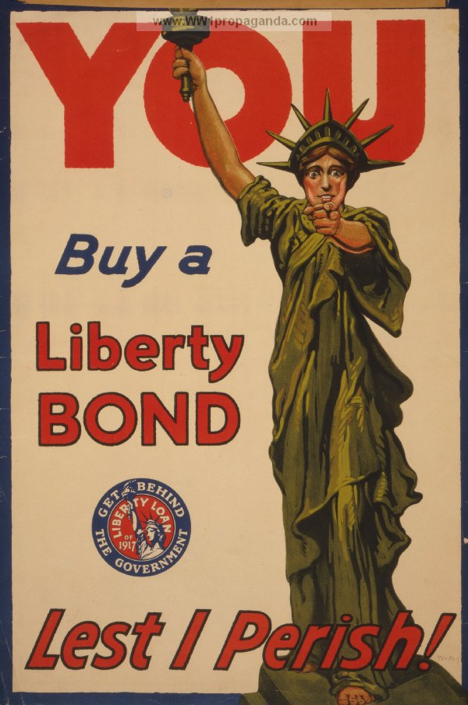
War Bonds
Gov needs $$$ to fight war
So, ask people to buy bonds: loan to gov, money paid back with interest

Slide 7
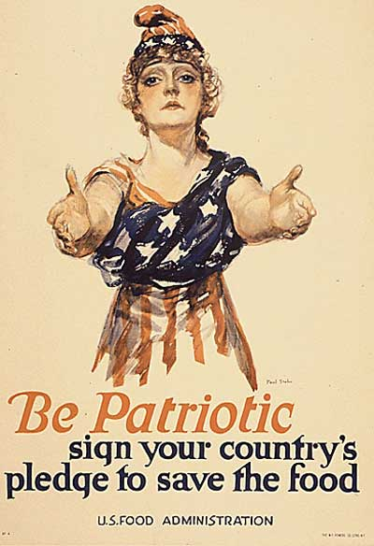
B
C
3
Make sure you know what the Food Administration is – from your homework!

Slide 8
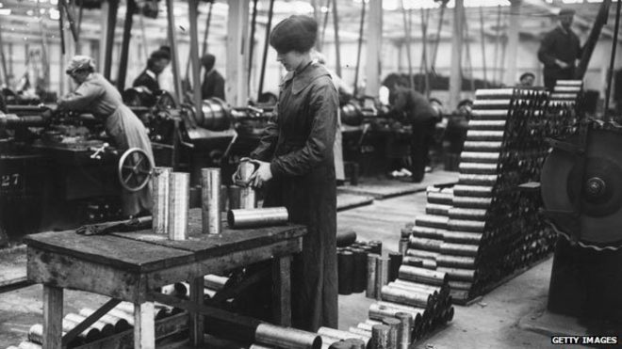
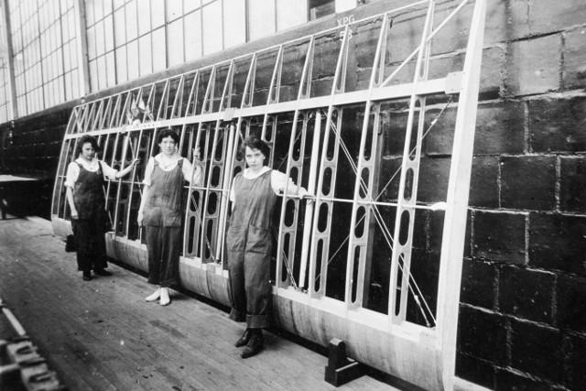
War Production
War Industries Board: Gov agency controlled economy:
Forced conservation (use less) of resources to use for war
Could only make 5 colors for typewriter ribbons – instead of 150 before the war

Slide 9
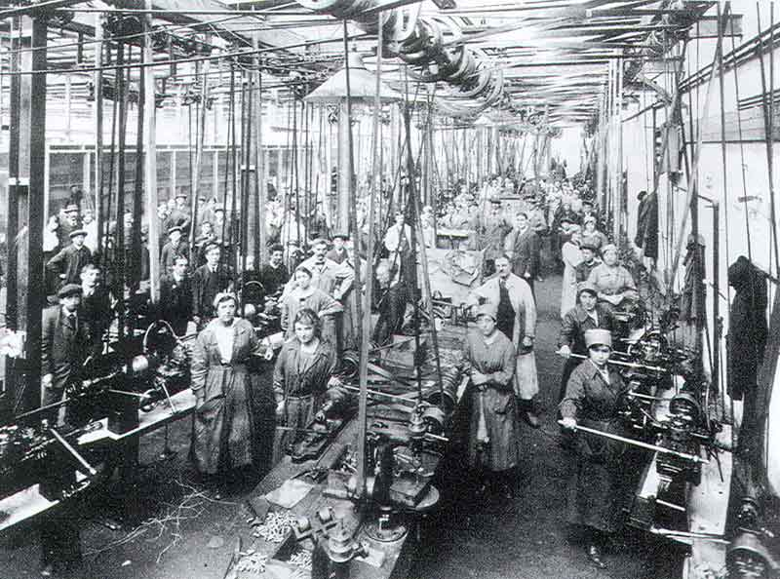
“Labor will win the war”
“Work or fight” – strikers could be drafted
b/c of massive increase in production:
Wages went up
Prices went up (inflation) too b/c limited supply
Needed all the workers they could get!

Slide 10
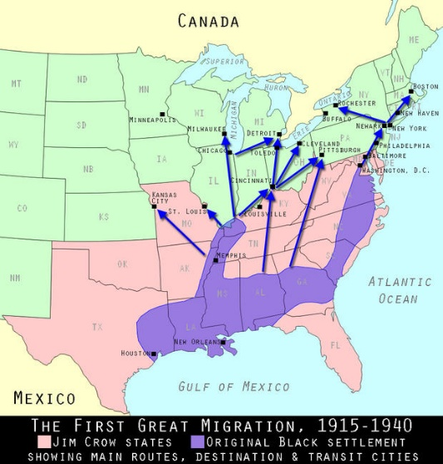
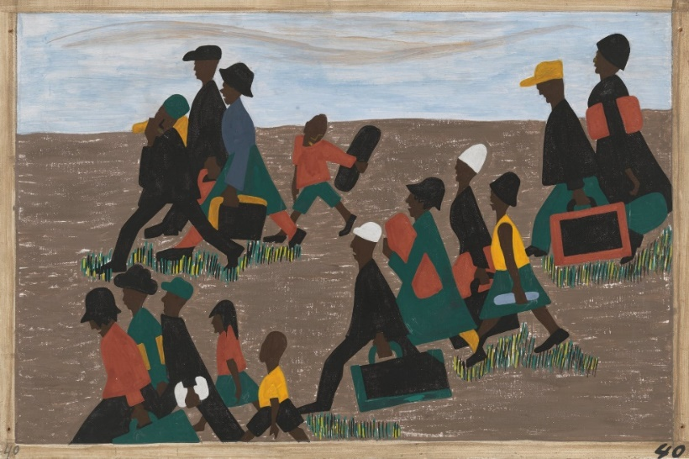
Great Migration (1915-1970)
Many African Americans will migrate (move) from South to North
Migrated b/c
Jobs in north
Fleeing segregation & Jim Crow laws in South
100 pounds of cotton a day

Slide 11
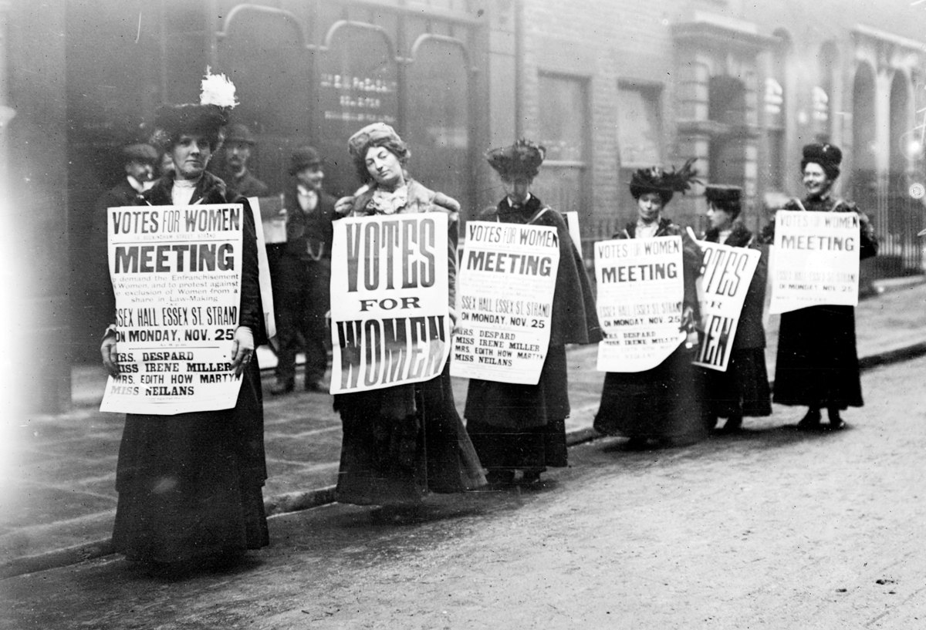
Women
Gained access to new jobs
Joined military
Will give final push to get suffrage

Slide 12
Espionage & Sedition Acts
Prohibited (made illegal) saying anything “disloyal or abusive” about the gov or war effort – including the flag or conscription
Punishment: fine of up to $10,000 (around $125,000 today) and up to 20 years in jail

Slide 13
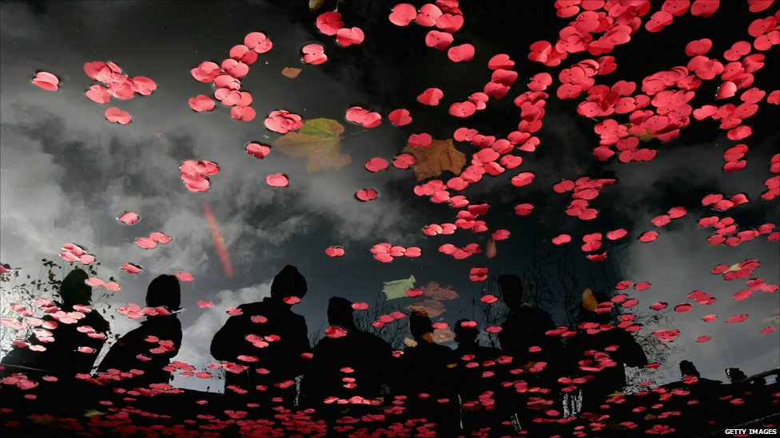
Armistice (stop fighting)
11th hour of the 11th day of the 11th month in 1918 – WW1 ends, Allies win
Veteran’s Day

Slide 14
U.S. vs Schenck (1919)
Supreme Court decides:
Schenck’s words are a threat to the war effort and thus the gov.
It’s like “yelling FIRE in a crowded movie theater” = “a clear and present danger”
THUS, he loses & gov wins

Slide 15
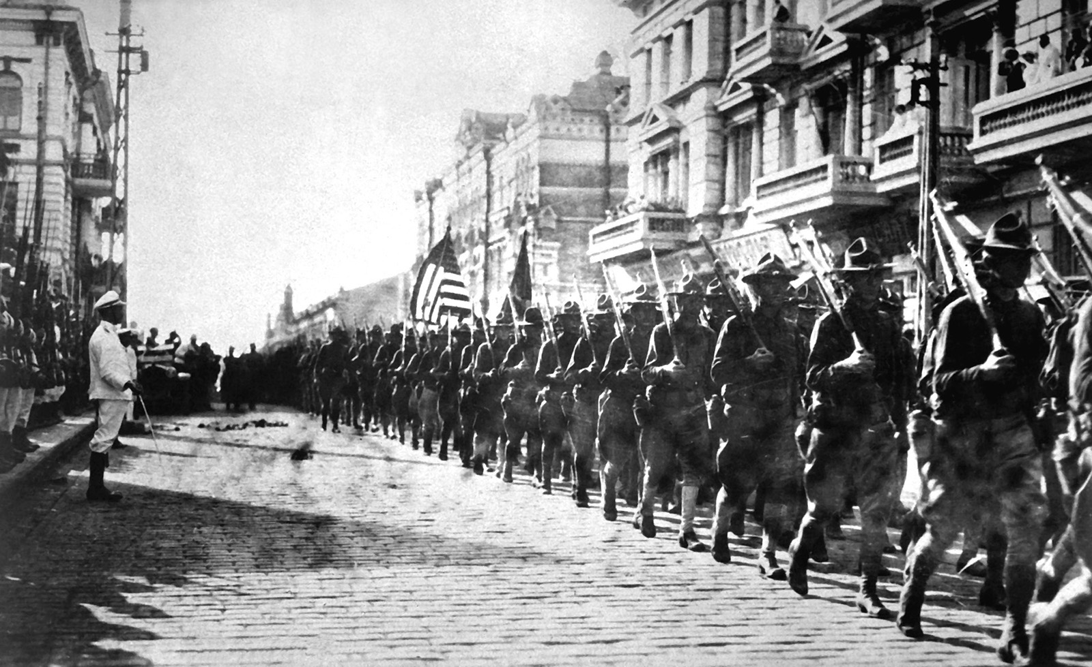
How does WW1 change America? Who benefited? Who suffered?

