Slide 1
1960s #7: 1968
Why is the US fighting in Afghanistan?
Why hasn’t the US won?
What should the US do to end the war?
Turn in paper!
Include rough draft and works cited
Community Service: On top: write up / hours / proposal

Slide 2
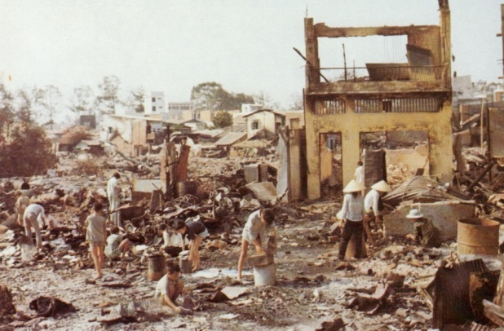
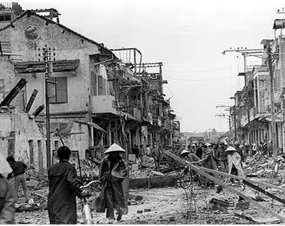
The Year 1968:
Tet Offensive: Lunar new year – holiday usually celebrated w/o fighting
January: North V. surprise attack in many cities in South V
US will win (after a month)
BUT…gov had said, “War is almost over!”
This does NOT look like winning

Slide 3
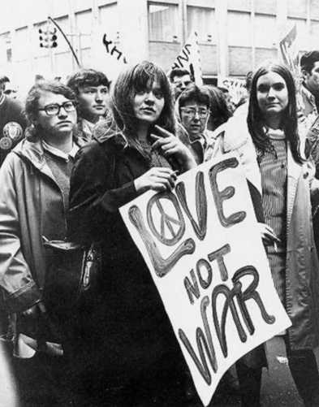
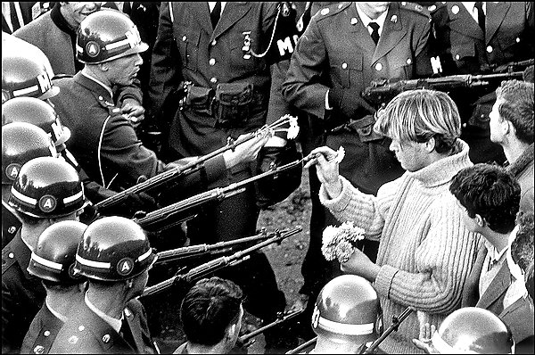
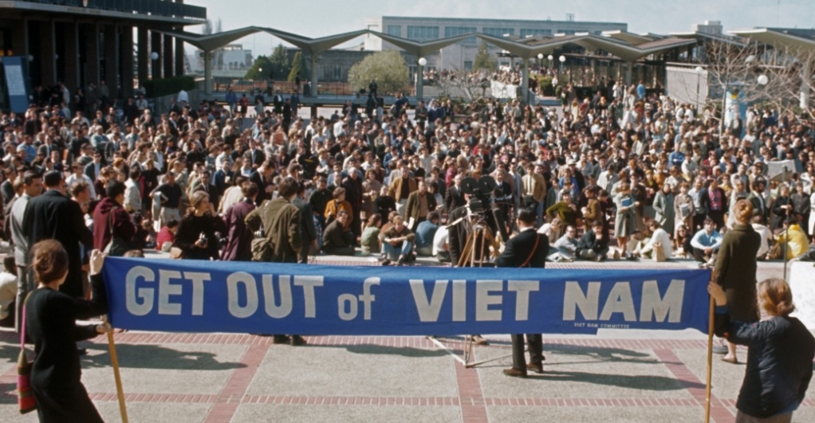
2. Major protests begin
Angry that gov appears to be lying & continuing an unnecessary war
Protests
Burn draft cards
Go to Canada

Slide 4
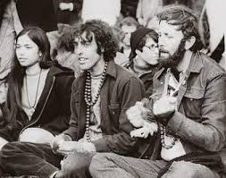
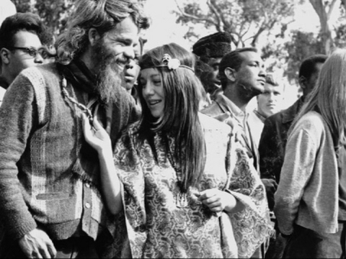
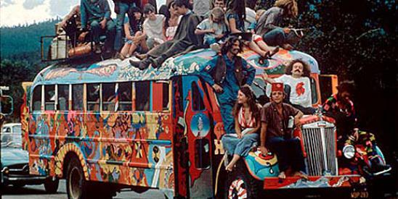
3. Hippies
Counter-culture (against the normal culture)
Dress, live, and act differently
Compare to 1950s conformity
Communes
Peace, love, and harmony

Slide 5
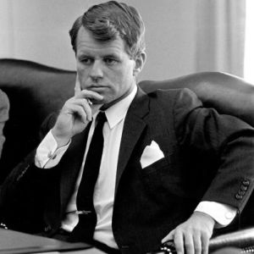
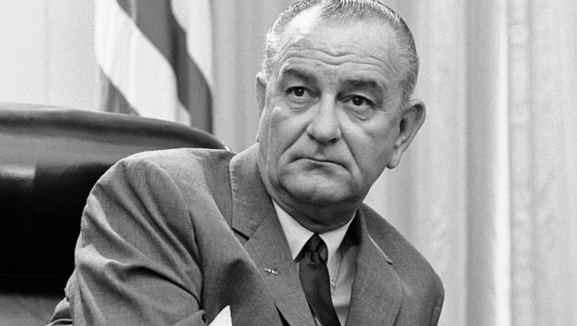
4. LBJ will not run again for presidency
Lyndon Johnson will seek peace in Vietnam
Robert Kennedy will run
OUT
IN

Slide 6
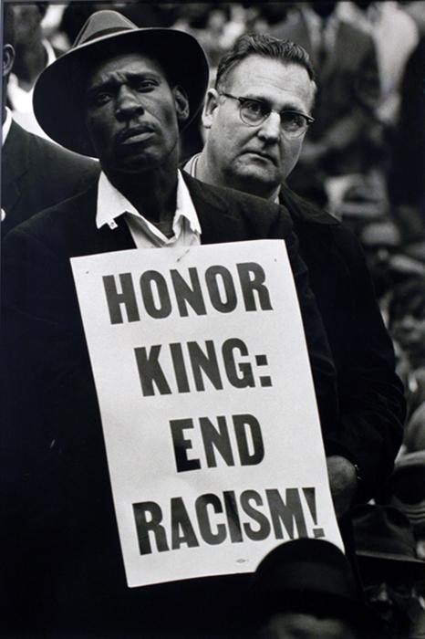
5. Assassinations
MLK – April 4th
R. Kennedy – June 5th
Rock the nation -

Slide 7
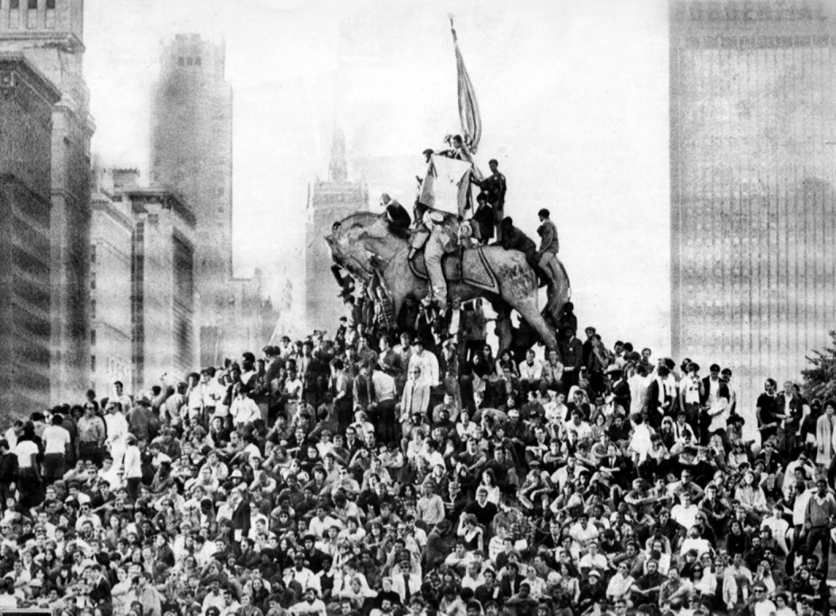
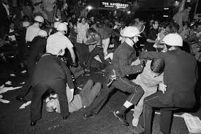
6. 1968 Election
Democratic Convention in Chicago
Violence / Riots : Police reaction

Slide 8
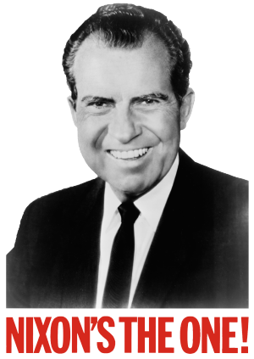
Richard Nixon (R): promises to end war – “Secret Plan”
Secretly telling SV NOT to deal w/LBJ – Nixon has a better deal
Wins election
Nixon

Slide 9
7. My Lai Massacre (me-lie)
Soldiers went to village, My Lai, told VC was there
Found women, kids, elderly
US begins shooting: 504 dead
No shots ever fired at US
Covered up at first – soldier reveals it – 1 man convicted in court
Similar incidents

Slide 10
Vietnam War: Why did the US fight?
"Even today, many Americans still ask whether the American effort in Vietnam was a sin, a blunder, a necessary war, or a noble cause, or an idealistic, if failed, effort to protect the South Vietnamese from totalitarian government," historian Steve Mintz writes.
Which 1 of these do you think best describes why the US is in Vietnam? Explain your answer with 2-3 reasons.

Slide 11
60s #8: School of Rock What does this song say about…..
Politics Society
Fashion / pop culture / Music
Slang (instruments/sounds)

Slide 12
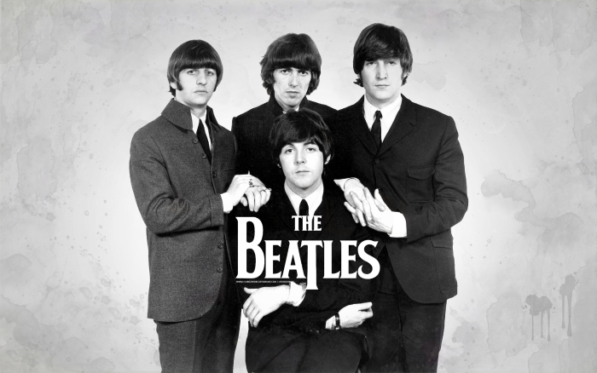
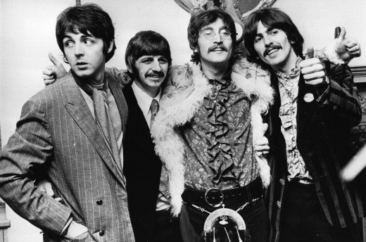
The Beatles: The band of the 1960s. How do they change?
Approx 1964
Approx 1968

Slide 13
#2/6: Compare and contrast 1950s to 1960s
#3/7: Compare and contrast 1950s to 2010s
#4/8: Compare and contrast 1960s to 2010s

