Slide 1
Why is US NOT winning this war?
List reasons from reading (Person 1 – stop at Vietnamese Strategy / Person 2 start at V. Strategy)
What would you propose that LBJ do in response to this evidence?
What would be the advantages of following your proposal and what would be the disadvantages?
Based on the adv/disadv you listed in #3, do you think LBJ should actually follow your proposal? Explain your answer.

Slide 2
What’s left: Extra Credit!
4/30 | 5/1 | 5/2 Final Draft DUE: print & turnitin.com | 5/3 | 5/4 1960s Quiz
5/7 Last day to turn in final draft for 70% | 5/8 | 5/9 | 5/10 | 5/11 1960s Test
5/14 1970s – 90s | 5/15 | 5/16 | 5/17 | 5/18
5/21 | 5/22 | 5/23 | 5/24 | 5/25 Final Exam Review

Slide 3
1960s #4: War begins
Due: Hours or Rough Draft
Find your birthday on the paper on the table

Slide 4
Vietnam War
"Even today, many Americans still ask whether the American effort in Vietnam was a sin, a blunder, a necessary war, or a noble cause, or an idealistic, if failed, effort to protect the South Vietnamese from totalitarian government," historian Steve Mintz writes.

Slide 5
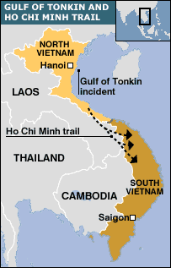
Gulf of Tonkin (Aug 1964)
2 US ships attacked by NV
Why were US ships there?
Spying
1st was attacked
2nd?

Slide 6
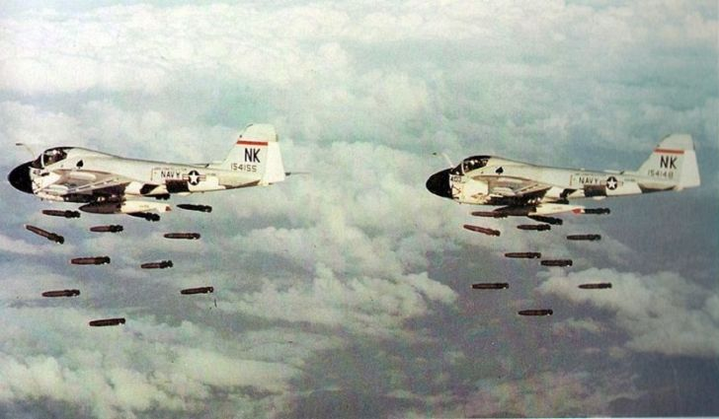
Gulf of Tonkin Resolution
Measure passed by Congress giving LBJ power to escalate war & send troops
Starts war

Slide 7
Operation Rolling Thunder (65-68): bomb NV
Careful to avoid China’s wrath
Target: supplies
Ground Troops

Slide 8
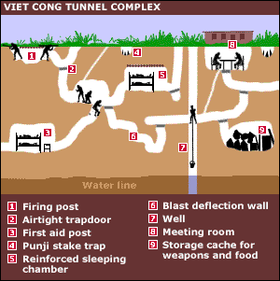

Slide 9
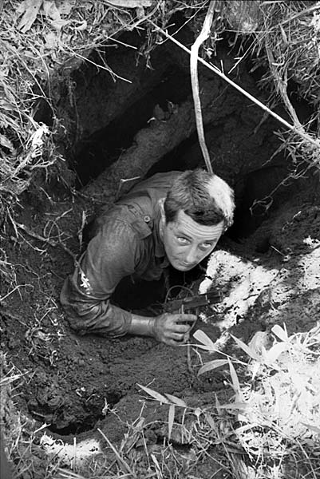
Problems in Vietnam
US should win – best military
BUT ----
1. Vietcong use “guerilla” tactics
Booby Traps/Land Mines/tunnels
Disguise as civilians
2. Vietcong see war as battle for survival

Slide 10
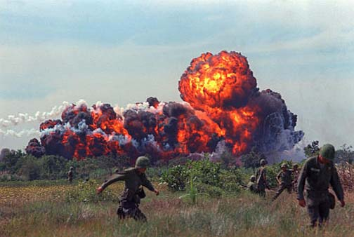
Problems cont’d
3. US strategy doesn’t work:
Napalm – gas-like, used as bombs
Agent Orange – kill plants (herbicide) – to wipe out jungle & incredibly toxic
Civilians

Slide 11
60s #6: Problems at Home
On 60s #5, what did you propose that LBJ do in response to the war in Vietnam?
DUE next time: write up / final paper
NO papers accepted after 3 days past due date

Slide 12
What should LBJ do in Vietnam?
Leave immediately.
Leave slowly. Reduce number of soldiers slowly until all are gone.
Increase number of soldiers to ensure a victory.
Use nuclear weapons.
Better idea?

Slide 13
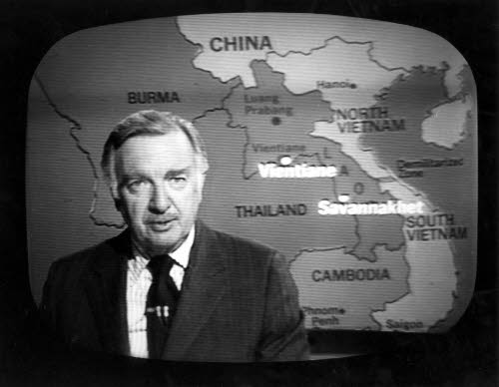
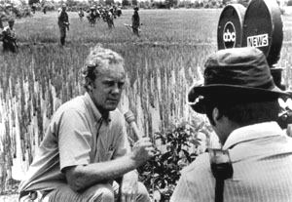
Problems at Home
LBJ unable to continue “Great Society” - all $$/energy goes to war
“The Living Room War” – ppl see the war nightly – and it’s discouraging

Slide 14
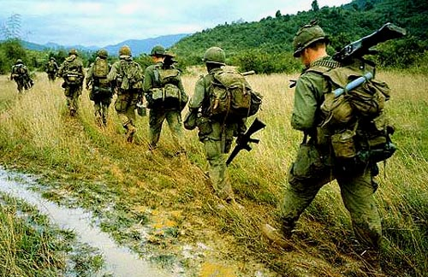
Problems at Home cont’d
Draft: Around 1/3 of troops were drafted
18-26 = eligible (couldn’t vote until 21)
BUT, it could deferred (put off) IF
In college
Medical disability
So, many who were drafted = low income & minorities

Slide 15
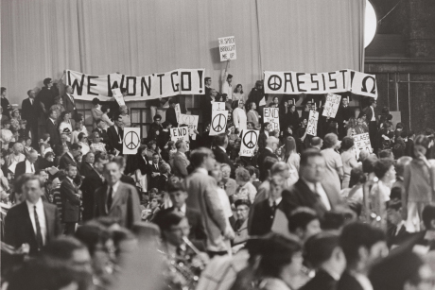
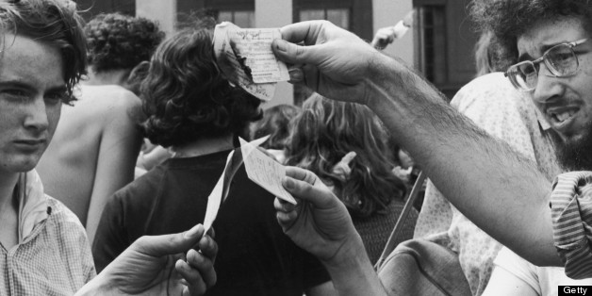
Protests
1965: “Teach Ins” at colleges – professors cancelled class and held anti-war rallies
Burning draft cards
Illegal

Slide 16
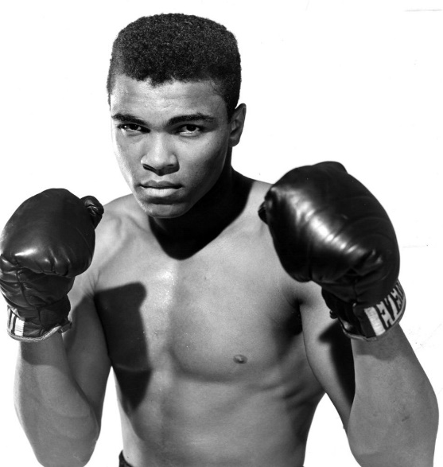
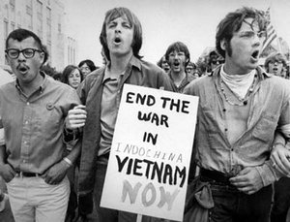
Problems at Home cont’d
MLK:
1967: asks why should blacks fight for rights in Vietnam that they don’t have at home
Muhammad Ali:
Drafted & refused to go
Initially got 5 years in prison, $10,000 fine & out of boxing for 3 years – some of which will be reversed

Slide 17
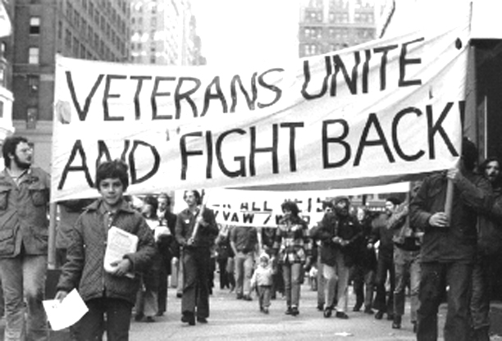
Veterans Against the War
Vets protested / gave back medals

Slide 18
Draftees Newsreel
How does each man respond to his draft notice?
Draftees
Describe the protests and the protests against the protests.
Protests

Slide 19
Why is US NOT winning this war?
List reasons from reading
What would you propose that LBJ do in response to this evidence?
What would be the advantages of following your proposal and what would be the disadvantages?
Based on the adv/disadv you listed in #3, do you think LBJ should actually follow your proposal? Explain your answer.

