Slide 1
1920s #5: Scares
Which amendment gave women suffrage?
Which amendment prohibited alcohol?
Which amendment repealed prohibition?
Give 1 reason why prohibition was put into place.
Give 1 reason why prohibition failed.
Give 1 reason why the US did not sign the Treaty of Versailles.
HW: Notebook Check Ind Rev #8-10/ All Imp.

Slide 2
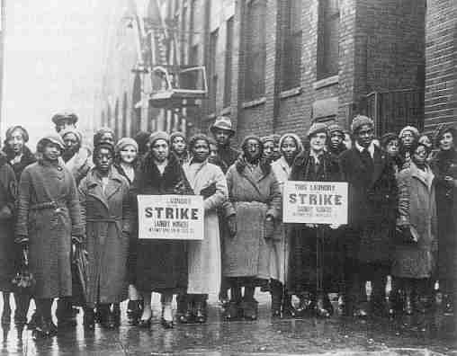
Workers
After war, workers could/did go on strike
Mixed results
Often associated with
Communism
or Socialism

Slide 3
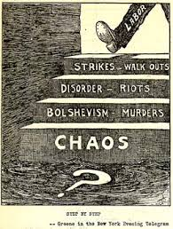
“Step by Step”
What is this cartoon saying about labor?
What is Bolshevism? And why is it bad?

Slide 4
Fears of the 1920s
Red Scare: Fear of communism (due to Russia recently becoming the 1st communist nations)
Why might ppl be scared of communism?

Slide 5
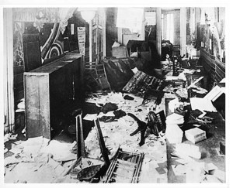
Palmer Raids:
Bombs exploded
A. Mitchell Palmer - Rounded up communists and anarchists (ppl opposed to gov) & had them jailed or had aliens deported (many Russians)
Broke into homes w/o search warrant

Slide 6
Emma Goldman: anarchist, deported back to home country of Russia. How does she compare US & Russia?
“On the deck above us I could hear the men tramping up and down in the wintry blast. I felt dizzy, visioning a transport of politicals doomed to Siberia, the etape of former Russian days. Russia of the past rose before me and I saw the revolutionary martyrs being driven into exile. But no, it was New York, it was America, the land of liberty! Through the port-hole I could see the great city receding into the distance, its sky-line of buildings traceable by their rearing heads. It was my beloved city, the metropolis of the New World. It was America, indeed America repeating the terrible scenes of tsarist Russia! I glanced up - the Statue of Liberty!”

Slide 7
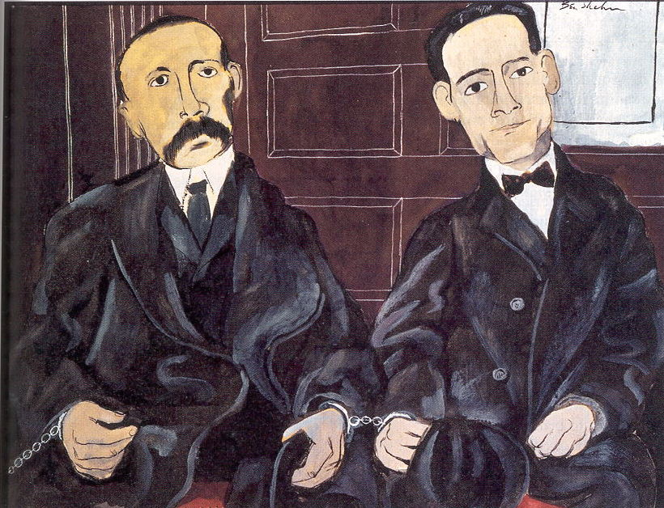
Sacco & Vanzetti
Italian immigrants, anarchists
Arrested for 2 murders & robbery
Claimed innocence until their execution
Many felt they were executed for their beliefs

Slide 8
Guilty? Innocent?
Sacco’s gun has been linked to the crime but we don’t know if he shot it
No evidence has been found to link Vanzetti

Slide 9
Nativism
Anti-foreigner/immigrant feelings & policies
Immigration Restrictions
Quota System: # of immigrants from each country was restricted to a set # - fewer from South/East Europe and none from Japan

Slide 10
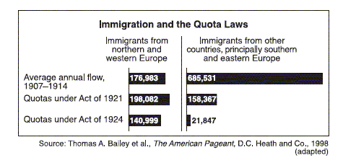
How did immigration change from before 1914 and after 1924?
What does this show us about the law or this era?

Slide 11
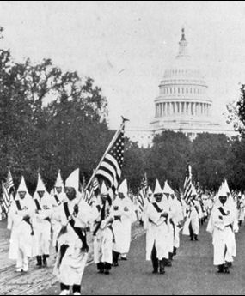
KKK: Ku Klux Klan
White supremacy group uses violence & intimidation
Anti Jewish, immigrant, Catholic, communist
Pro-prohibition
Uses these anti-immigrant, anti-communist feelings to encourage membership

Slide 12
Palmer Raids
Answer questions on a separate sheet of paper

Slide 13
20s #6: Was the 1920s roaring or restraining?
Restraining : Give examples of when the 1920s limit people’s rights, freedoms, or economic opportunities.
Roaring: Give examples of when the 1920s allow for an expansion of people’s rights, freedoms, or economic opportunity.

Slide 14
Did the U.S. in the 1920s expand the rights of its people or limit their rights?

Slide 15
Decision of Assistant Secretary of Labor Louis F. Post in the Truss Case
Secretary Post chose to disregard any oral or written statements made by Truss while he was being questioned without the opportunity to have a lawyer present. Consequently, on April 10, 1920, Post decided to release Truss after concluding that he had never been a knowledgeable and active member of the Communist Party. It was this decision by Secretary Post that led to the attempt in the House of Representative to impeach him.

