Slide 1
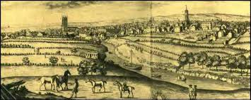
The Urban Game Urban =

Slide 2
Game Requirements
1 large piece of blank paper per group
Pencil / eraser
1 piece of binder-paper per person.
Each answer should require a few sentences of explanation. Please answer in complete sentences.

Slide 4
The Setup
Draw a river across your paper connecting east to west; the river should be about 1 inch wide;
draw a simple wooden bridge crossing the river;
draw 2 roads one running north to south and crossing the river at the bridge and one running from east to west. Neither road needs to be straight.
Draw 10 houses;
1 church; 1 cemetery;
1 store
1 coalmine;
& at least 30 trees!!
**Use symbols or have some kind of code to distinguish a house from a store from a coalmine
**Give your village a name

Slide 5
English Village
Life here in our rural English village is similar to other villages throughout Europe in the 18th century. Change traditionally comes very slowly. People moved at a much slower pace and had access to very little information about the world outside their village. London, England’s largest city and one of the two real cities in Europe had a population of about 750,000 in 1750. Three out of every four Englishmen were rural and lived in small villages like this one. The average village was inhabited by about 200-400 people. The tallest structure in the village was the church.

Slide 6
1st Question
1.) Describe England before 1750

Slide 7
Home life in this Village
Home life & work life were closely connected as most work was done in nearby fields or in the home. Every member of the family worked very hard from sun-up to sun-down. Even small children had chores. The homes of villagers were very small with dirt floors and inadequate lighting and ventilation.
All members of the family slept in the same room and sometimes shared living quarters with the livestock. Sons worked with their fathers farming and tending livestock while daughters worked with their mothers cleaning, cooking, and sewing. Life expectancy was slightly over 40 years of age.

Slide 8
2.) Describe what work was like before 1750.
Most people married in their teens and had babies before they were 20. It was common for women to die during childbirth so the average marriage lasted about 15 years. Step mothers and step fathers were common. One baby out of three died before their first birthday, only one child in two saw their 21st birthday.

Slide 9
Villages were connected by a system of dirt roads that became almost impassable during the wet season. As a result, transportation was often slow and trade beyond the village was not easy. Most English farmers never visited any place further than 25 miles from their birthplace! People made their own food, clothes, furniture, tools, and homes. A few items which could not be produced could be obtained from wandering peddlers who also brought with them news
3.) How was transportation back then?
4.) How did the people get the goods and products that they needed?

Slide 10
Industrial Revolution
Over the next 100 years, a revolution will completely change life in your village. Some historians believe this revolution (the Industrial Revolution) is the largest mass change in human history. We will experience some of these changes today.

Slide 11
Round 1:
It is now 1745. England’s geography is unique in that no section of the country is more than 90 miles from the sea and there are many navigable rivers that crisscross the countryside.
An enterprising young capitalist entrepreneur (you) decides to invest money in the construction of a canal. The profits from your canal are astonishing!
For example, one canal built in 1745; the Oxford Canal yielded a 300% annual return for its investors for a period of more than 30 years. This new revolution in transportation reduced the price of raw materials and reduced the cost of transportation drastically.
Coal could now be transported from the mines to the towns for half the price of horse-wagon transportation. Since you invested your money, thereby making a tidy profit:
Build yourself 1 fancy home anywhere on the map you would like it to be. Don’t forget to construct the canal. It must run parallel to the river.

Slide 12
Round 2:
It is now 1750. For a variety of different reasons (soap, diet, sanitation, ect…) there is a population explosion in England, and your village. The cursed Bubonic Plague which for centuries wiped out your village has been virtually eliminated due to the disposal of sewage in the canals and then ultimately the ocean.
Add 5 houses (total 15).

Slide 14
Round 3:
It is now 1773. A man named Richard Arkwright invents a new machine that can spin and weave cloth a hundred times faster than could be done by hand in a farm cottage ( the most common way of producing cotton cloth up to this time; the cottage industry). He calls his new machine the Water Frame because its principle source of power was water.
Let’s imagine that the first water frame was built in your village (because of the river). Since the water frame was large, a special building was needed and thus, the first factory for producing cotton cloth was built.
Add 1 factory (no smoke—it is powered by water). Remember, the cotton factory must be placed on the river bank. Canal water is not swift enough to generate the power to the working parts of the water frame. Don’t add any smoke to this factory!! Add 5 houses for workers (total 20)

Slide 15
Round 4:
The profits from the first textile factory are enormous. It should be no surprise that Richard Arkwright is: The first millionaire and the father of the factory. New factories are built in your community:
Add 5 new factories (must be on the river bank as they need water power).
The early owners of these factories called themselves capitalists because they had the capital or money to purchase the raw material, the building, the water frame, and to pay their workers a fixed wage and make a profit.
Add 5 houses (total 25)

Slide 16
Round 5:
It is 1780. Unemployed workers from surrounding areas flood into your community looking for work. Although wages are very low, they look attractive to starving families. Housing is in great demand and for the first time a new kind of housing is constructed called Tenements. Here dozens of families reside under one roof similar to apartments.
Add 5 Tenements.

Slide 17
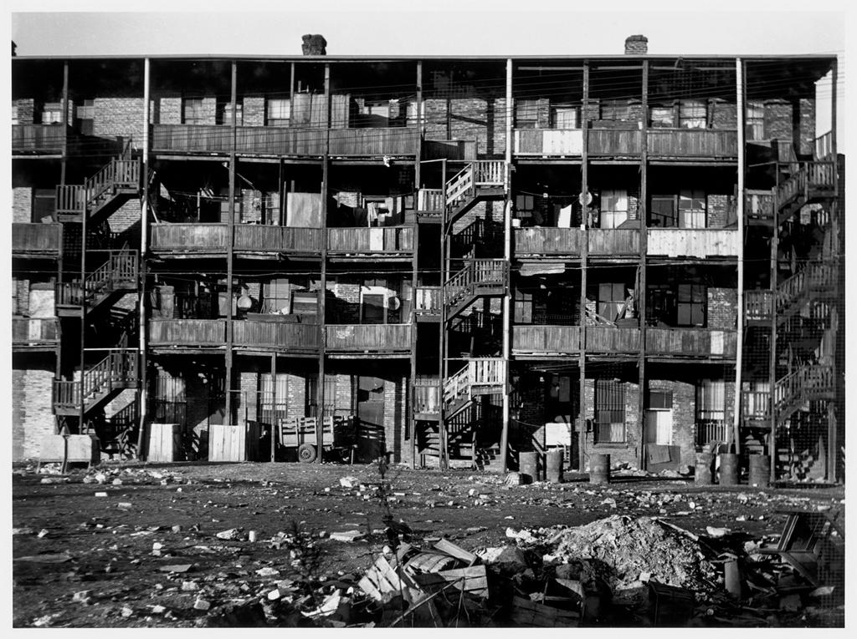
Tenement Housing

Slide 18
Round 6:
It is now 1781. More workers need to live, eat, shop, drink, worship. We need the social support services to go along with the demand.
Add 1 store, 1 pub, 1 church, & 1 school for those families wealthy enough to send their children (boys) to school.
Since workers in the factories work 6 days a week, the only day of rest is Sunday. People flock to your churches so make them convenient for their tired feet.

Slide 19
Round 7:
It is now 1782. Workers work long, hard hours in the factories. The average work day begins at 6:00 a.m. and ends at 9:00 p.m. There is only a 30 minute break for lunch. After work, exhausted, “stressed out” workers stop at their local pub for some relaxation. Alcohol begins to be consumed throughout England in record amounts.
Add 3 more pubs. Add 4 tenements

Slide 20
Round 8:
It is now 1783. Workers never have enough money to save and some workers go into debt. Few, if any, could afford to send their children to school. Still, there are a few families whose lifestyle is quite comfortable, even luxurious. Who are they? They are the large landowning farmers and factory owners. Add 2 special homes. Handsome manor houses are built and some are lavishly furnished with art. These new rich (nouveau riche) are not part of the aristocratic class of England but they now can enjoy some of the refinements of the aristocratic rich such as food, servants, furniture, education, fine clothing, carriages, etc….Add 1 factory, add 15 houses for management personages (total 40) (Note: from this point on trees may be removed if you need space).

Slide 21
Round 9:
The year is 1785. A man named James Watt invents a new machine called the steam engine. The steam engine replaces the water frame. First, it is far more efficient. Second, it allows factories to be built away from the river. This source of power is more mobile. Capitalists quickly replace their water frames with steam powered weaving and spinning machines. The main business in England is still textile manufacturing.
Add 10 factories with smoke. Add smoke to all other pre-existing factories. Also, add 1 nicer house since people continue to get rich. Add 5 houses (total 45) and 1 tenement.

Slide 22
Question 5
5. How does the steam engine affect the village in both positive and negative ways?

Slide 23
Round 10:
The year is 1815. Coal miners are busy mining coal. There is a great demand for coal right now: home-heating, fuel for the steam engines, for the production of iron.
Add another coal mine.
Although in the 1700’s coal miners were adults who worked in the winter to supplement their wages, in the 1800’s they are typically children between the ages of 8 and 14. The work is dangerous and unhealthy. Children become victims of black lung, explosions, & accidents. Their growth is stunted as they spend their 14 hour day stooped over. They are malnourished and unable to exercise or eat properly. Casualty rates go up.
Draw 1 cemetery.

Slide 24
Round 11:
It is 1820. The existing canals and dirt roads cannot accommodate the heavy industrial traffic. New experiments with transportation using the power of a steam engine are tried. The most successful appears to be a steam engine that pulls a series of wagons or cars on an iron track. The first railroad is tested and proves to be quite effective.
Add 1 major railroad line connecting all your factories to your coal mines. This is one continuous track which must connect all factories and mines (you may build additional railroad bridges only as needed).
Add 5 houses (total 50) for railroad builders.

Slide 25
Round 12:
It is 1827. This new “revolution” in transportation draws thousands of people to your community. Soon there becomes a surplus of workers (more workers than necessary). Capitalists who wish to ensure their profits decide to hire women and children over men because can perform the same factory labor at one-half to one-quarter the price. More and more children leave their homes to work.
Depressed, ashamed, and angry about their wives, and children toiling in factories, many men turn to crime, and the social life of the pub. For the first time in England’s history, alcoholism appears in epidemic proportions. Family life that existed for hundreds of years in England is disrupted. Family members seldom eat together or see each other.
Add 1 jail & 2 pubs and 2 tenements.

Slide 26
Round 13:
It is 1840. There is a need for quicker transportation.
Coal, iron, finished products, & raw materials must all be transported from one area of England to another. In Ireland in the late 1830’s a devastating potato famine drove hundreds of thousands of Irish to England. Here was the cheapest of labor possible to build more railroads.
Add 1 more railroad line passing east to west through your town. Add 5 houses (total 55) and 1 tenement for the new railroad workers.

Slide 27
Round 14:
It is 1842. There are some advantages to urban dwellers. City life is very different from the country life. For the small but growing middle classes, a whole new cultural life is available. Museums, theater, opera, restaurants, plays, & concerts are made available. Whereas before only the aristocrats could afford the arts, but now the middle class enjoys the fine life of culture and good living.
Add 1 theater and 1 museum.
Add 2 private schools for upper class students (mark these schools with the letter “P”. Add 1 nice house.

Slide 28
Round 15:
It is 1845. There are no pollution controls so the air in your community looks dark. Windows, walls even trees are covered with layers of soot and coke. The river that once flowed through your quiet village for hundreds of years is now unfit for drinking, bathing, or laundry. A new disease begins to take the lives of people. Malignant tumors grow in peoples’ bodies and the term cancer is first used in the medical profession. The average life expectancy for the poor classes is now 30 years of age. Your city is overcrowded and shrouded in factory smoke. The noises, the loss of privacy, & the loss of the family unit shatters the peace of the old ways.
Add 1 cemetery, 1 jail, 1 hospital to accommodate the victims of urban life.

Slide 29
Round 16:
It is 1850. By this year several million acres of good English land has been enclosed and sold to private parties who own large estates. Despite the misery this creates for England’s landless poor, the economy benefits for the rich are obvious. These farmers purchase the newest power-driven machinery and can easily feed the working class of England (including the Irish). The small landowning farmer is crushed by the enclosed commons. They cannot afford the machinery and therefore cannot compete and grow food profitably.
Thousands of these folk leave their villages (where their ancestors had lived for hundreds of years) and move to towns and cities looking for work to feed their families. Some refused to leave but took jobs working for the large landowning farmers. By the thousands, they moved to the bleak, uninviting towns of the north and the new cotton mills.
Add 20 houses (total 70), 5 tenements, 2 stores, 1 church, 5 factories, and 1 pub, and 2 more nice houses and one special house.

Slide 30
Question 6
Do you think this scenario about how cities grew during the Industrial Revolution was accurate? Why or Why not?

Slide 31
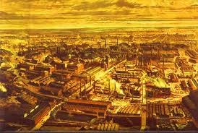
Manchester, England
1750
1850
7. How does the Industrial Revolution change the city?

