Slide 1
The Boom Period of the 1920’s

Slide 2
Rules to the Game
Your objective, is to use the stock market (purchase/sell stocks) to become the richest group during the 1920’s.
Each group will have jobs that correspond to the amount of income that they have initially.
You may then spend money on stocks.
Stocks: Makes you a part owner of that company.
Feel free to trade (buy and sell)

Slide 3
Jobs
Card Drawn | Occupation | Salary
2 | Actor | $500.00
3 | Mechanic | $300.00
4 | Magazine Publisher | $600.00
5 | Automobile Dealer | $400.00
6 | Teacher | $200.00
7 | Congressman | $500.00
8 | Waiter/Waitress | $150.00
9 | Doctor | $600.00
10 | Police Officer | $250.00
Jack | Accountant | $450.00
Queen | Administrative Assistant | $250.00
King | High School Dropout | $100.00
Ace | Motion Picture Producer | $1,000.00

Slide 4
Opening Round
The opening price is $10 per share
Each stock certificate represents 10 shares of stock (so students must purchase in blocks of 10)
Therefore, in the opening round, each certificate costs $100 ($10 X 10 shares of stock).

Slide 5
Research
Please read the prospectus of the stocks available to you during the 1920s.
Based on your knowledge of what industries did well and what didn’t, you may purchase your initial stocks.

Slide 6
Opening Round
Name of Stock | State of the Company | New Stock Price (per share)
Kroger Foods | Purchases a West Coast Food Chain | $10
Radio Corporation | New model released with built-in antenna | $10
Mammoth Oil | 9 New wells begin producing in Wyoming | $10
Gotham Bank | Bank declares a 6% dividend | $10
Durant Motors | Fails to make payments on notes to Gotham Bank | $10
Midland Utilities | Extends services into Michigan and Wisconsin | $10
Kansas-Pacific Railroad | K & P will pay no dividends this year because of expansion into the Southwest | $10
Tel-Tone Communications | Dial telephones will be installed in parts of New York City | $10

Slide 7
Round 2--1920
Name of Stock | State of the Company | New Stock Price (per share)
Kroger Foods | Purchases a West Coast Food Chain | $12
Radio Corporation | New model released with built-in antenna | $13
Mammoth Oil | 9 New wells begin producing in Wyoming | $18
Gotham Bank | Bank declares a 6% dividend | $11
Durant Motors | Fails to make payments on notes to Gotham Bank | $7
Midland Utilities | Extends services into Michigan and Wisconsin | $17
Kansas-Pacific Railroad | K & P will pay no dividends this year because of expansion into the Southwest | $9
Tel-Tone Communications | Dial telephones will be installed in parts of New York City | $20

Slide 8
Round 3: 1922
Name of Stock | State of the Company | New Stock Price (per share)
Kroger Foods | Merger with large eastern chain of stores | $15
Radio Corporation | 15 patents are purchased from the Edison Company | $14
Mammoth Oil | Largest oil field in the United States may be located under Mammoth Oil land in Tea Pot Dome, Wyoming | $22
Gotham Bank | Bank pays a 6% dividend | $12
Durant Motors | Locomobile sales are depressed because of competition from the Ford Motor Company | $5
Midland Utilities | Insull’s manipulation allows Midland to take control of Commonwealth Edison | $21
Kansas-Pacific Railroad | Profits begin to rise as agricultural shipments from the Southwest begin | $12
Tel-Tone Communications | The New York Stock Exchange announces that Tel-Tone has shown the greatest increase of any stock listed on the exchange. | $25

Slide 9
Special News Bulletin
As reported by the radio (an invention that became prominent during the 1920’s)
President Warren Harding today, August 2nd 1923 died while touring San Francisco. The doctors that treated Harding believe he died of a stroke, though there is some skepticism.
The stock market will close in approximately 3 minutes for new postings…

Slide 10
Round 4: 1923
Stage 3—1923
Name of Stock | State of the Company | New Stock Price (per share)
Kroger Foods | The death of a President will generally have a negative effect on market prices | $14
Radio Corporation |  | $15
Mammoth Oil |  | $20
Gotham Bank |  | $12
Durant Motors |  | $4
Midland Utilities |  | $19
Kansas-Pacific Railroad |  | $10
Tel-Tone Communications |  | $22

Slide 11
Round 5: 1925
Stage 5—1925
Name of Stock | State of the Company | New Stock Price (per share)
Kroger Foods | Drought on Kroger Farms causes huge losses of crops | $14
Radio Corporation | Speculation on new patents cause rise in stock price | $22
Mammoth Oil | Japanese offer to buy the total production of Elk Hills | $34
Gotham Bank | The French Government announces they will begin to pay their WWI debts to American banks | $20
Durant Motors | The DuPont family begins to buy large blocks of Durant Motors stocks | $22
Midland Utilities | Insull fears that Cyrus Eaton of Cleveland may be trying to take over Midland by purchasing large quantities of stock, so he decides to flex his muscles | $48
Kansas-Pacific Railroad | Speculation on increased profits from holdings in Mexico cause stock prices to rise | $18
Tel-Tone Communications | Announces completion of a successful merger, market speculation continues | $40

Slide 12
Buying on Credit
Remember, you may always buy on credit:
Credit: Borrowing money with the intention of repaying it.
You may repay the money at any time throughout the game, though after the 10th round you will be required to pay it back.

Slide 13
Round 6: 1926
Name of Stock | State of the Company | New Stock Price (per share)
Kroger Foods | Speculation that Purity Markets are buying Kroger Stock for an attempted takeover | $19
Radio Corporation | Rumored to be considering a merger with Edison Company | $30
Mammoth Oil | Congressional committee begins an investigation into possible fraud in the management of Mammoth, but stocks hold | $50
Gotham Bank | Banks pays a 6% dividend | $25
Durant Motors | Louis Chevrolet is hired to design a luxury automobile | $25
Midland Utilities | Cyrus Eaton begins dumping large blocks of Midland Stock into a depressed market | $60
Kansas-Pacific Railroad | Drought in the Southwest and depressed farm prices cause profits to fall | $20
Tel-Tone Communications | Banker JP Morgan sells off 200,000 shares of stock, temporarily resulting in a drop. Market analysts predict only a temporary setback. | $35

Slide 14
Round 7:
Name of Stock | State of the Company | New Stock Price (per share)
Kroger Foods | Food prices continue to suffer because of agricultural surpluses | $14
Radio Corporation | Merger with the Edison Company falls through when Radio Corporation pays no dividends | $17
Mammoth Oil | Harry Sinclair is called before the Congressional Committee and many corporate officers at Mammoth are indicted on charges of fraud | $7
Gotham Bank | Announces that profits have increased by 5% over the last quarter | $15
Durant Motors | Announced a merger with Fisher Auto Body. The new company will be called General Motors. | $18
Midland Utilities | Reports in the Chicago Tribune claim that Insull’s “House of Cards” is about ready to crumble | $15
Kansas-Pacific Railroad | New Oil Fields in Oklahoma cause a mini-boom along the K & P track | $13
Tel-Tone Communications | Fails to rise as predicted. Brokers are unable to explain the downward trend | $24

Slide 15
Special News Bulletin
Monday, October 28, 1929
The market slipped today as the government announced that home construction (typically an indicator of prosperity) was at an all-time low. The Federal Reserve Board also announced that a change in the prime-interest rate would take place in the near future—speculation of the stock market is getting out of hand. It is rumored that the house of Morgan intends to sell 12 million shares of common stock at a loss before interest rates change. The Gotham Bank announced that margin buyers of stock are being notified that they must put up more money to cover today’s losses.
You have 2 minutes to continue trading

Slide 16
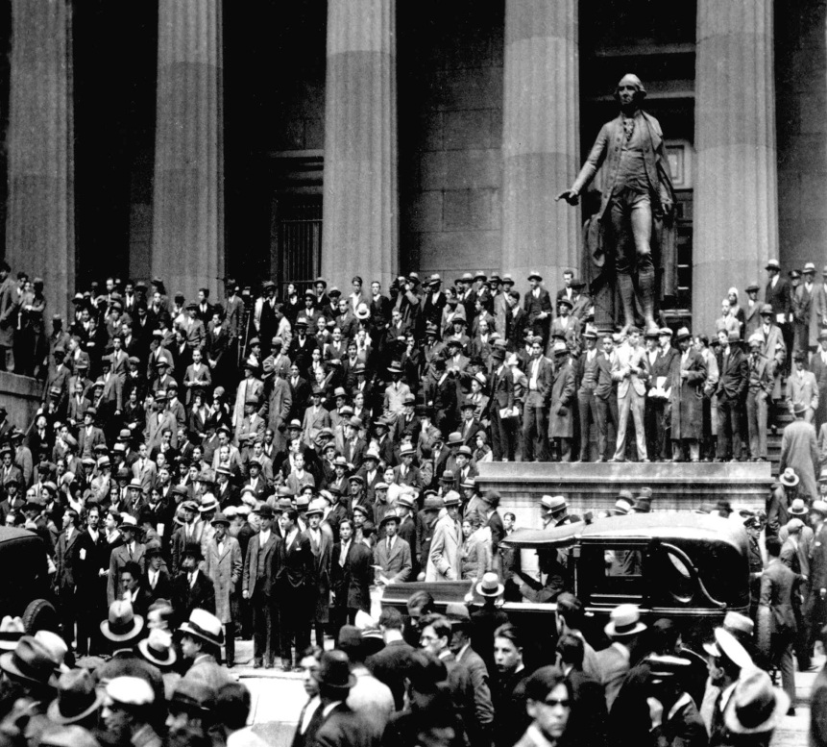
Black Tuesday
Tuesday, October 29th, 1929
Panic hits Wall Street. 12 million shares are traded in one day on the New York Exchange. $700 million is lost by stock holders in one day as the market takes the greatest dive in history…

Slide 17
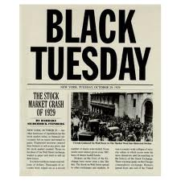
Black Tuesday: October 29, 1929
Stage 7—1929
Name of Stock | State of the Company | New Stock Price (per share)
Kroger Foods | The Stock Market Crashes as part of Black Tuesday | $8
Radio Corporation |  | $3
Mammoth Oil |  | $2
Gotham Bank |  | $8
Durant Motors |  | $8
Midland Utilities |  | $3
Kansas-Pacific Railroad |  | $7
Tel-Tone Communications |  | $5

Slide 18
How much do You Have?
count up your total cash and the value of their stocks.
Be sure to include the money that you might owe for taking out credit.

Slide 19
Great Depression #1 : Debrief
1.) How much money did you win/lose?
2.) What is the Stock Market?
3.) What is buying on credit or on margin?
Why might some people in the 1920’s wanted to do this?
4.) Why do you think the 1920’s is referred to as a boom period?
5.) What do you think caused this prosperity?
6.) What was your feeling during the middle rounds?
Why?
7.) What happened in rounds 6 & 7?
8.) What were your feelings then?
9.) What do you think caused the Stock Market to Crash?
10.) What effects do you think the Stock Market crashing had on the citizens of the United States?

