Slide 1
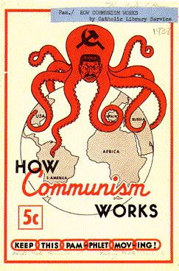
1950s #5 Spies Amongst Us!
Who does the octopus represent?
Why did the artist choose an octopus?
What is the message?
Why is communism scary?

Slide 2
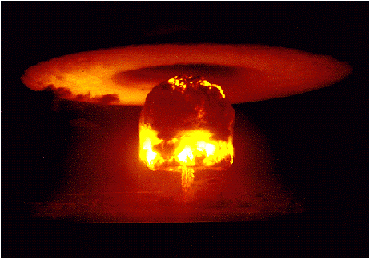
Arms (weapons) Race
1949: USSR had an A-bomb!
How did they get it SO fast?
US needs a bigger bomb!
1952: US detonates (sets off) a Hydrogen Bomb (H-bomb) thousands of times stronger than an A-bomb
Destroys everything w/in 5 miles! Severe destruction within 10 miles
USSR gets one too!
What could it lead to?

Slide 3
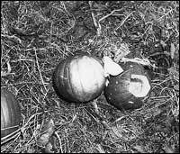
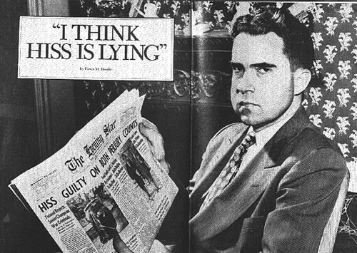
Red Scare: Fear of Communism
Spies? Espionage
YES!
Alger Hiss:
Rosenbergs
HUAC – House Un-American Activities Committee
Congress began looking for communists
Richard Nixon:

Slide 4
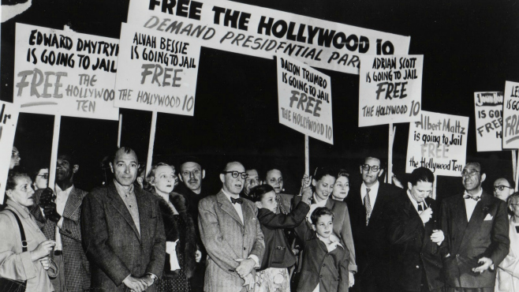
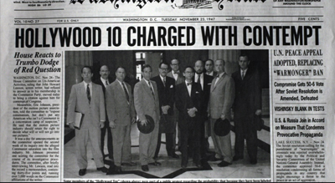
“Hollywood 10” refuse to answer questions about being a communist --- go to jail
Hollywood will blacklist (refuse to hire) 500 “suspected communists”
Fear
Loyalty tests

Slide 5
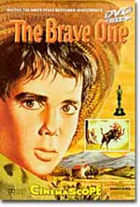
"Are you now, or have you ever been, a member of the Communist party?”
“After being blacklisted, Dalton Trumbo, screenwriter and member of the Hollywood Ten, was forced to use false names to continue writing. In 1956, he won an Oscar for The Brave One under the name Robert Rich. It wasn't until 1960 that he could use his real name in Hollywood again.”

Slide 6
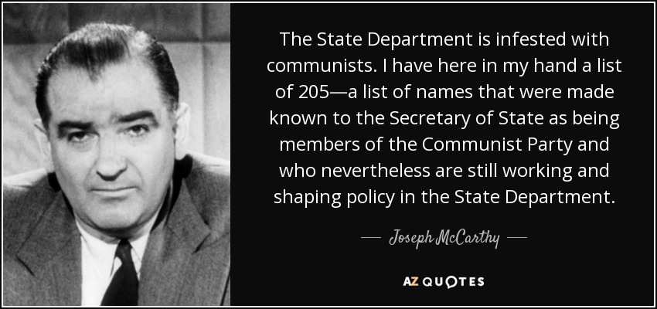
Senator Joseph McCarthy
Announces that he knows there are communists in the gov! (1950-53)
Brings many into Congress to testify
McCarthyISM: unfair attacks on people / witch hunt
clip

Slide 7
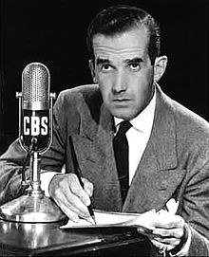
Edward R. Murrow TV news reporter
“Dissent is not disloyalty”
What does this mean?
Is he right?

Slide 8
Red Scare, 50s style Answer these 3 questions @ end
From looking at all these sources, what is America’s view on communism in the late 1940s – 1950s? Include 3 specific pieces of evidence from the reading.
How did this viewpoint affect average Americans? Explain.
How did this viewpoint affect foreign policy and America’s role in the world? Explain

Slide 9
1950s #5: Rosenberg Trial
Questions
Notes
5 L 1 Qs
2 L 2/3 Qs
Include 1 - 2 pieces of info per paragraph
Summarize the Rosenberg Trial

Slide 10
50s #6: Magazines
What are the articles about? What are the story ideas?
Name a couple of good, catchy headlines.
What is advertised? How is advertised?
Compare and contrast to what you might see in a magazine today.

Slide 11
Cold War Review
Which 2 countries were “fighting” in the Cold War?
What happened to all of Eastern Europe?
How did the Truman Doctrine stop communism?
What is containment?
What did the Marshall Plan do?
Who did NOT participate in the Marshall Plan?
What happens to China in the late 1940s?
Where is Korea divided? Which part is communist and which is free?
What is the name of the congressional committee searching for communists – even in Hollywood?
What Senator led the fight against communists?

Slide 12
War on Terror vs. Cold War
War on Terror
5-7 things that make the War on Terror DIFFERENT from Cold War
Similarities
5-7 similarities between War on Terror and Cold War
Cold War
5-7 things that made the Cold War DIFFERENT from War on Terror

