Slide 1
What’s the difference? Yesterday’s headlines according to 2 different news agencies.
Top Stories from NBC News and MSNBC
1. Latest battleground polls show tightening raceWatch
2. Conway: ‘We’re going to win the election’Watch
3. Analysis: The vengeful world of Donald Trump
4. Could Clinton be charged over newly discovered emails?
Fox News:
DEMS TURN ON COMEY: Same pols who praised FBI boss July doing 180 over renewal of Clinton probe
Schoen: I'm a Democrat, and I worked for Bill Clinton, but I can't vote for Hillary
Controversial Dem operative 'close' to Clinton campaign boss, email claims

Slide 2
Imperialism #2: Spanish American War
(Which doesn’t take place in Spain or USA……)
What does imperialism mean?

Slide 3
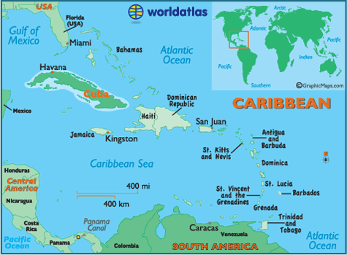
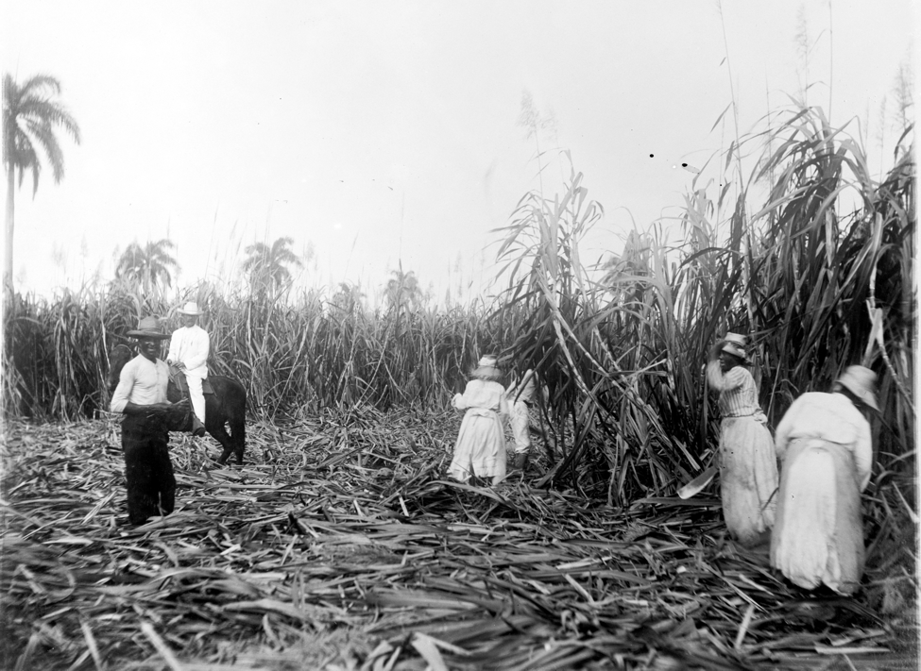
Cuba
Colonized by Spain
Many US businesses
US asked to buy Spain
Spain said – we’d rather see Cuba sunk in the sea!

Slide 4
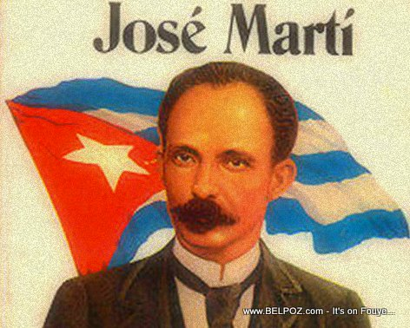
Cuba Libre
1895 – Jose Marti cries:
Cuba Libre! Free Cuba!
He led revolution against Spain
Spain arrests opposition– 300,000 Cubans
US began to support idea of a free Cuba

Slide 5
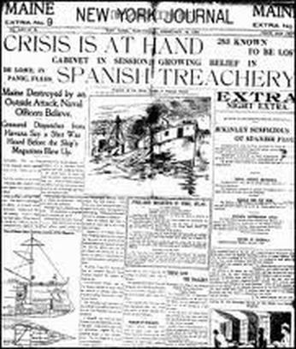
Causes of War:
De Lome Letter: Spanish official insulted US President …..called him “weak”!
Is this enough to go to war?
Btw, Spain apologizes

Slide 6
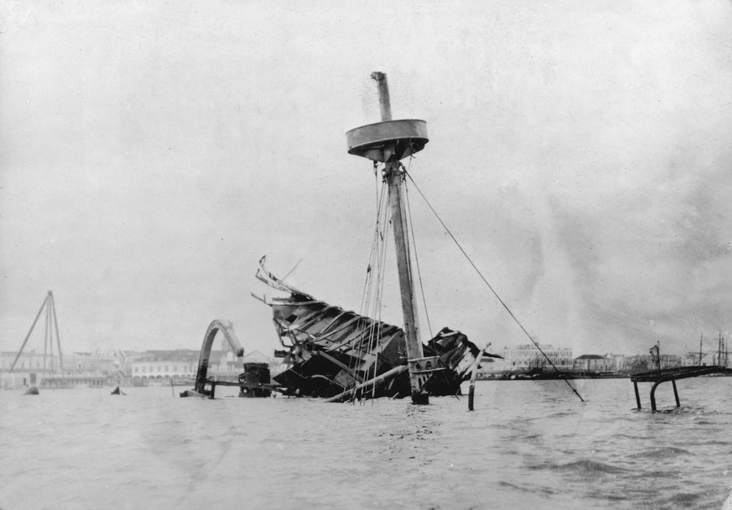
2. U.S.S. Maine (US Ship)
Yellow Journalism: exaggerate the news, make it interesting!
William Randolph Hearst owns a paper & says:
“You furnish the pictures, I’ll furnish the war.”
Maine explodes near Cuba (1898)
No one knows why
Hearst’s paper blames
Spanish

Slide 7
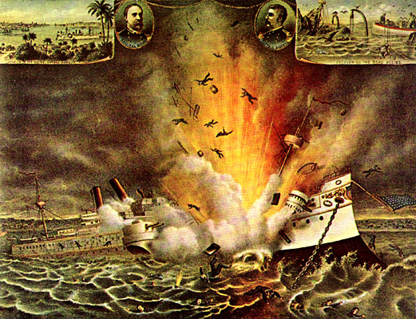
Explosion of the USS Maine Havana Harbor, 1898

Slide 8
“Awake United States!”
This song was rushed into print between the sinking of the Maine on February 15, 1898, and the declaration of war on April 25, 1898.
Eagle soar on high, and sound the battle cry!
And how proudly sailed the warship Maine,
a Nation’s pride, without a stain!
A wreck she lies, her sailors slain.
By two-faced butchers, paid by Spain!
Eagle soar on high,
And sound the battle cry
Wave the starry flag!
In mud it shall not drag!

Slide 9
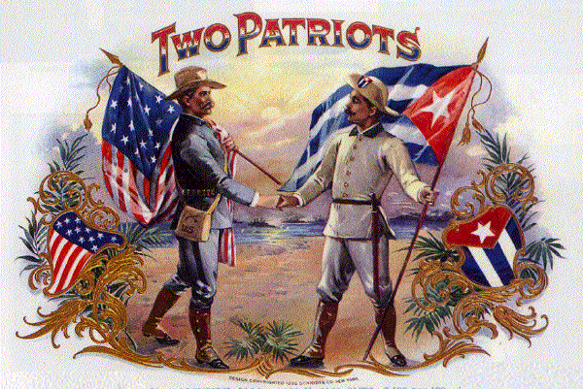
Spain will agree to nearly all the US demands BUT US declares war on Spain anyway

Slide 10
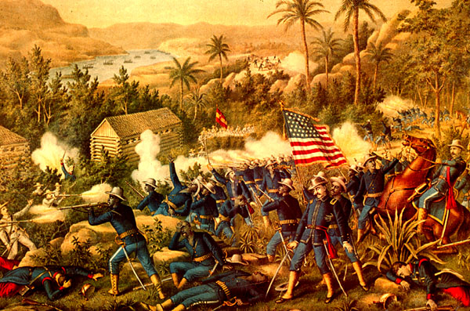
Spanish – American War (1898)
1st battle – in Philippines - which Spain also controlled & wanted independence
US destroys all Spanish ships

Slide 11
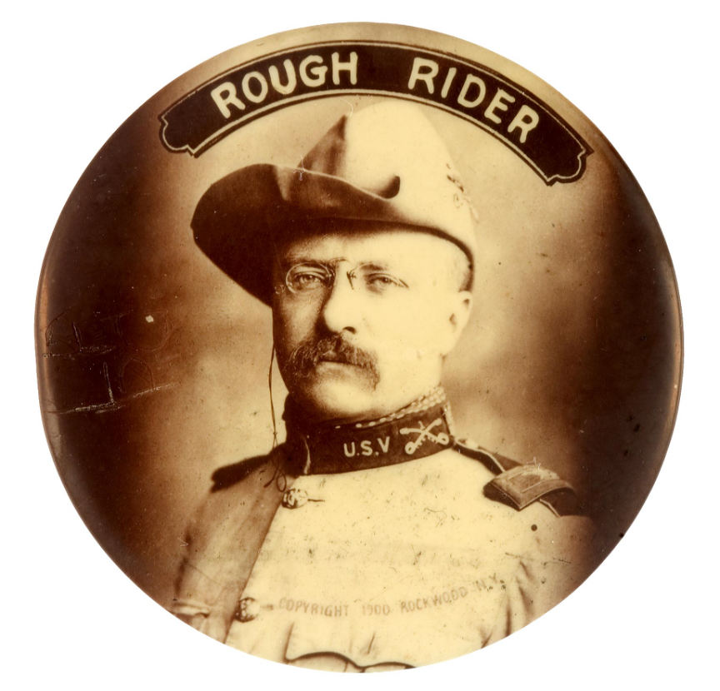
In Cuba
Rough Riders : voluntary group of fighters
Led by – Theodore Roosevelt
San Juan Hill: US victory, makes TR famous

Slide 12
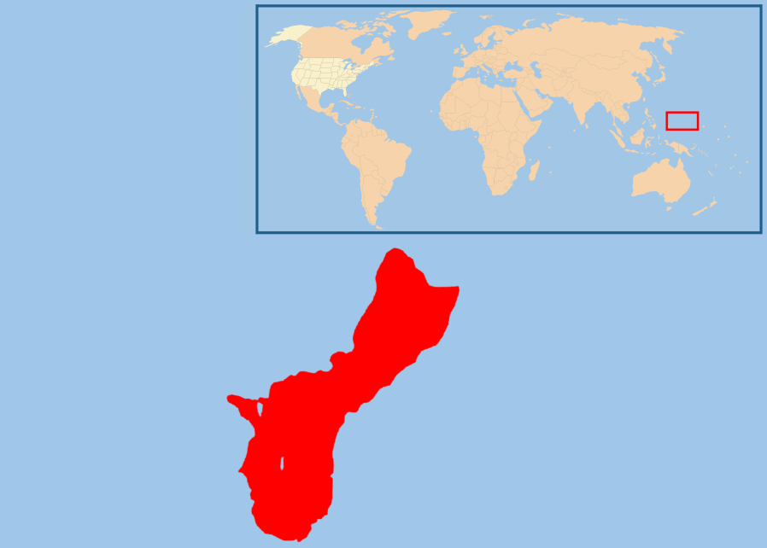
Treaty of Paris
Cuba = independent
Puerto Rico & Guam given to US
US pays $20 million for Philippines
*US has an empire*
Is it ever ok for one nation to take over another?

Slide 13
Answer:
Should the Spanish American War have even started? Explain your answer w/2 reasons.
Was it a fair treaty? Explain your answer with 2 reasons.

Slide 14
Add to questions….
For question #3 for both articles, be sure to include specific references to the text.
Answer on the back:
Compare and contrast the two sources
Have 3 similarities and 3 differences
How can one tell which source is more reliable? Give specific evidence that shows it’s a trustworthy source or an untrustworthy source.

