Slide 1
B/W Wars #7: Soviet Life
Stalin begins to develop an entirely new form of government, one that controls everything you do! This is called….
20 million or more will die under Stalin’s totalitarian regime!

Slide 2

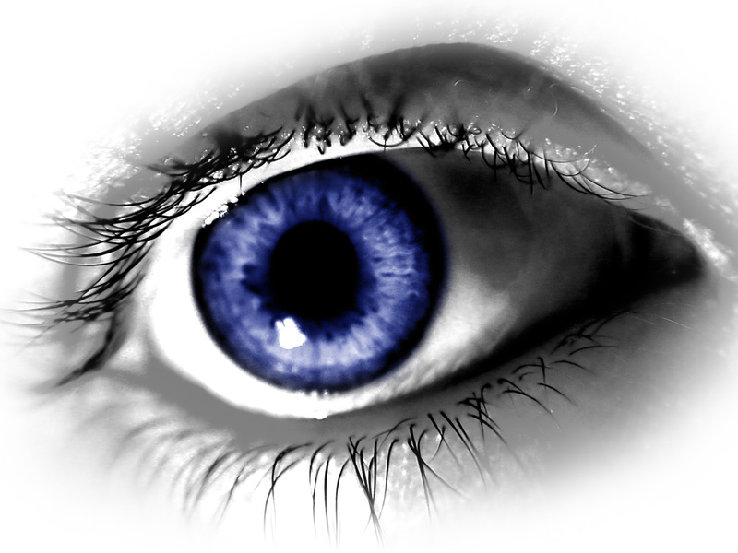
Totalitarian Control:
Police Terror: you were watched!
  A. Cheka – secret police
  listen to phone calls, read mail, kids tell on parents

Slide 3
B. Great Purge (purge – get rid of)
1934, Stalin put Bolshevik leaders on trial for “crimes against the state”
  show trials – fake
  Tried ppl who Stalin feared might overtake him
  “guilty” = gulag or executed

Slide 4
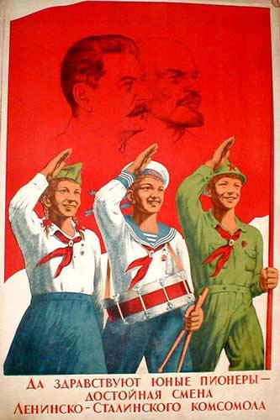
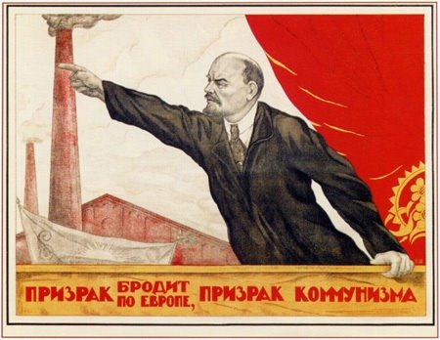
2. Propaganda: shows only 1 side of story
  Indoctrination: taught only 1 side
  Children were indoctrinated with the propaganda given to them at school.
  Young Pioneers – Communist youth groups
  Stalin is called Uncle Joe

Slide 5
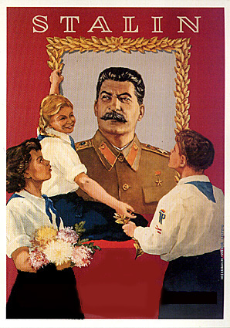
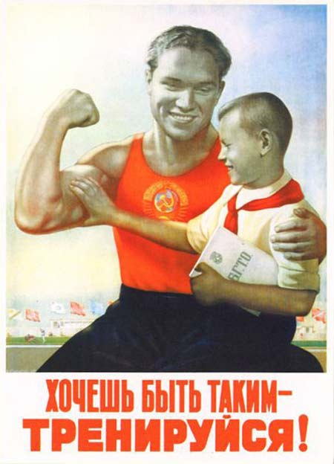
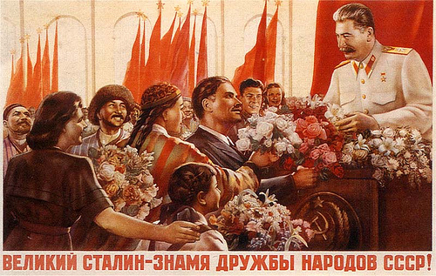
Propaganda Posters:
Socialist Realism: promoted strength & glory of communism

Slide 6
3. Censorship: gov deletes info – only shows news the gov approves of
  Pravda (The Truth) – official newspaper told the news according to The Party (communist leadership)
  Some people really believed the propaganda
China censors certain websites even today!

Slide 7
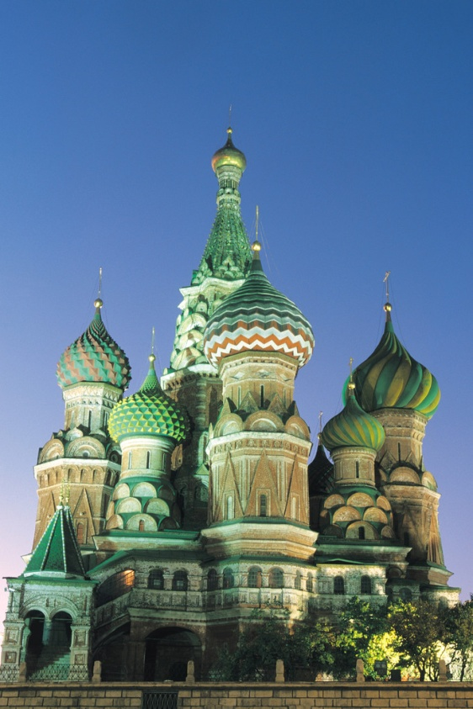
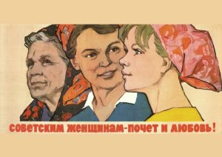
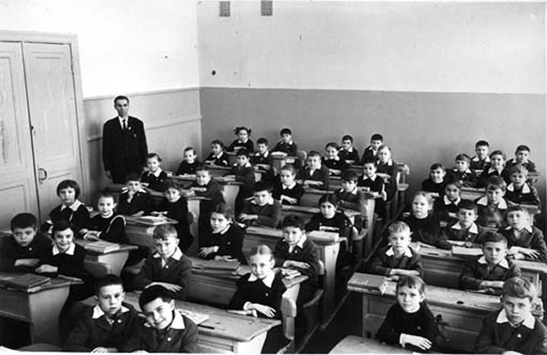
Daily Life
Religion replaced w/communism
  Atheism
Education encouraged
Gender equality

Slide 8
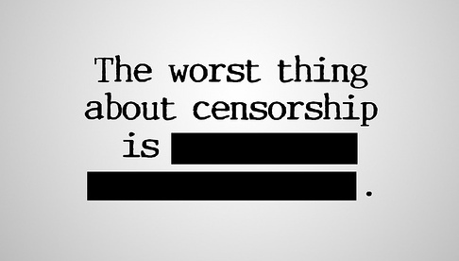
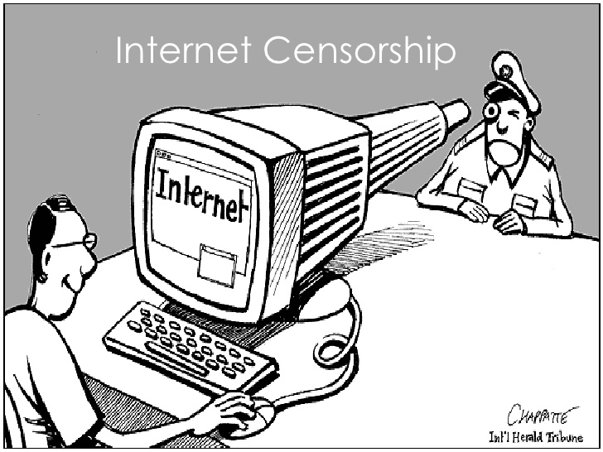
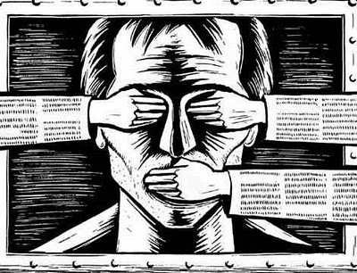
Censorship
Which picture best describes it? Why?
A
B
C

Slide 9
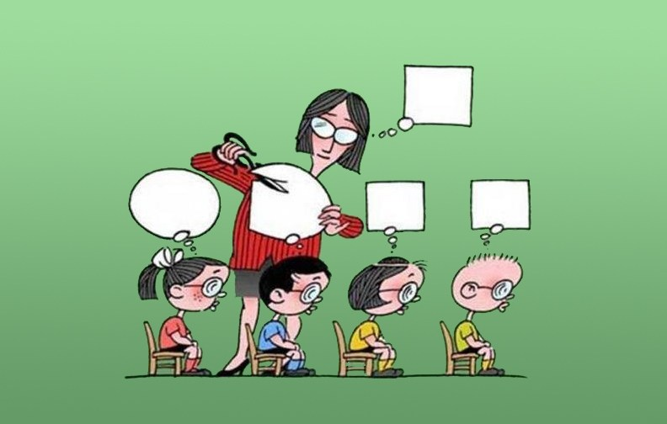
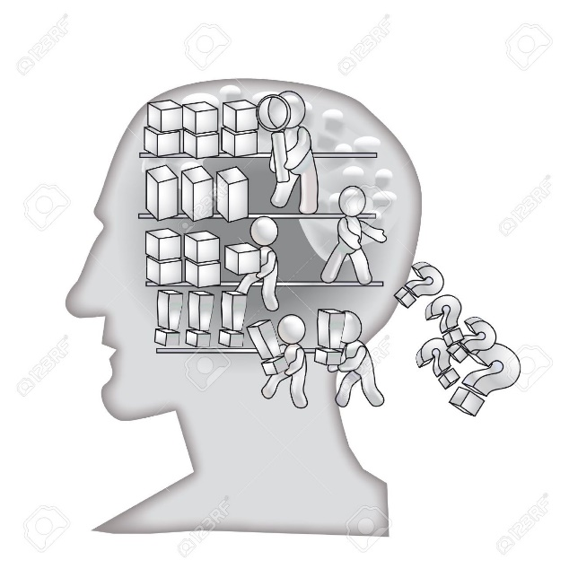
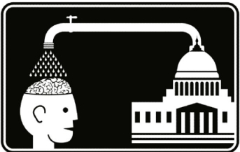
Indoctrination
Which picture best describes it? Why?
A
B
C

Slide 10
Did Stalin’s policies improve life for the people of Russia?
Thesis:
  Answer question with 3 reasons for your answer (use information from chart).
    Stalin’s policies improved / hurt the people of Russia because….(reason 1), (reason 2), and (reason 3).

Slide 11
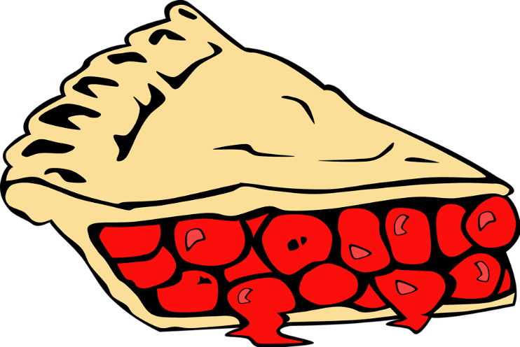
Pick 1 of the 3 reasons you put in your thesis and write a body paragraph
USE PIE
  Point (claim)
  Illustration (evidence / support)
  Explanation (why it matters/what it shows us)

