Slide 1
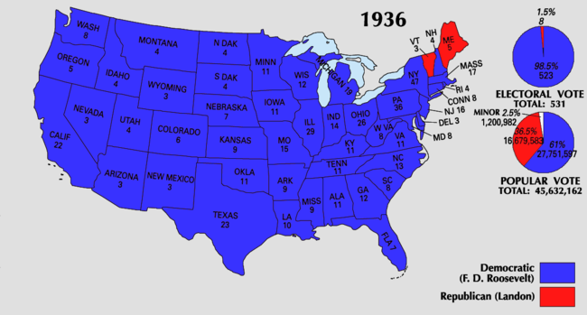

Slide 2
Volunteer?

Slide 3
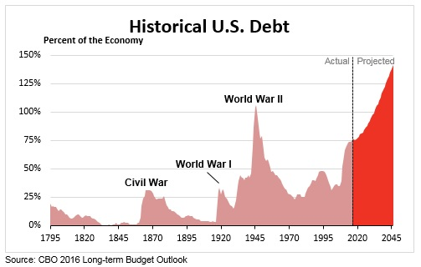
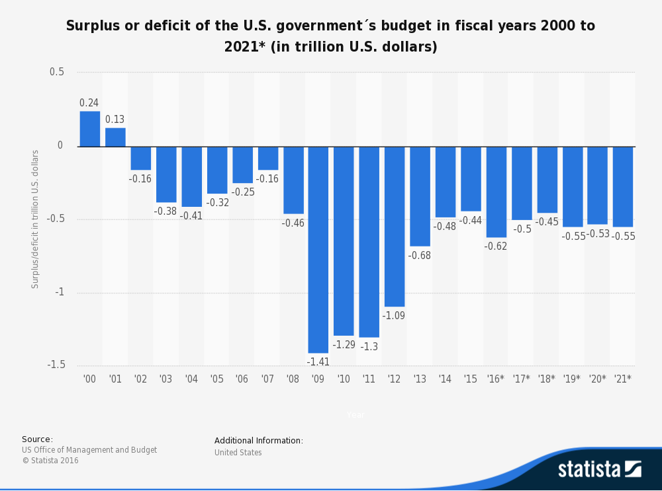

Slide 4
Great D #8: Second Term “Second 100 Days” – new programs in 1935-36
AAA
Replace it in 1938 w/ new AAA – meets Const.
NYA: Nat’l Youth Administration – helped students w/part time jobs , job training

Slide 5
Workers’ Rights
Sup Ct overturns NIRA b/c it took power from states & gave it to feds
Replaced it w/ Wagner Act: allows for unions to organize & collective bargaining
Creates Nat’l Labor Relations Board – hears about unfair work practices (today)
Fair Labor Standards Act
Max working hours = 44, = 40 after 2 years
Min wage = 25 cents / hour
No hazardous work under 18, rules for work under 16

Slide 6
Social Security
Old Age Pension / retirement paid by workers & employers
Get money back at age 65
Unemployment
Aid for families & disabled

Slide 7
Was the New Deal a success or a failure?
Your team will be given your position that it was a success or a failure.
ADD to the “Organizing the Evidence” from Stanford Docs
ADD evidence from: WPA article, and notes. Fill out info for BOTH sides.
Create an opening statement that supports your position including at least 3 pieces of evidence.
Present your evidence like this: In Document A, it says, “alkdjfkldjf” …..
Find one visual (use Chromebook) to support your position
Present
Rebuttals

Slide 8
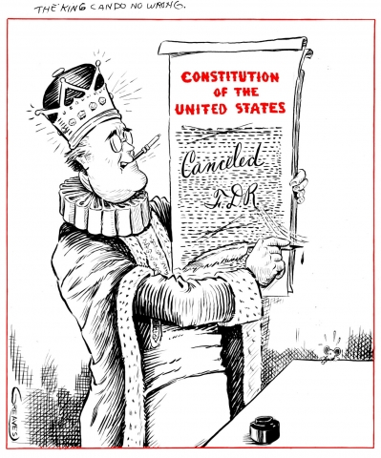
Supreme Court
Feb 1937: FDR decides to ADD 6 justices to Sup Ct – making a total of 15
Court packing scheme: critics argued unconstitutional
Congress can change size of court, not pres
Back away
Replaced 7 justices over the next few years anyway
“The King Can Do No Wrong”

Slide 9
Great D #9
What do you see? What symbols, exaggeration, caricature, irony, etc, are used?
What is the message? Is it a positive or negative view of FDR? Explain.

