Slide 1
B/W Wars #2: Causes of the Russ Rev
What is the name for the Russian monarch?
What is the new word for a dictatorship? (Starts w/an “a”)
List 2 reasons why Russians were unhappy with their government.
If absent for test – must make it up today or tomorrow ! Also, turn in your notebook.

Slide 2
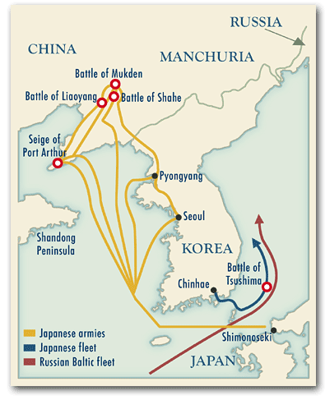
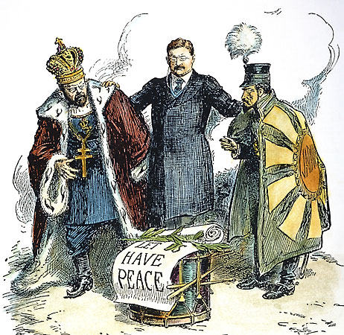
B/W Wars #2: Causes of the Rev. Immediate Causes
Russo-Japanese War: both wanted to control Manchuria (part of China) – Russia loses! PPL = MAD!

Slide 3
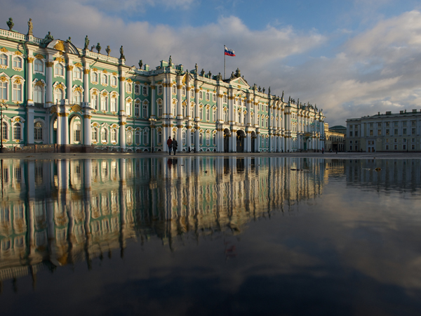
2. Bloody Sunday: 1/22/1905
200,000 workers protest at Winter Palace (Czar’s home) demanding better working conditions, more freedom & elected government
Led by Father George
Gapon – socialist
leaning priest

Slide 4
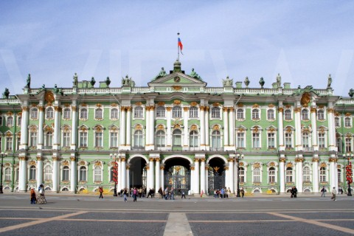
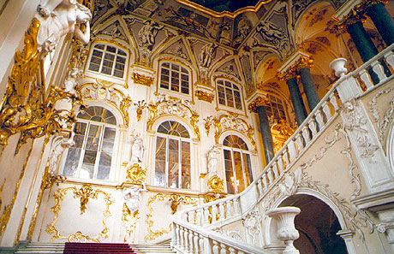
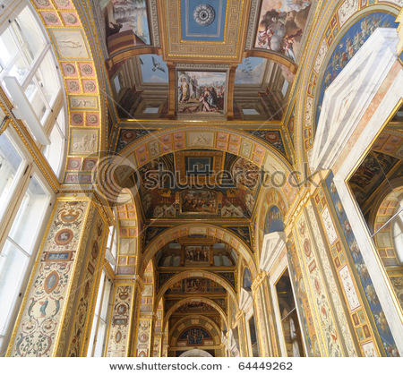
Winter Palace, St. Petersburg
Does this look familiar?

Slide 5
Gapon and his legion of demonstrators were not anti-tsar – indeed, dressed in their Sunday best, they bore banners and portraits of the tsar, carried icons, and sung hymns and songs proclaiming their support for him, whom they affectionately called their ‘little father’. They believed that essentially, Nicholas II was a good man who had their best interests at heart and that once he knew the extent of the workers’ discontent, he would put in place the means to address their grievances. The march was good-natured, with women and children leading the way.
Summarize the march in 10 words or less in your notes (right side).

Slide 6
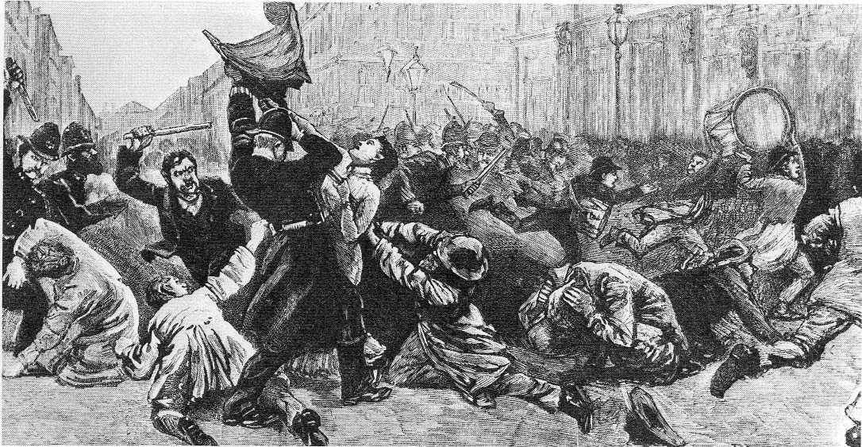
Bloody Sunday
Czar isn’t home, BUT his army is – they fire on the crowd killing approx 200 ppl
Who ordered the shot?

Slide 7
In his diary that night, Nicolas II wrote:
the ‘serious disorders in St Petersburg’ concluding with the words, ‘God, how painful and sad’.
What kind of a leader is he?

Slide 8
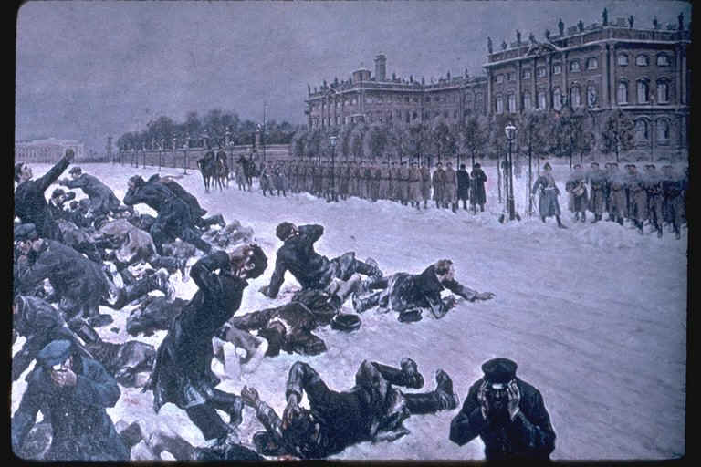
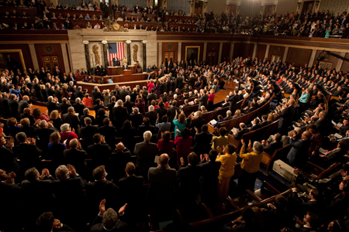
More strikes begin as act of protest
To calm the ppl, Czar calls for an elected legislature called the Duma
That should help, right?

Slide 9
Czar dissolved (ended) it w/in a few weeks
Why would this
upset the people?

Slide 10
Change at least 10 things in your essay: MLA, grammar, capitalization, thesis, etc.
Turn in final draft
On turnitin.com
By 11:59 on Tues 2/27

Slide 11
Communism Check – Up True/False: If false, change the underlined word to the correct one. EX: Czar Alexander III was the last czar of Russia. F, Nicholas II
Communism is when everyone shares everything equally.
Often, people who are rich like communism.
Adam Smith wrote the book on communism.
One advantage of communism is that no one is poor.
Bourgeoisie are the workers.
Proletariat are the workers.

Slide 12
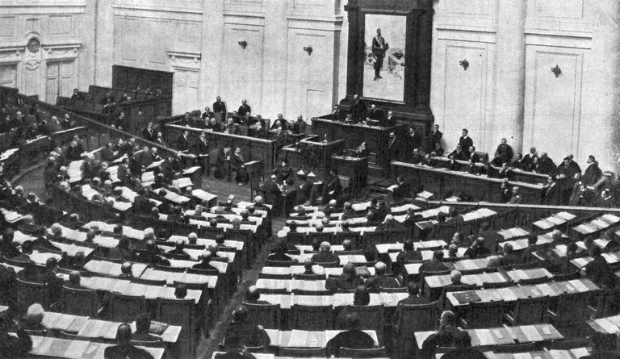
Duma
After several false starts, the Duma will eventually be allowed to exist but with pretty limited power

Slide 13
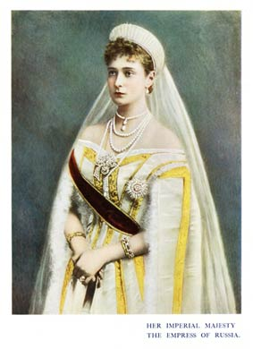
The country is moving along until…
3. World War One
Russia wasn’t ready – had no supplies, millions die
Nick goes to front for support
Czarina Alexandra is left behind

Slide 14
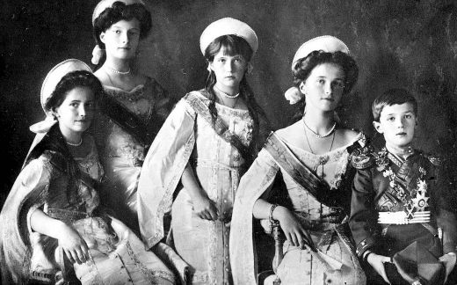
Czar had only one son – and he was very sick.

Slide 15
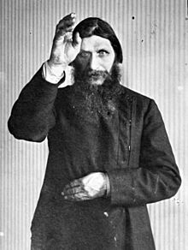
Czarina turns to Rasputin: magical healer, “Mad Monk”
Helped their sick son & so Czarina trusted him & let him advise her
He seemed to be running the country

Slide 16
Rasputin
Her other advisors assassinate him
Legend says:
Poison, shoot, & drown him
Rasputin said, “If I die or you desert me, in 6 months you will lose your son & your throne.”

Slide 17
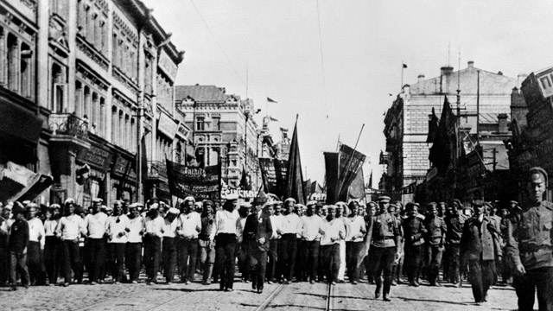
February Revolution (1917)
Women workers go on strike – want bread & fuel for heat
Grows!

Slide 18
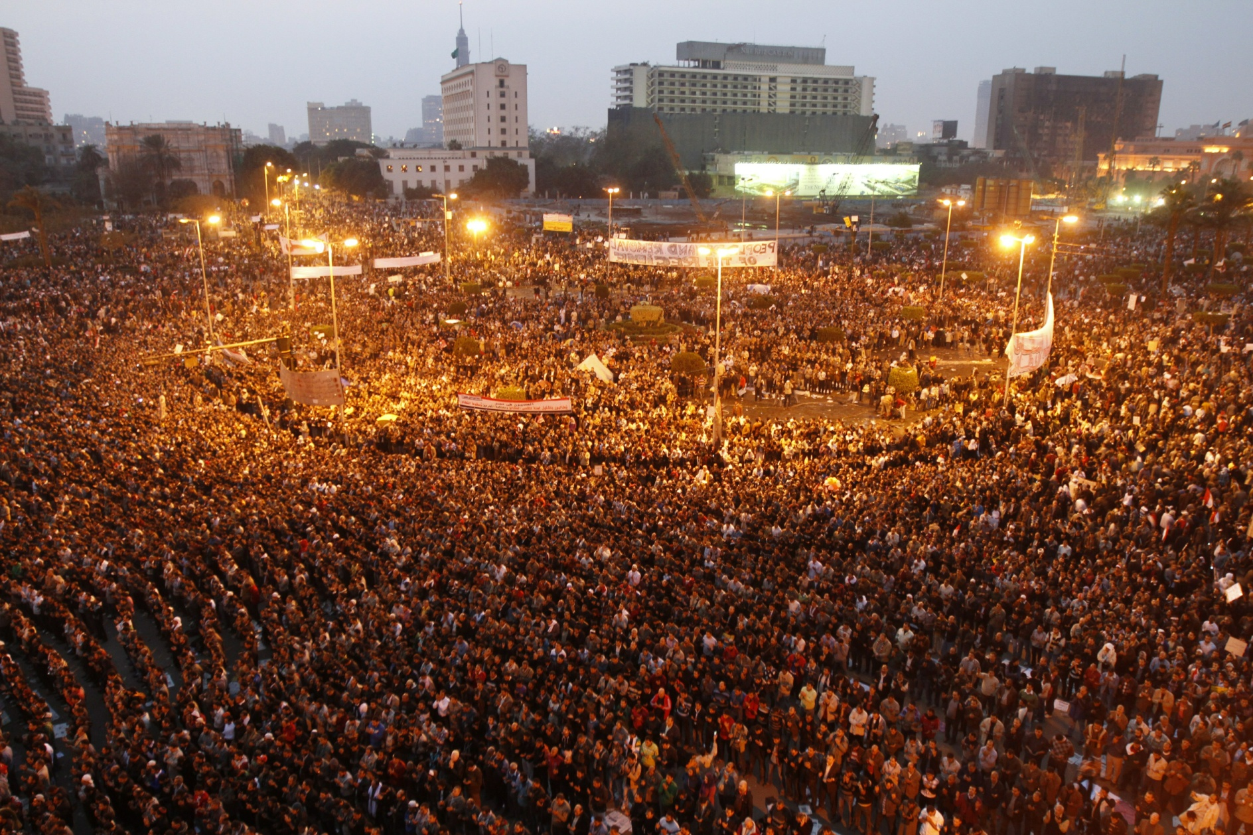
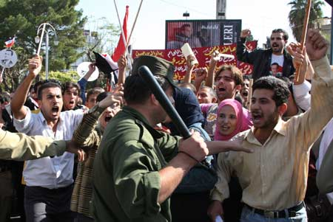
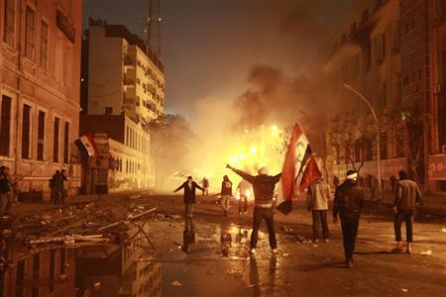
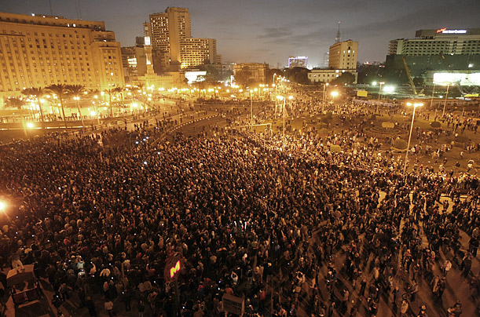
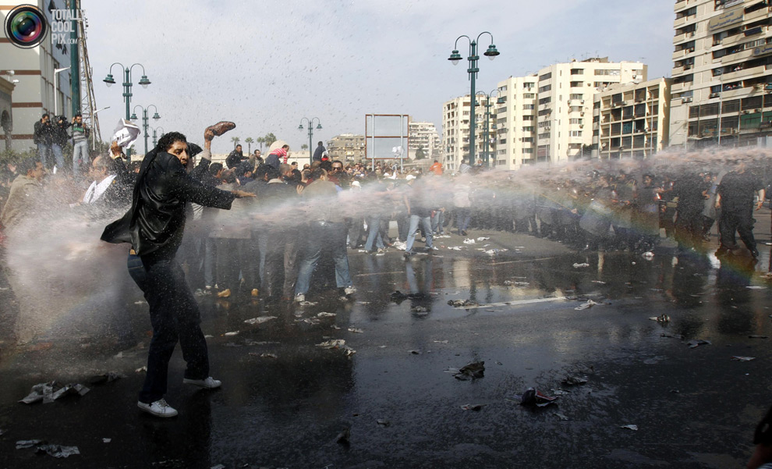
Egypt
Notes:
18

Slide 19
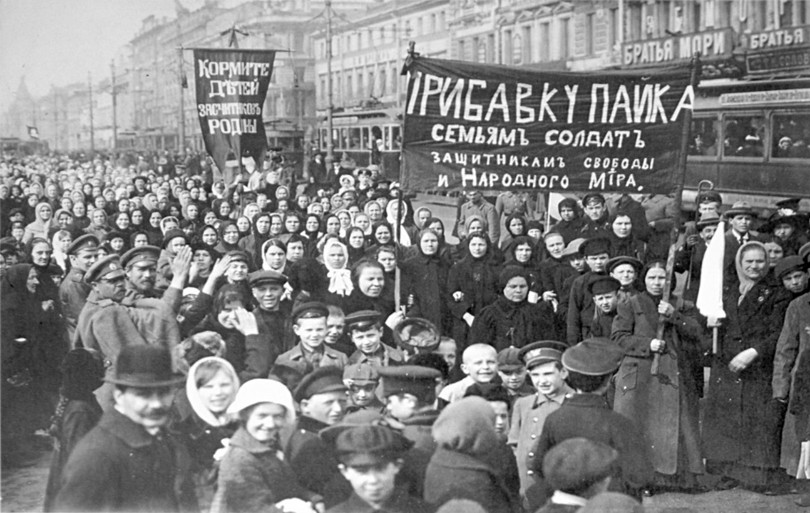
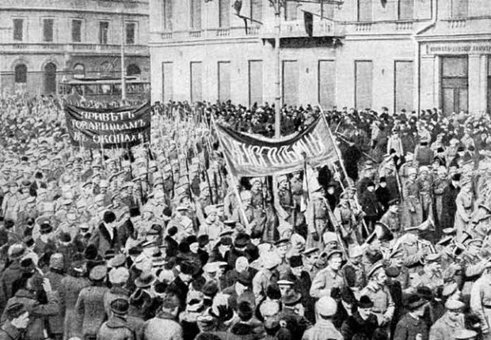
Feb Rev
Soldiers are ordered to shoot – but soon side with the crowd who shouted:
“Down with the autocracy”
“Down with the war”
Near anarchy in Russia

Slide 20
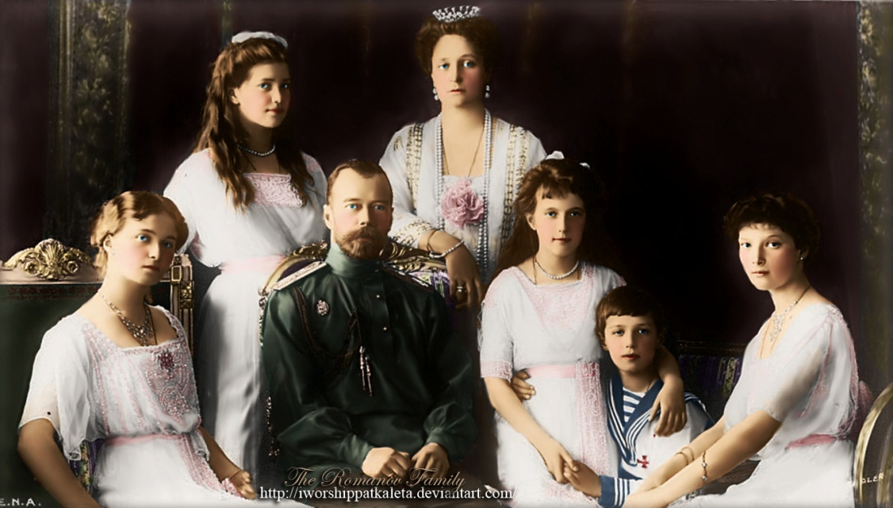
Czar Responds
1917 - He abdicates: steps down
Exiled
1918 – his entire family shot & killed
Legend says: Anastasia survived – a woman will claim she is the surviving daughter
The Russian monarchy is over forever!

Slide 21
5 Level 1 Questions

Slide 22
Final Thoughts:
Who should be blamed for the Russian Revolution?
Czar Nicholas II
Czarina Alexandra
Rasputin
World War One
These events were beyond any one person’s control.
Answer the question with 2 specific reasons.

Slide 23
Industry leads to problems
Unions were outlawed
Leads to rise of Marxists (communists)
What do you remember about communism?

Slide 24
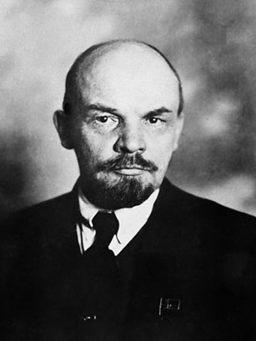
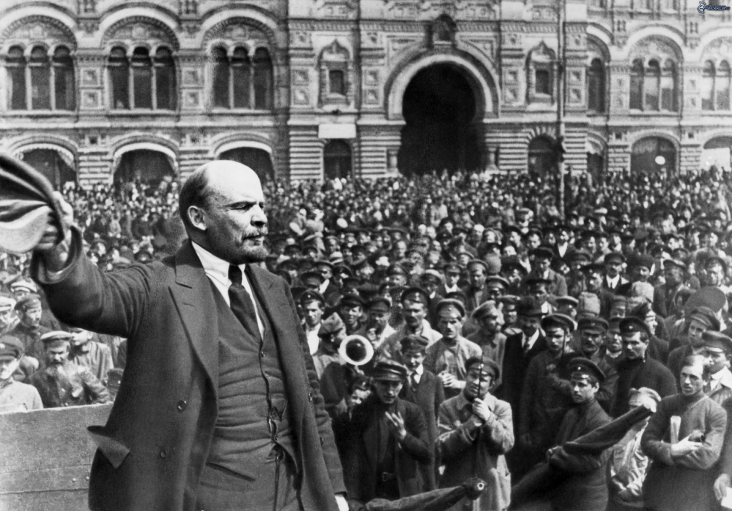
Vladimir Lenin
Leader of Bolsheviks: radical revolutionaries

