Slide 1
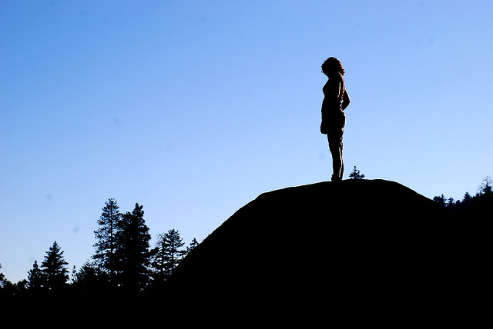
Imagine you have just graduated from college and have been offered your dream job – but it’s in Brazil. List some advantages to moving and some disadvantages. Would you take the job?

Slide 2
Immigrating
Advantages ☺
Disadvantages ☹

Slide 3
Get out: Article (stapled) Notebook Signed Info/Syllabus Sheet Name tent Levels of questions handout *Add 1 L3 question about your article to your Revolution paper**

Slide 4
Grab Bag
Object:
Meaning:
What does it look? What it contains? What is it used for? Key details
1.
2.
3.
4.
5.
What we will be studying based on the object / Our prediction about why this object is significant to this unit
Summary: How do all these objects fit together? Explain.

Slide 5
Groups of 4
Youngest person goes first – go clockwise from there:
Hi ☺
Your Name (Turn name tent to face group)
Which is better: block schedule or all periods?

Slide 6
In-Class Note-Taking Tips! Informal language
Don’t write every word!!!! Summarize
But, don’t just write what’s on the board. Add in teacher examples & explanations.
Abbrev. everything! Ppl, enuf, &, thot,
Copy what’s in a black font.

Slide 7
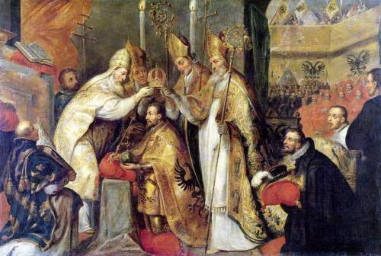
Foundations #1: Who should have power?
King / Monarch
Established religion: Controlled religion
Hierarchy: Society divided into strict categories (born into)
Very little ability to “move up”

Slide 8
So, the king should have all the power, right?

Slide 9
Enlightenment (1600s)
Would Enlightenment Philosophers agree with the following? Yes / No / Bonus – add name of original philosopher
People are born with certain rights.
The king is given power by God and cannot be questioned.
If the gov’t doesn’t protect people’s rights, the people should get rid of it.
All people are equal.
Women should be included in statement #4.

Slide 10
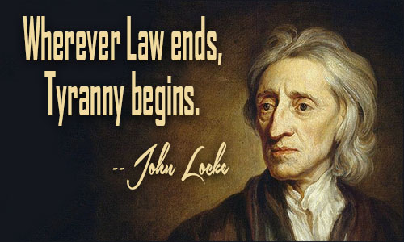
Enlightenment
Questions ideas about power
John Locke: king must respect people’s natural rights: - , - , -
If king does NOT – people can --

Slide 11
Gov’t in Britain
Limited Monarch:
King’s power is limited
Parliament (law makers) have power
Ppl have rights
What limited the power of the British king?

Slide 12
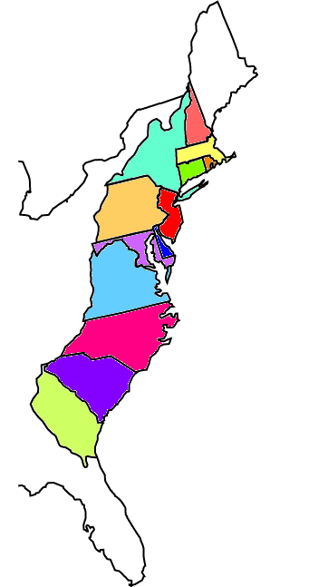
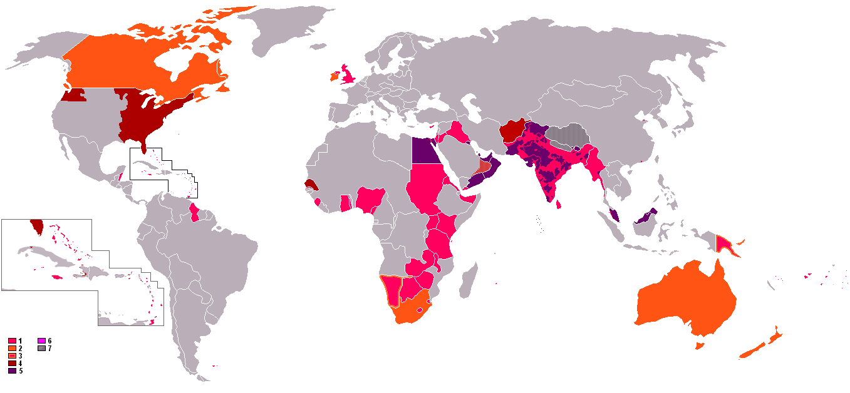
Great Britain in 1700s
Most powerful nation
Controlled empire: US

Slide 13
People moved to American colonies for:
Religious freedom
Economic freedom
Landless nobles
Would you move? What kind of person would?

Slide 14
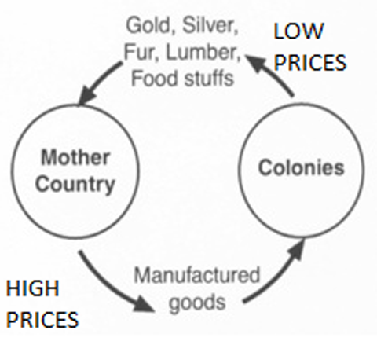
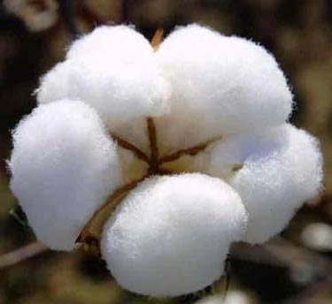
But, colonies were still under king’s control:
Mercantilism
Am provided raw materials to Br & Br creates manufactured goods
Am grows cotton
Br turns into textiles

Slide 15
Colonists also find many ways around this control
Create local govt’s
Men with property can vote

Slide 16
ON the left or back of notes:
ADD 5 Level 1 Questions
Questions your teacher might just ask on a quiz
Do NOT answer them

Slide 17
Draw the U.S. Label each state

Slide 18
Iowa
Kansas
Kentucky
Louisiana
Maine
Maryland
Massachusetts
Michigan
Minnesota
Mississippi
Missouri
Montana
Nebraska
Nevada
New Hampshire
New Jersey
New Mexico
New York
North Carolina
North Dakota
Ohio
Oklahoma
Oregon
Pennsylvania
Rhode Island
South Carolina
South Dakota
Tennessee
Alabama
Alaska
Arizona
Arkansas
California
Colorado
Connecticut
Delaware
Florida
Georgia
Hawaii
Idaho
Illinois
Indiana
Texas
Utah
Vermont
Virginia
Washington
West Virginia
Wisconsin
Wyoming

Slide 19
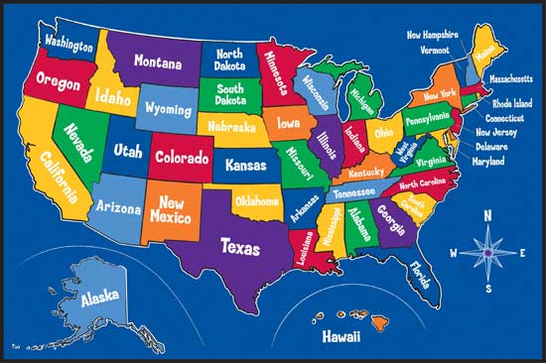

Slide 20
Questioning
Create one L1, one L2, one L3 question based on the map of the US
Write each question on a separate post it note

Slide 21
Map Quizzes
Western US: Th/Fr 8/24-25
Eastern US: Th/Fr 8/31, 9/1
Use website to study!

