Slide 1
1950s Culture
What do you see? Describe what’s being advertised and how.
Who is the target audience? Who are they selling this to? Or, whose attention are they trying to grab?
Any stereotypes? Are they portraying anyone in a stereotypical way? All men / All women
What does it show about 1950s life? What did they like doing? What were the new exciting inventions? How is it similar or different to today?

Slide 2
Quiz on Thurs. Fake quiz – right now!
What is containment?
Which president tried to stop communism in Greece & Turkey ?
Which plan gave money to any country in Europe who wanted it? Which countries do NOT take it?
What city was cut off from supplies by the Soviets but airlifted supplies by the US?
Name of Congressional Committee that targeted communists.
Person who said he knew the names of communists in the gov’t – but never really proved it.
Who started the Cold War? Why?

Slide 3
What do you see? Describe what’s being advertised and how.
Who is the target audience? Who are they selling this to?
Any stereotypes? All men / All women
What does it show about 1950s life? How is it similar or different to today?

Slide 4
1950s #7 – Returning Home
What does these ads show you about life in the 1950s?
What’s the same? What’s different? What was new? What was the fashion like? What about family life?

Slide 5
1950s #7: Returning Vets
What should be done to help veterans returning from war? List a 3-4 things that are already being done and/or things that still need to be done to help vets.

Slide 6
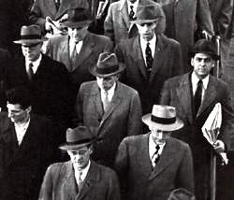
Returning Vets… want to go back to “normal”
G.I. Bill – gave vets $$$ for college & buy house
Increase in white collar jobs – professional jobs
Larger middle class
*Emphasis on conformity – being like everyone else. How much was true and how much is exaggerated?

Slide 7
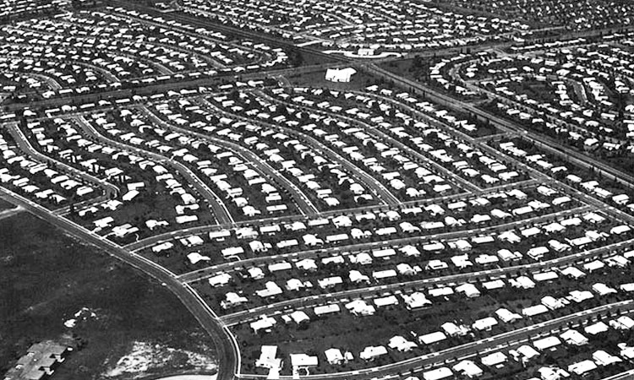
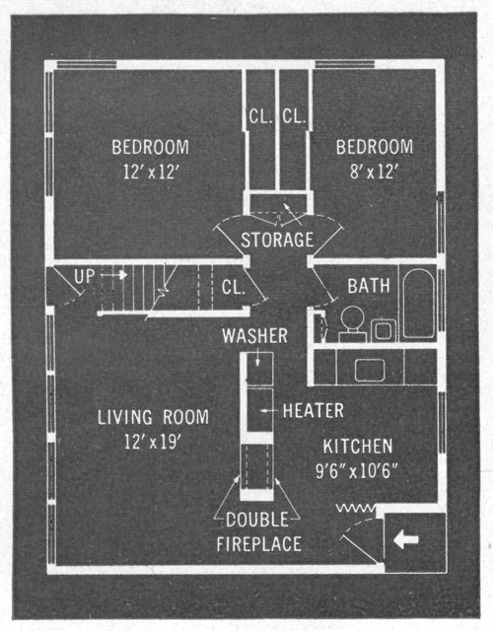
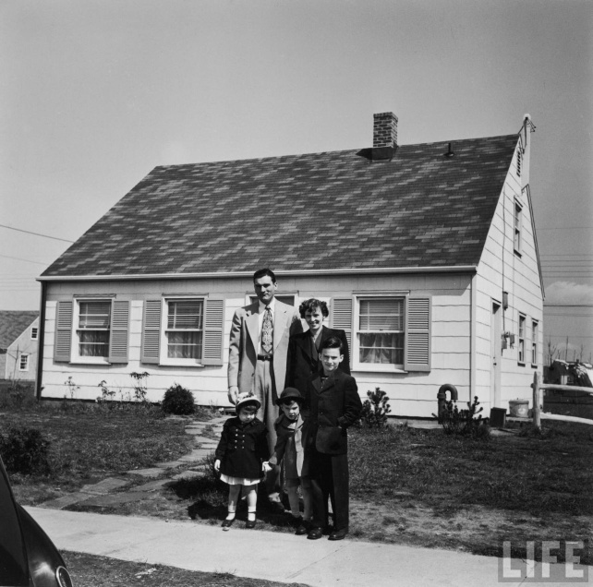
Buy a House
Cities Suburbs: Buy a house in the suburbs (outside of town)
Levittown: assembly-line houses / same /

Slide 8
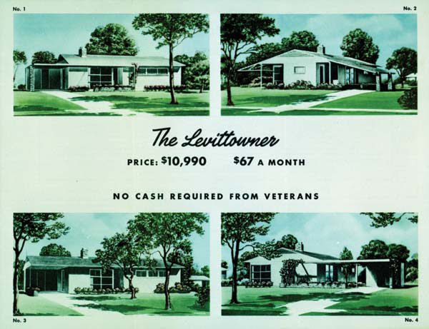

Slide 9
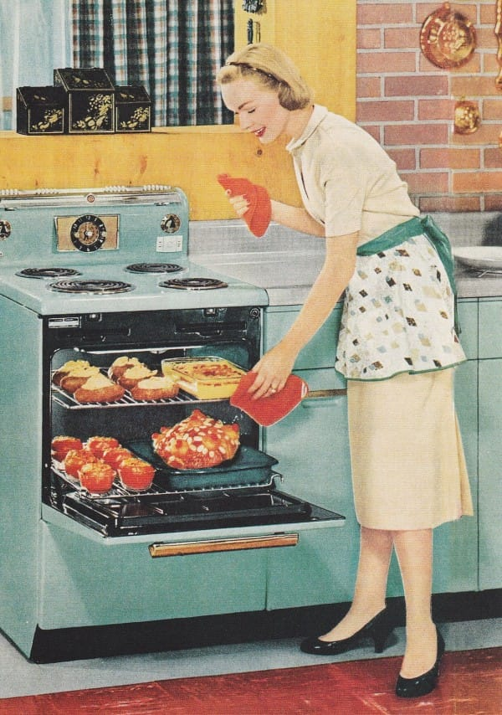
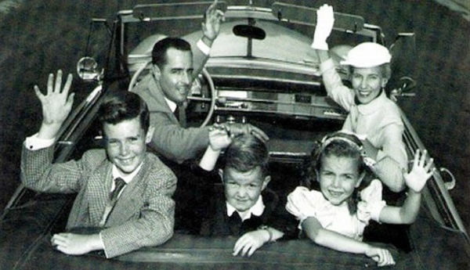
Get married
Ave age of marriage:
22.8 men /20.3 women Today: 28.2 (m), 26.1 (f)
Baby Boom: huge # of births Ave # of kids = 3.77 / today it’s less than 2
Housewife: moms stayed home w/kids
1/3 women worked – jobs limited
Today: 3/5

Slide 11
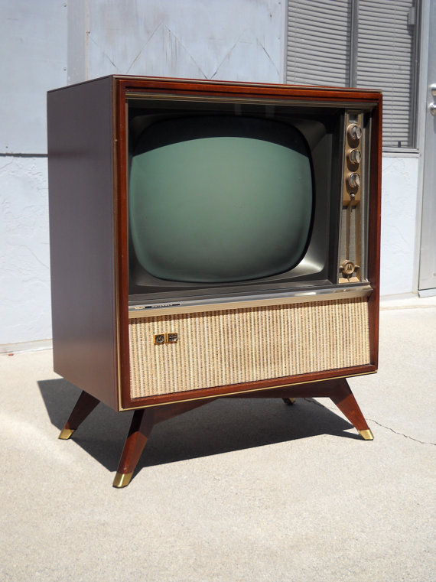
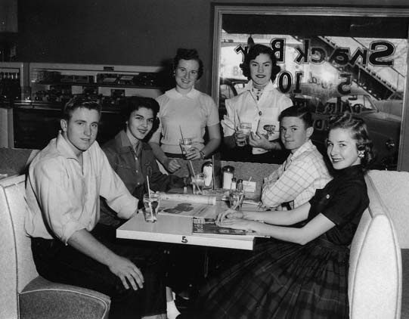
Buy Stuff
Rise of consumerism – buying lots of stuff!
TV!
Teenager: new concept
Free time, unique interests, buy
stuff

Slide 12
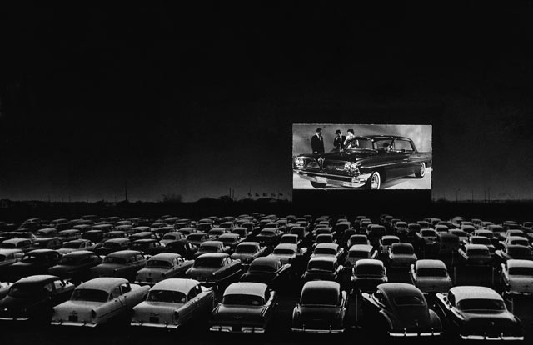
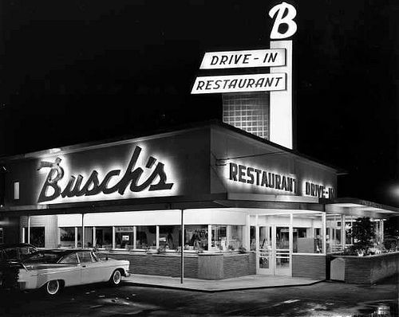
Cars: An American Love Affair
Freedom
Drive-In movies, diner
Highway Act 1956:
46,000 miles
Defense
Controversy:

Slide 13
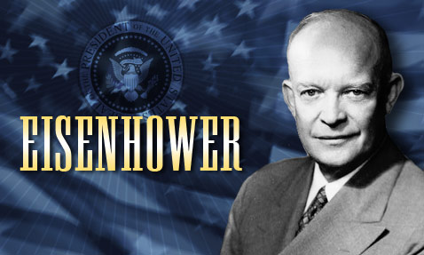
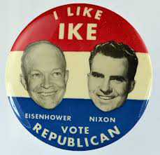
Conservative (not a lot of change) Politics
1952-1960: President Dwight D. Eisenhower, hero of WW2, “I like Ike”

Slide 14
ADD 5 Level 1 Questions
ADD 1 Level 2/3 and answer it
Adv, Disadv, Compare, Contrast, Evaluate, Predict

Slide 15
50s #8: Prosperity or Hardship?
“10 Amazing Years”
List all the positive changes of the 1950s.

Slide 16
The Other America
What is the “other America” the author refers to? Give both a # and some descriptors.
Why is that many Americans can avoid seeing – and thus believing – in this “other America”? Give at least 2 reasons.
What 2 reasons does the author give for why they remain invisible?
Why is being invisible such a problem? Explain.
Do you think we have 2 Americas today? Explain.

Slide 18
Plagiarism
Using someone else’s words without giving credit
Copying from another student
Copying from the internet, book, etc.

