Slide 2
What does it mean to be free?
DUE: Current Event

Slide 3
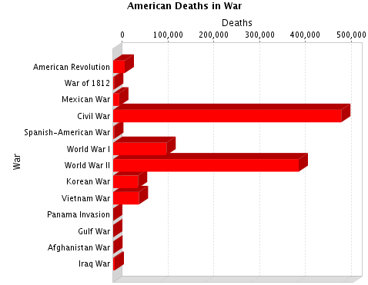
What does this chart tell us about the Civil War?

Slide 4
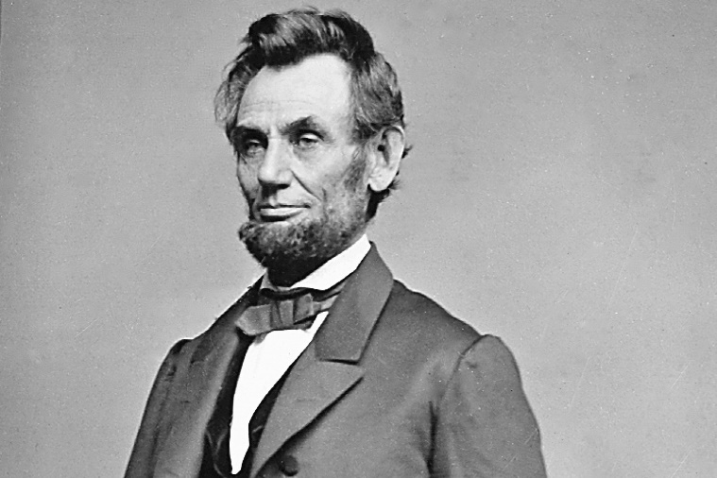
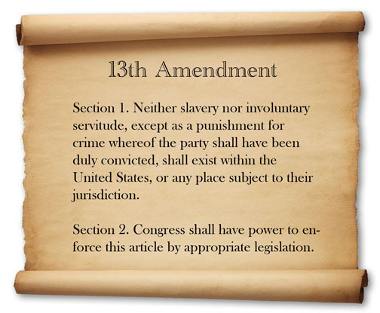
Found #10: End of War
During war,
Abraham Lincoln (R)
Emancipation Proclamation: freed slaves in Confederacy
13th Amendment : ended slavery in US
Freedmen – ppl released from slavery

Slide 5
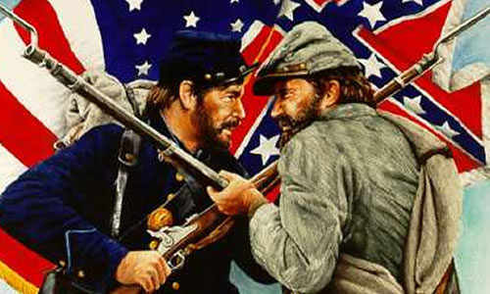
Reconstruction: Period after Civil War meant to rebuild and reunite the nation
Questions to answer?
Punish the South? Or be lenient?
What do we do with their military leaders? Soldiers? Gov’t officials?

Slide 6
Freedmen
What do you do now?
What kind of help do you need?
What does it mean to be free?

Slide 7
DUE: Docs B-E Leave in front of you!
Upcoming Events:
Re-take E US Quiz? See me during ADVO
Fri: Quiz 20 m/c questions
Thurs: Back to School Night
Fri: Minimum Day (12:22 release)
Wed: Test / Notebook DUE / Bring textbook

Slide 8
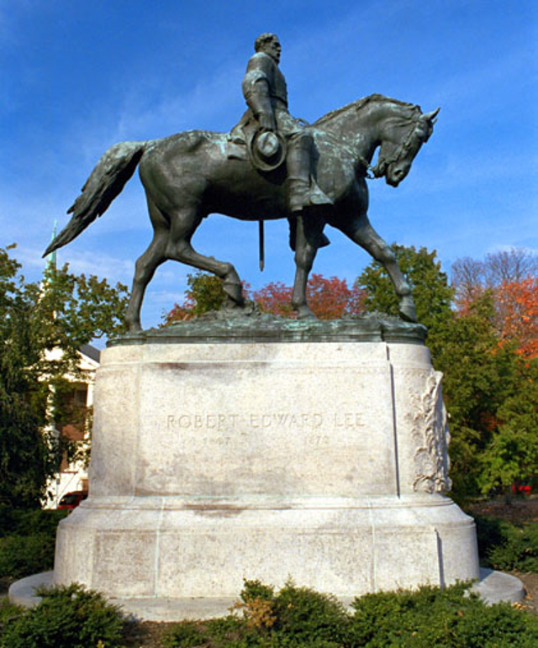
Who is this?
Why has he been in the news lately?
What is the controversy?

Slide 9
Reunite nation
Lincoln: lenient (go easy)
10% of 1860 voters take an oath of allegiance & abolish slavery = it’s back in!
Republicans dominate Congress
Radical Republicans: want to end power of slaveholders & give power to freedmen
Write a law that requires more of Confederate states
Lincoln will NOT sign

Slide 10
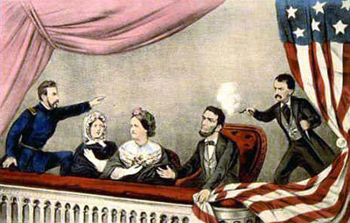
Lincoln’s Assassination
Andrew Johnson: President
Amnesty (Forgives group) many Confederates
Allows other to ask for pardons (forgives 1 person)
States begin “Black Codes”
Restrict freedmen
Could NOT purchase / rent land, bear arms, etc.

Slide 11
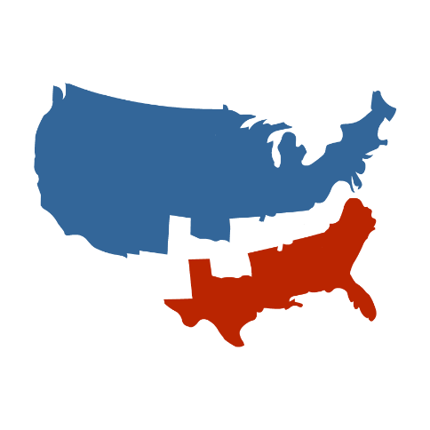
Congress Fights Back
Refuse to seat new Congressmen from Confederacy: Cong set rules for reuniting nation
Freedmen’s Bureau: provides food, clothing, education, etc.
Civil Rights Act: African Americans can buy property, sue, are citizens
AJ vetoes both, Congress overrides veto

Slide 12
14th Amendment
All freedmen are now citizens s of the US (1866)
Before Civil War, slaves were not even people they were ruled by the Supreme Court in Dred Scott case to be “property”
Johnson says, “Vote NO”

Slide 13
First Reconstruction Act (1867)
Sends military into South to ensure they’re following the rules
Forces states to ratify 14th
AJ vetoes, Cong overrides
Impeach AJ
Congress writes law: Pres can’t remove someone from office w/o Senate approval
AJ does it anyway
Impeached
Falls 1 vote short of REMOVAL!

Slide 14
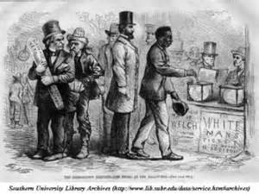
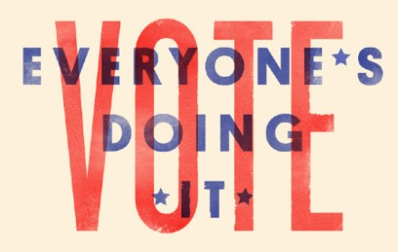
15th Amendment (1870)
Freedmen have the right to VOTE!
Only men (not women yet)
Made some white women very upset!

Slide 15
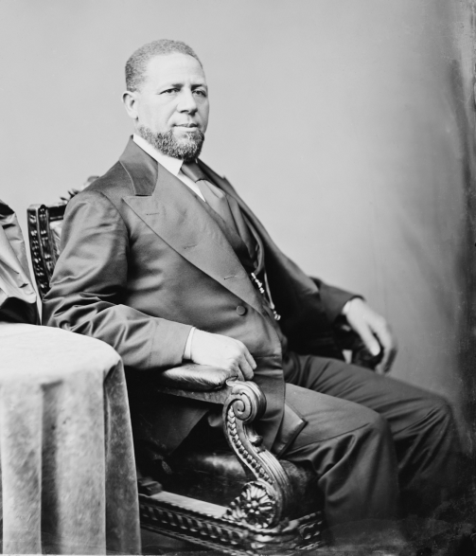
Impact
North ensures ALL people are voting from 1865 - 1877
African Americans will get voted into major offices – like the U.S. Senate
The next time an African American gets elected to the Senate will be 1967 – nearly 100 years later – what went wrong?

Slide 16
Were freedmen really free?

Slide 17
Were freedmen really free?
With your partner, develop 4 pieces of evidence that prove your position.
In Doc A, it says, “ xyz “ this proves that …..

Slide 18
Meet with a team from the opposing side….
One side goes first. Each partner will present 2 reasons for their position.
The opposing team listens and writes down their main arguments.
Repeat the arguments back to the team to make sure you got it right and/or ask any questions.
SWITCH!

Slide 19
What do you really think?

Slide 20
Consensus building
Try to decide – as entire group of 4 – what your answer will really be.
You are NOT trying to WIN but to come to an agreement!

Slide 21
Summary: On back of arguments
Describe your position on the question, “Were African Americans truly free during Reconstruction?” Use 3 specific pieces of evidence and state their source.
6-8 sentences.

Slide 22
Found #11: End of Recon
Take out who has the power handout

Slide 23
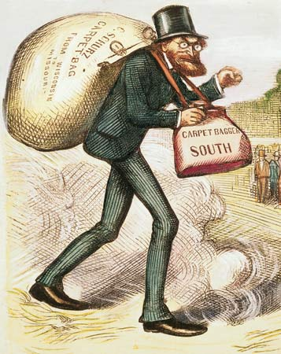
South During Recon.
Carpetbaggers: insult for Northerners who go to South – for money, to help, etc.
Scalawags: Southerners who support Rep. (insult)
KKK: Ku Klux Klan – uses violence to intimidate freed blacks

Slide 24
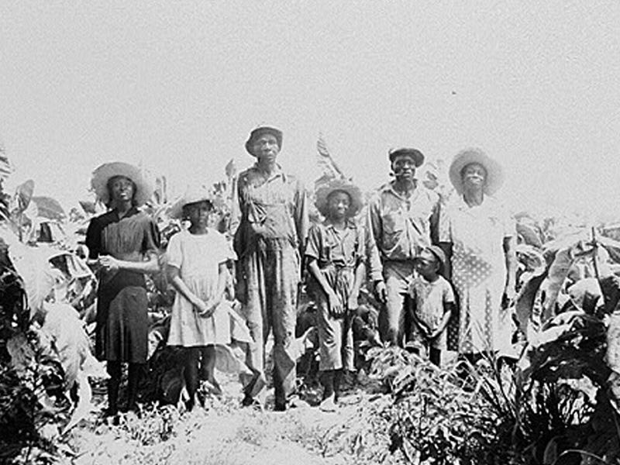
Sharecropping
Freedmen rented land (often from former owners) and paid back with a portion of their crops b/c couldn’t afford to buy anything
The Freedmen almost NEVER made enough to pay back debt AND became indebted to land owner
Land owner decided how much you owed him if he said $100 – that was it. There was no real way to argue with this system. Who would help?

Slide 25
Recon. Ends
Cong passes laws to restrict KKK
BUT many former Confederates get right to vote back
Freedmen’s Bureau ends
Economic crisis
New President – officially end Recon in 1877

Slide 26
Describe the conditions of the average freedmen at the END of reconstruction.
2-3 sentences

Slide 27
Invention Project
Write-Up:
Introduce the idea of how inventions change lives (you can discuss some from today). 1 paragraph
Write paragraph on 1 invention that includes what it is, how it works, who invented it and how it changed things.
Write 2nd paragraph on a different invention following same guidelines as part B
Brief summary / conclusion . Short paragraph
Brainstorm
Pick your top 3
Using book and handouts complete chart
YOUR CHOICE: Ad or Write-UP
**Does the show that this invention changed lives?

Slide 29
