Slide 1
1st Semester
12/4 | 12/5 Begin Essay | 12/6 Begin Essay | 12/7 Notebook Check | 12/8 Notebook Check
12/11 | 12/12 Essay DUE | 12/13 Essay DUE | 12/14 1920s Quiz Open Note | 12/15 1920s Quiz Open Note
12/18 Per 1-6 Final Review | 12/19 Finals 1 & 2 Imp – 1920s m/c test Release @ 12:22 | 12/20 Finals 3 & 4 | 12/21 Finals 5 & 6 | No School / End of First Semester

Slide 2
1920s #4: Prohibition
US Senate rejects Treaty of Versailles
Does NOT join League of Nations
US becomes isolationist: stays out of foreign affairs

Slide 3
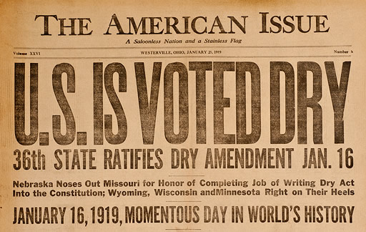
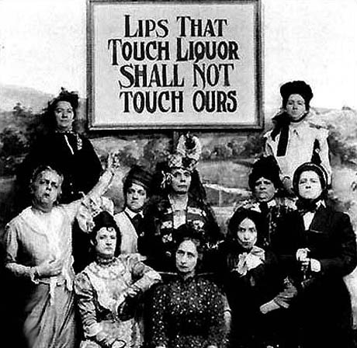
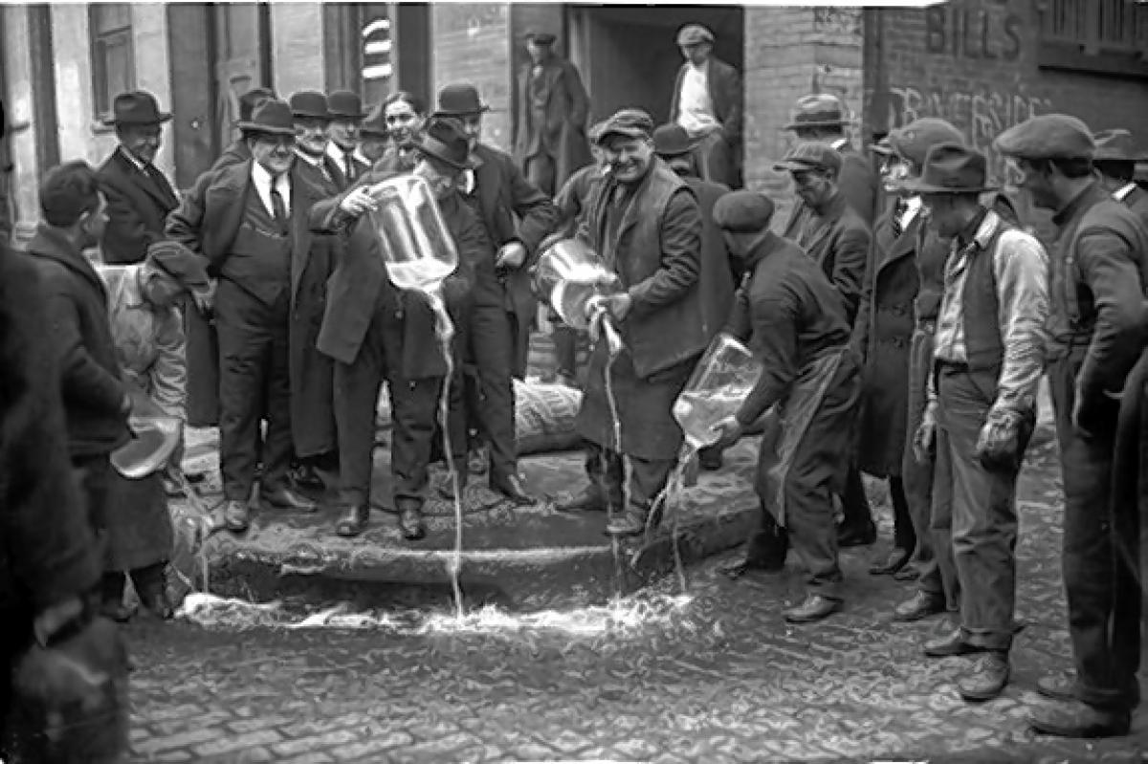
18th amendment
PROHIBITion of making & selling of alcohol
WHY?
Causes abuse, crime, accidents
Women’s group supported it to protect families
Anti-immigrant

Slide 4
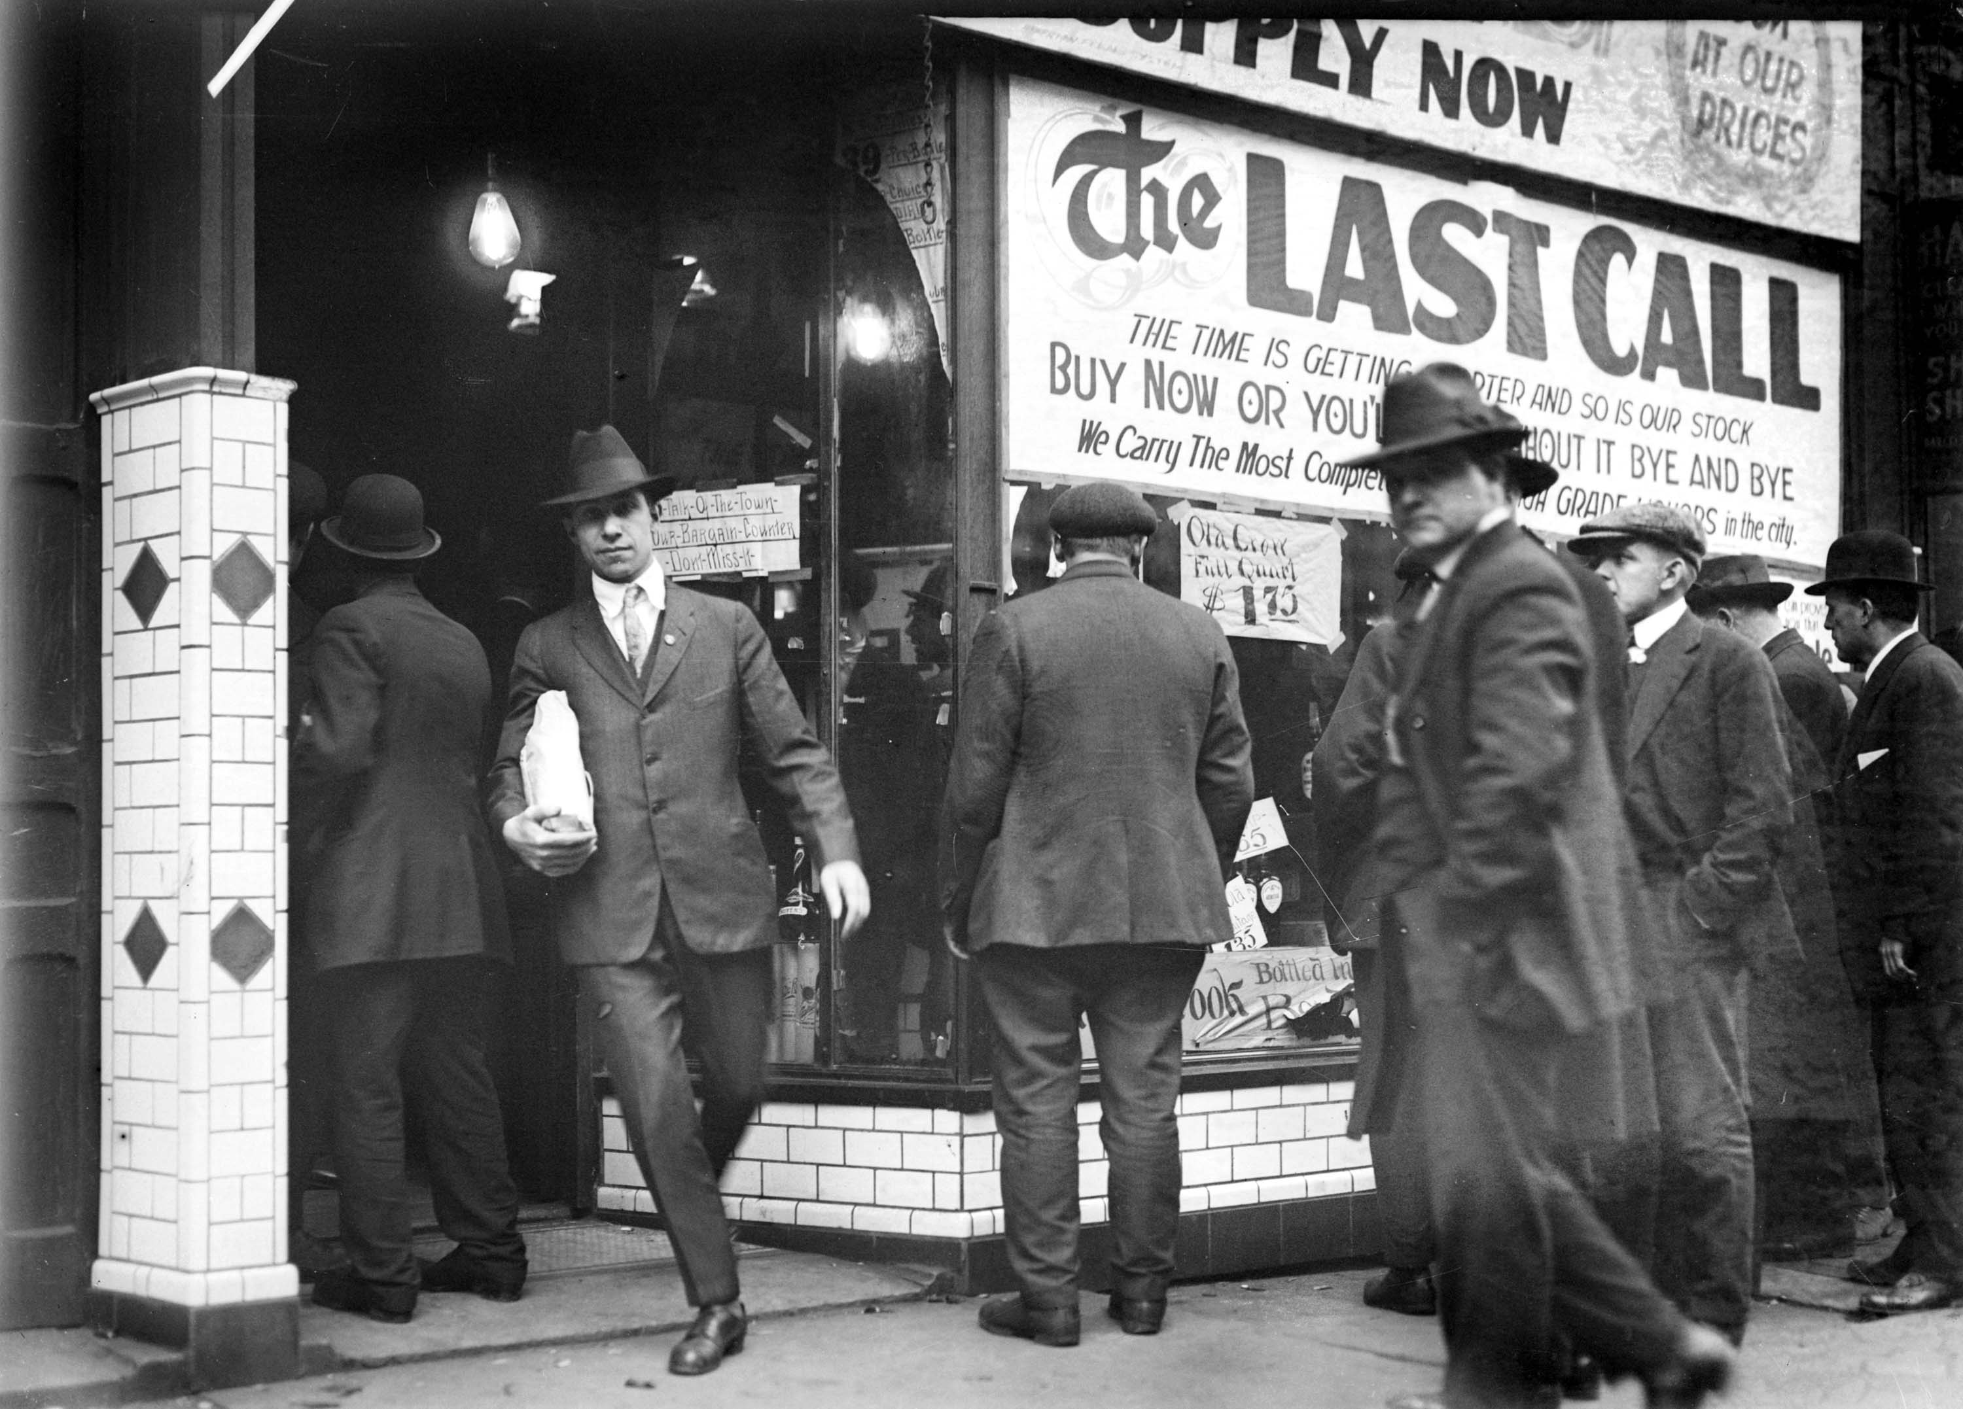
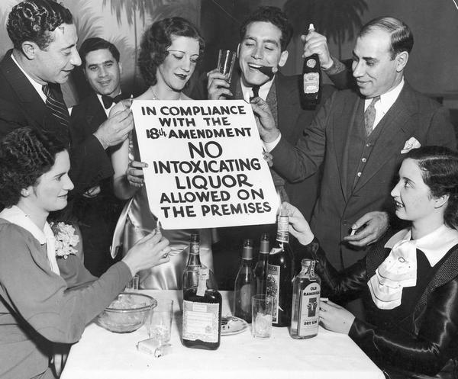
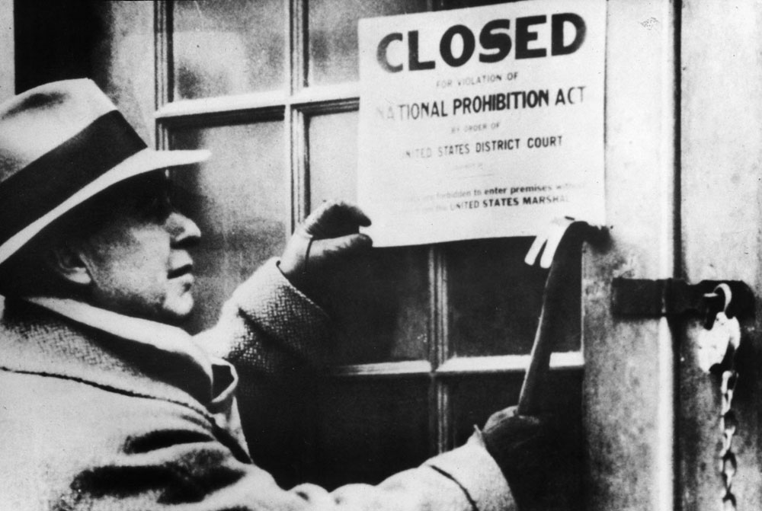
Volstead Act
Law enforces amendment
Exceptions for medicine, religion
NO $$$ - could NOT enforce

Slide 5
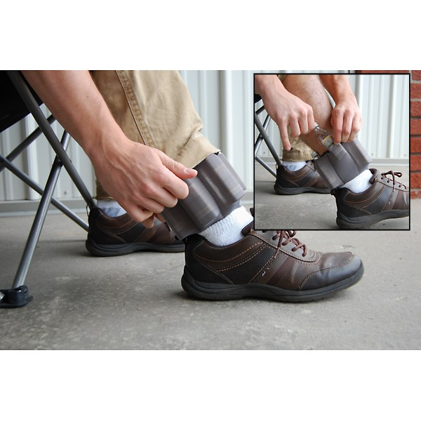
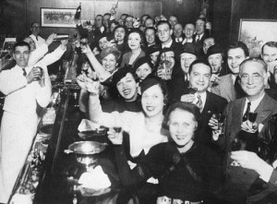
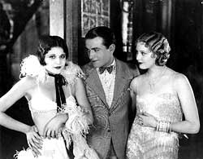
Problems
Speakeasies: Underground clubs / bars
Bootleggers: illegal sellers of alcohol

Slide 6
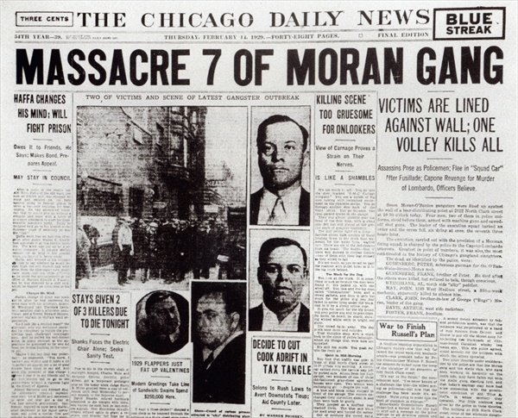
3. Gangsters: often sold alcohol & used violence to control market
Al Capone: controlled Chicago
St Valentine’s Day Massacre:
Capone’s men dressed as police & gunned down rival gang
4. Corruption
Bribes

Slide 7
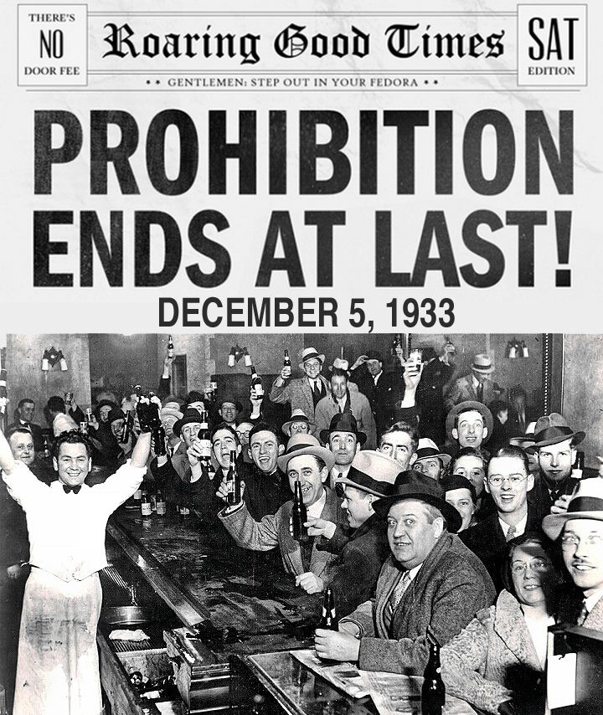
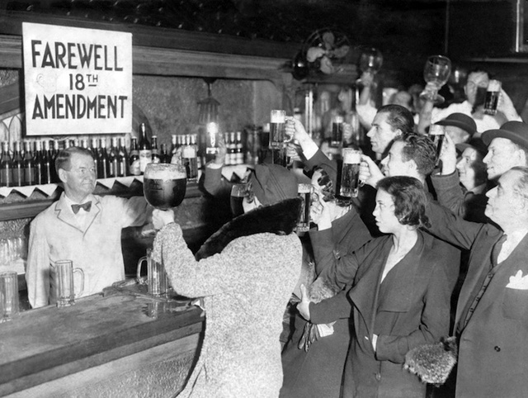
21st Amendment (1933)
Repealed (undid) 18th

