Slide 1
IR #6: Political Machines
Think About: Have you ever asked for a favor? What did you ask for? Did you have to pay it back somehow?

Slide 2
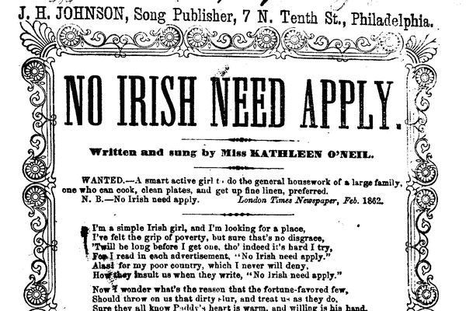
Immigration Reaction
Nativism: discourage immigration & give preferences to native born Americans
Does this attitude still exist today?

Slide 3
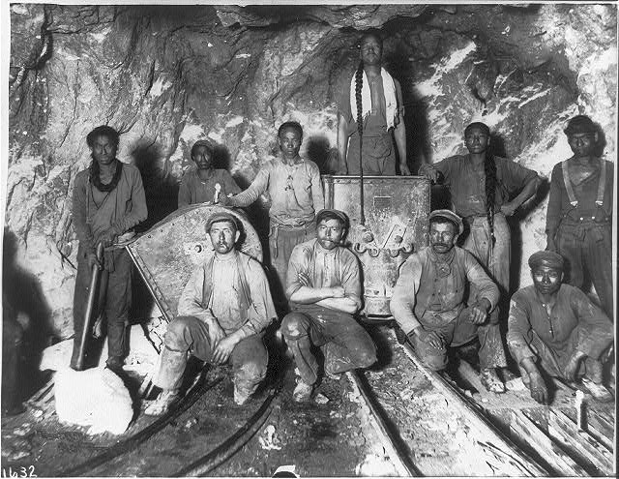
Asian Immig.
Chinese Exclusion Act 1882: ended most Chinese immigration for 60 years
Gentlemen’s Agreement: to end segregation of Japanese in CA schools, Japan agreed to limit immigration to US to skilled workers

Slide 4
Urbanization
B/C of urbanization – lot of people needed help!
Where do you turn if you a new immigrant or a small farm boy from Iowa who now finds themselves in New York City? You need a job, a place to live, you might not speak the language…..

Slide 5
Political Machines
Non-politicians offer services (jobs, housing, food, etc) to ppl AND in return they want you to vote for candidate they support
Exchange of favors!
Would you take the deal?
Is it legal to sell your vote?

Slide 6
How to get the votes cont’d
Pyramid of power / hierarchy
Local workers for Pol Mach (bottom level) ensure that everyone votes
“Vote early and vote often” – vote more than once / vote under dead ppl’s names
Know how you vote b/c ballots were color coded

Slide 7
Boss: leader of the pol. machine
Get politicians elected & get from politicians:
Construction projects: build a bridge
Boss would charge $2 million, it would cost $1 million
He kept profits
Used this jobs as a way to buy votes
Pol Machines even hired police
Graft: gain an advantage through illegal ways
Is this graft? Is this corrupt?

Slide 8
How bad was it?
A carpenter was paid $360,751 (roughly $4.9 million today) for one month's labor in a building with very little woodwork.
A furniture contractor received $179,729 ($2.5 million) for three tables and 40 chairs.
Source: Digital History
Answer the question: how bad was it? In one sentence on your paper. It was so bad people were

Slide 9
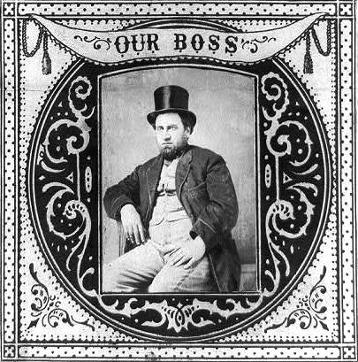
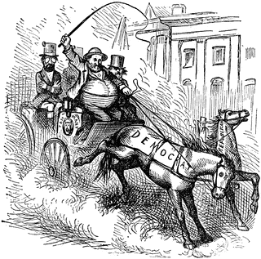
Boss Tweed
Leader of New York City political machine that controlled the Democrats
Tammany Hall – name of its headquarters
Boss Tweed Ring – Tweed charged w/crimes (escape, caught, die in prison)

Slide 10
Political Machines = Helpful or Harmful? Did they help society or make it worse?
Helpful for society
Harmful to society

Slide 11
Use the info below to fill in chart
Provide jobs, homes, etc.
Voter fraud – buying votes, etc.
Graft
Organize elections
Overcharging for construction projects

Slide 12
On left
Define a political machine and explain what it does to stay in power. Why would politicians go along with this system? (Or what do politicians gain from it?)

Slide 13
“The Rich are Good Natured”
Find his thesis.
Find all the evidence he uses to support his thesis.
Which of his arguments are the most convincing? Why?
Which of his arguments are the least convincing? Why?

Slide 14
Develop Level 2 / 3 Questions
Create 5 Level 2 or 3 questions.
Must be open ended.
No “yes or no” answers. Add word “why” if you happen to write a yes/no question.

Slide 15
Mini Socratic Seminar
First, as a group, decide on his thesis.
Second, ask the questions you have developed and answer them as a group.
Stuck? Ask my questions: best/worst arguments and why?
Each person has been given 5 tokens. Each time you talk, put the token in the middle.
If you run out, no more talking until everyone has used up 3 tokens. When all tokens are in middle, redistribute so that each person has 5 and start over.

Slide 16
In the end,
Summarize his argument.
Decide if you agree or disagree and explain your answer.

Slide 17
Pick top 3
Robber Barons: Vanderbilt, Rockefeller, Carnegie, Stanford, Morgan
Union Leaders: Samuel Gompers, Eugene V Debs, Mother Jones, Terence Powderly
Social activists/commentators: Jane Addams, Horace Mann, Horatio Alger
Economists: Karl Marx, Adam Smith
Boss Tweed

Slide 18
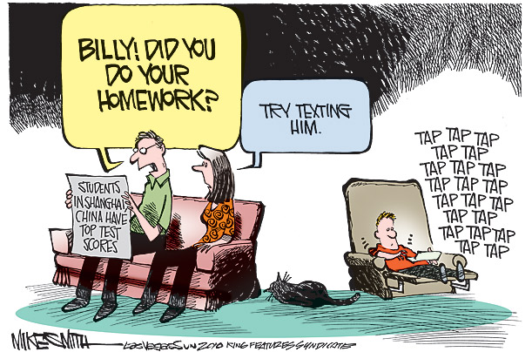

Slide 19
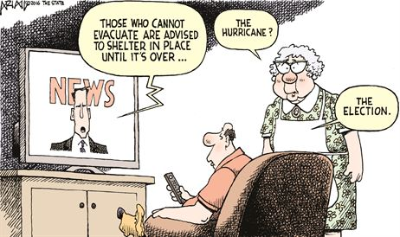

Slide 20
Essay
How successful were unions in organizing labor to make changes in the workplace?
What role should the U.S. government play in regulating industry in the 1800s?

Slide 21
Outline
Intro
Hook:
Background:
Thesis
Body #1: Topic
Supporting info
Supporting info
Body #2
Body #3
Conclusion

