Slide 1
DUE: Docs A/B / Iron Curtain
Pass up questions / keep reading
DUE dates:
  Research / volunteer proposal NOW
    Do NOT start working on your project without my approval first
  3 sets of notes (on 3 sources): 3/13
  Final 2 sets of notes (2 sources): 3/22

Slide 2
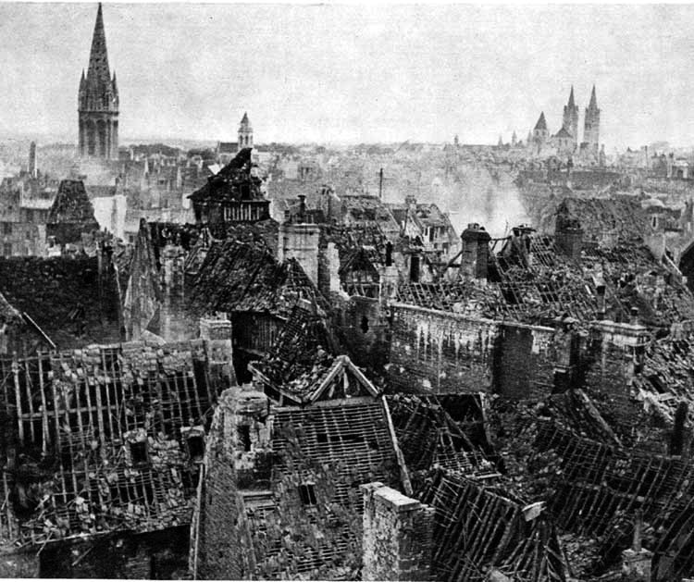

Slide 3
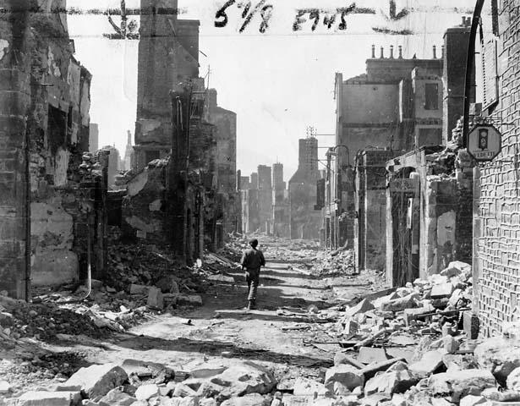

Slide 4
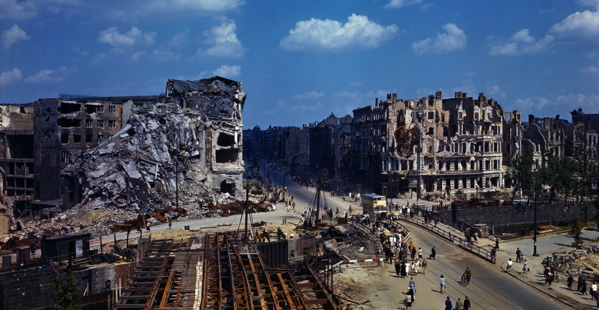

Slide 5
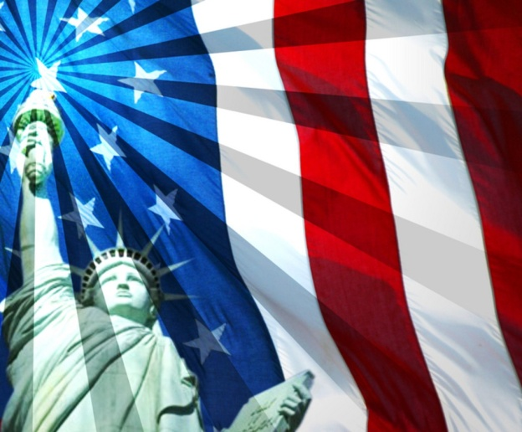


1950s #2: Origins
War is over …. so how do we create world peace?
Who should we blame for starting the Cold War – US or USSR?
Who’s winning the Cold War?

Slide 6

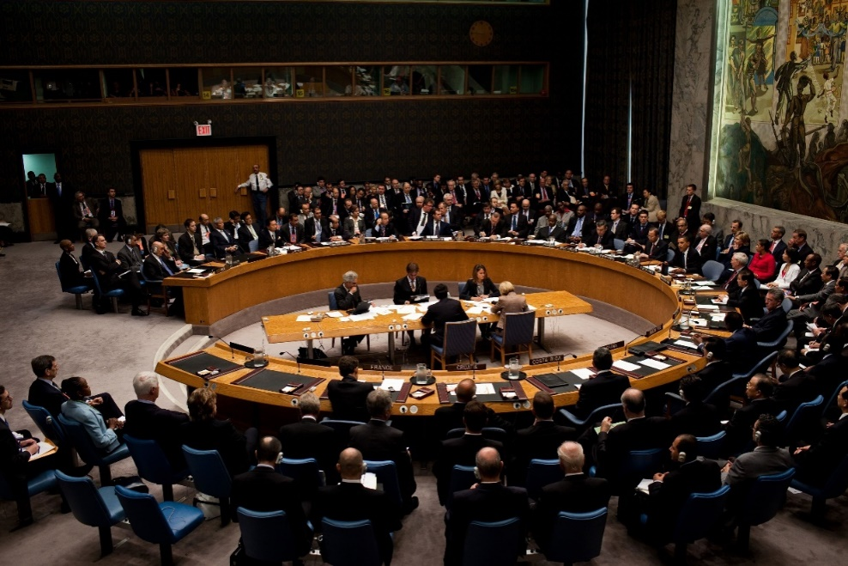
United Nations (1945)
Most countries in the world are members
Place to negotiate problems
This should work, right???
5 nations have veto power:

Slide 7
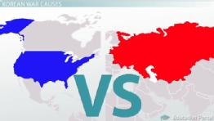
So, what goes wrong?
What causes the Cold War?
  Cold War: tensions b/w US & USSR from 1949 – 1991 (no direct fighting)
Who started it:
USSR or US?

Slide 8


1. Different forms of gov/diff war experiences
US: no civilian causalities & factories and industry stayed intact (whole)
  Democracy :
  Capitalism
USSR: ¼ of its people were injured or killed in WW2
  Communism:

Slide 9

2. Satellite Nations
BUT, Stalin puts in communist gov’s to give a buffer or “wall of protection” called
  Satellite nations: Eastern Eur countries under Stalin’s direct control (1946-1949)
    Poland, Czech, Hungary, etc
Iron Curtain: dividing line b/w free W. Eur and commie E. Eur (1946)
Why would Soviets feel like they need protection?

Slide 10
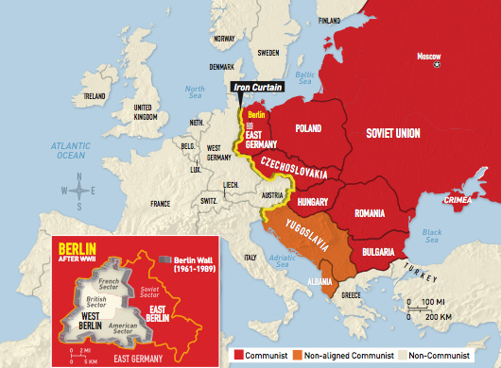
Iron Curtain

Slide 11
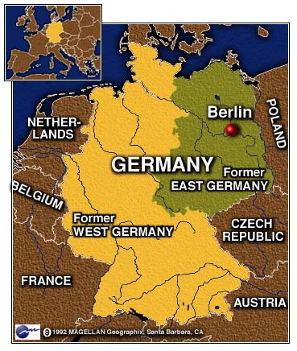
Ger zones of occupation (1949):
      West Ger = democracy
      East Ger = communist
      Berlin: West Berlin (free) & East Berlin (commie)
Who’s winning the Cold War?

Slide 12
3. Truman Doctrine
1947:$400 million to Greece & Turkey to fight commies
It works! Gr & Turk remain free ☺
Begins containment: stop communism from spreading!

Slide 13
4. Marshall Plan
1948: US will give $$$ to any Eur country who needs assistance
Vote YES:
Vote NO:

Slide 14
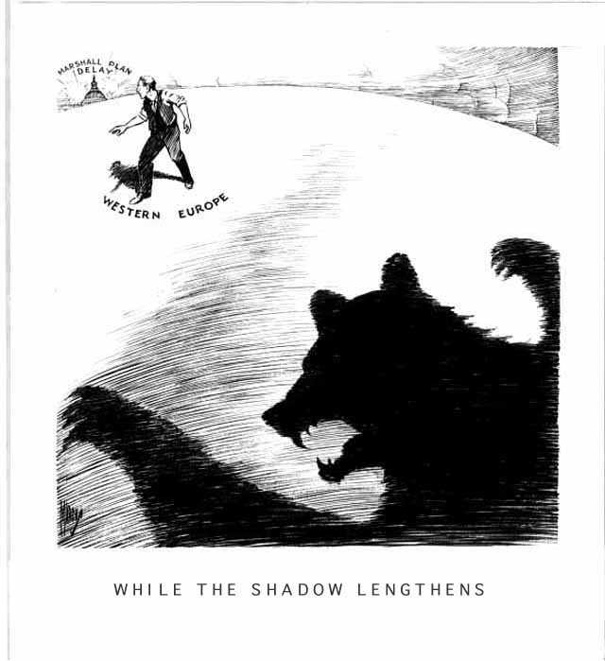
D
Describe what you see in cartoon.
Explain the message.
Charts:
2 key pieces – high / low / trends
What is the significance?

Slide 15
Speech on the Marshall Plan
Rep. Charles W. Vursell (R-IL)
..[I]f we weaken ourselves by shipping away our resources, causing the cost of living to go higher and higher, and spending our Nation into bankruptcy, such action will bring smiles and great satisfaction to Stalin, Molotov, and Russia.
…The first responsibility of the Members of this Congress is to protect the interests of our own people and preserve the financial solvency of our own Nation. The greatest contribution we can make for the future peace of the world, is to keep America strong.
5. Is he for or against the Marshall Plan? Give 2 reasons.

Slide 16
Marshall Plan Political Cartoon
Decide if you want your cartoon to be in favor of the Marshall Plan or against it.
Draw a sketch of how you can show that message in pictures.
Answer the following in 3-5 sent each:
  Explain the message of the cartoon and how you conveyed that message.
  Explain 2-3 reasons for your position on the Marshall Plan (may not be shown in cartoon).

Slide 17
DUE: Cold War docs
Continue notes #2
Define Cold War in your own words. Who is involved? What happened? Why fighting?
What is containment?

Slide 18
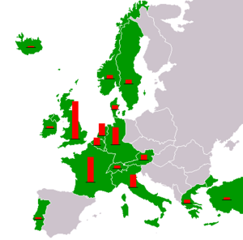
4. Marshall Plan
1948: US will give $$$ to any Eur country who needs assistance
$12 billion
Why?
  Trade
  Rebuild
  Stop Comm.
Which 2 countries got the most aid? Who got the least?

Slide 19
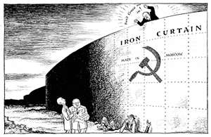

Barely approved by Congress – but the communist takeover in Czechoslovakia convinces them to act!
Soviet Union & satellite nations do not accept the $ - why not?
  Don’t want help from US – seen as imperialism
Rebuilds W. Europe!

Slide 20
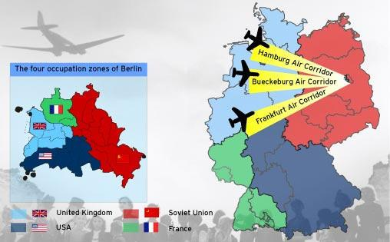
5. Berlin Airlift (1948-49)
Br/Fr/US plan to consolidate their Ger zones into 1
  USSR leaves Allied Command that had coordinated the country jointly
  West creates their own currency – w/o telling Soviets
Stalin cuts off W. Berlin from all supplies – as a way to take over entire city
Berlin is in the middle of East Germany!

Slide 21
It was determined that the city's daily food ration would be 646 tons of flour and wheat; 125 tons of cereal; 64 tons of fat; 109 tons of meat and fish; 180 tons of dehydrated potatoes; 180 tons of sugar; 11 tons of coffee; 19 tons of powdered milk; 5 tons of whole milk for children; 3 tons of fresh yeast for baking; 144 tons of dehydrated vegetables; 38 tons of salt; and 10 tons of cheese. In total, 1,534 tons were needed daily to keep the over 2 million people alive. That's not including other necessities, like coal and fuel.

Slide 22
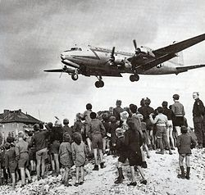
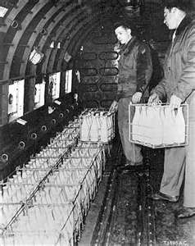
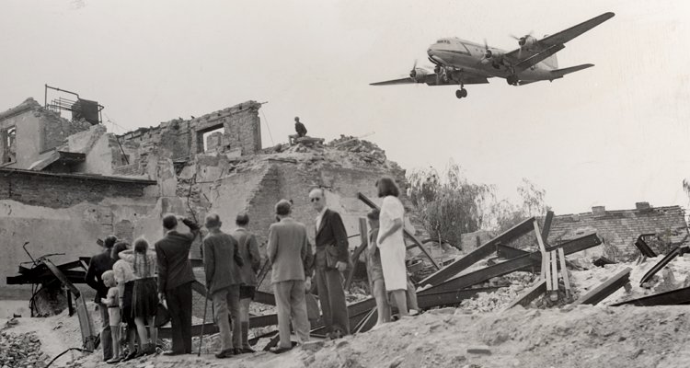
US flies food & supplies into Berlin for a year!
USSR gives up!
Who is winning the Cold War?

Slide 23
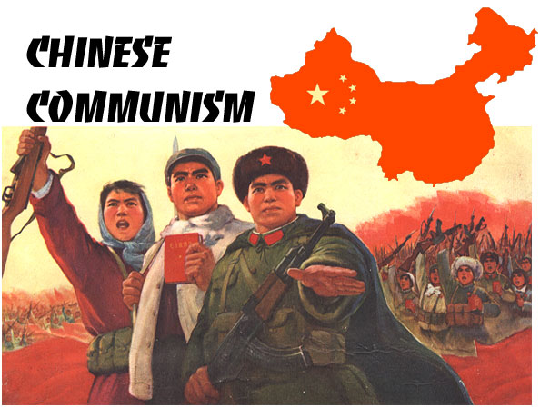
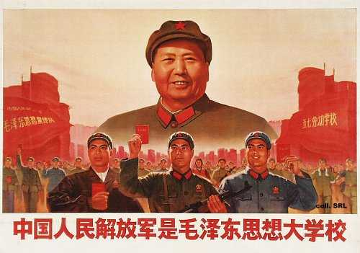
6. China
1949: Mao takes over China & makes it the People’s Republic of China

Slide 24
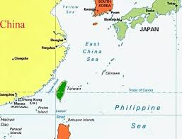
Nationalists / Non-commies
Taiwan
Called Republic of China
  Consider this the “real China”
  This will be the China in the UN until 1970s
Still some disputes today

Slide 25
Cold War Tally
Who is winning the CW?
Eastern Europe
Truman Doctrine
Marshall Plan
Berlin Airlift
China
Describe each event.
Who won?

Slide 26

USSR is to blame
Reason 1
Reason 2
Reason 3

Slide 27
What is communism?
What is the UN designed to do?
What does Stalin promise to do at Yalta?
Does Stalin keep his promise? Describe.
What is a satellite nation? Name 1.
What is containment?
What is the iron curtain?
Which side of the iron curtain would you want to live on? The west or the east? Why?

