Slide 1
HW: Docs
Was the New Deal a success or failure?
Annotate successes in 1 color
Annotate failures in another color
Complete chart @ end

Slide 2
On the left…
Who became the president in 1932 after Hoover?
What political party did he belong to?
What was the name of his program to help people?
Name 1 thing he did that helped people.

Slide 3
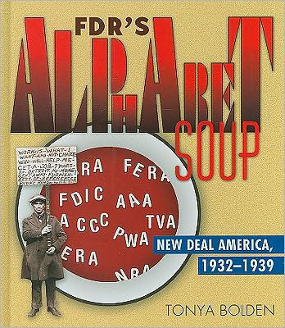
2. Helping the People
A. Rural Areas:
AAA: Agricultural Adjustment Act: 1933
Paid farmers to destroy crops & livestock / farm less --- less supply, increase prices
Controversial

Slide 4
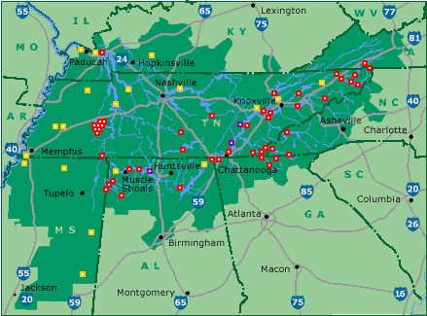
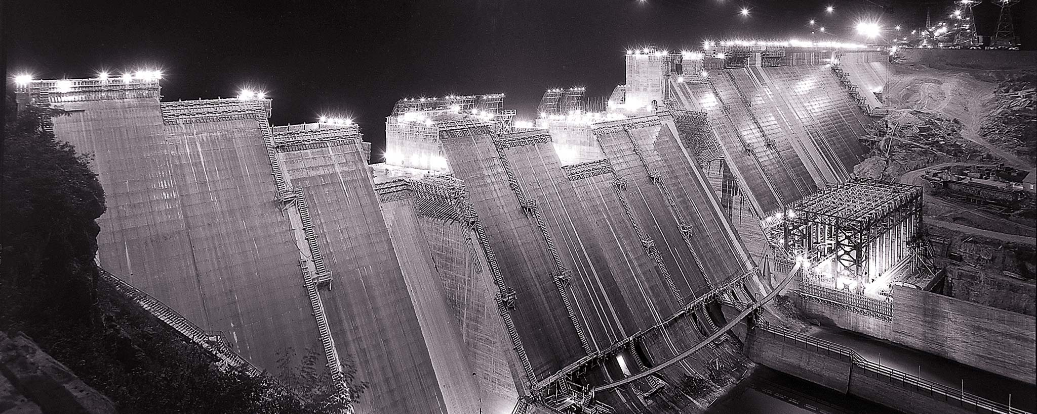
TVA: Tennessee Valley Authority: (1933)
Created dams, hydroelectric power for a poor area
Gov run company
Cheaper ---
Fair?

Slide 5
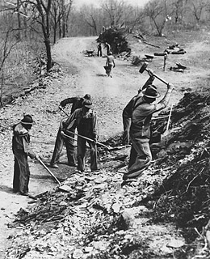
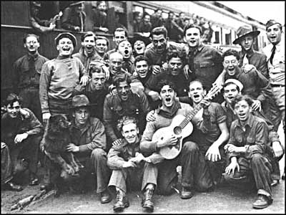
B. Jobs
CCC: Civilian Conservation Corps
Jobs for 18-25 men
Made parks, etc
Free room & board + small pay
CWA: Civil Works Administration
Built schools, roads
Expires
WPA: Works Progress Admin
1935-43, $11 billion

Slide 6
Great D #7: New Deal & Critics Match the org w/its description
AAA
WPA
SEC
FDIC
CCC
Regulate stock market
Protects bank deposits
Creates jobs for young men
Helps farmers
Creates a lot of jobs

Slide 7
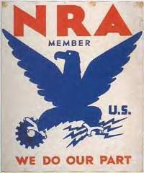
Continue #2
Nat’l Industrial Recovery Act (NIRA) : 1933
NRA: National Recovery Admin – oversaw businesses
Cut workers hours, regulates wages, quality
Allow unions
Creates PWA: Public Works Admin

Slide 8
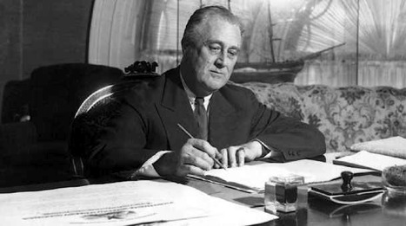
C. Immediate help!
FHA: Federal Housing Administration:
Loans to help ppl pay mortgages
FERA: Fed Emergency Relief Act
$500 million for food and cash

Slide 9
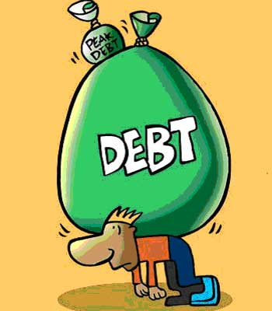
Criticism 1. How do you pay for this?
Deficit Spending: gov spends more than it has
Created debt
Promoted by John Maynard
Keynes aka Keynesian Economicd
** Did not end depression

Slide 10
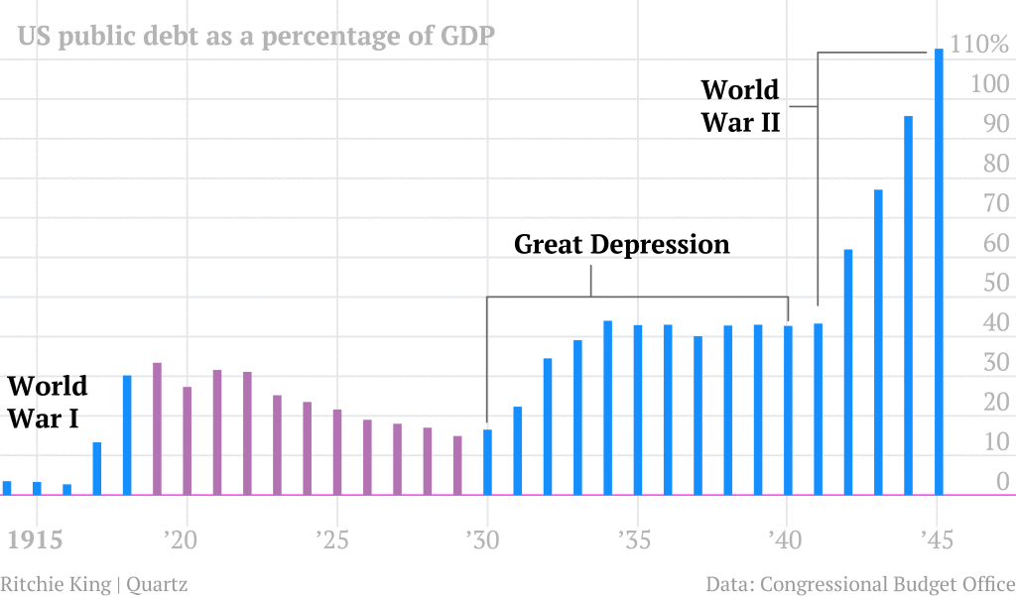
1. Look for highs/lows/trends 2. What can we infer about US debt?

Slide 11
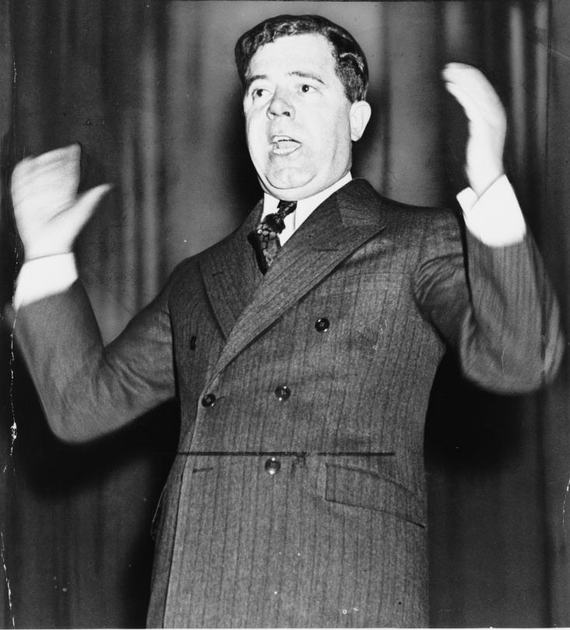
2. Not enough!
Huey “Kingfish” Long:
Share-Our-Wealth
Cap income at $50 million (approx $600 million today)
Heavy tax on those over $1 million
Ensure that every American gets $5000 & has a car, house, radio, etc.
What does this sound like?
“Every Man a King”
Assassinated in 1935
Do you like Huey Long’s ideas better than FDR’s?

Slide 12
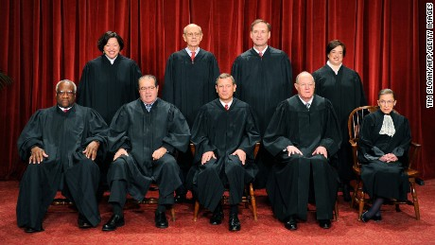
3. Supreme Court Reaction
Overturned some of FDR’s laws: NIRA, AAA
SO, FDR said he’d appoint (nominate) 6 new justices!
“Court Packing” – fill Court w/justices favorable to FDR
Couldn’t do it b/c public upset!

Slide 13
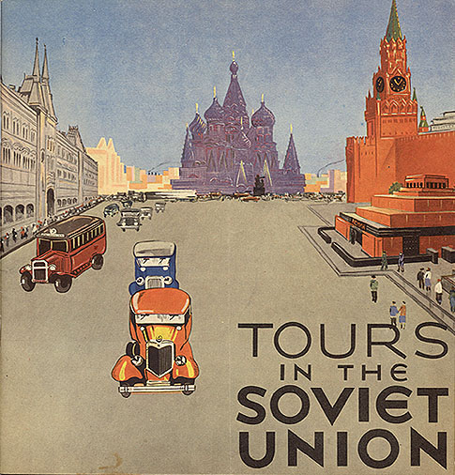
Around the world in the 1930s
Extreme gov’ts are forming – especially b/c of poor economies
Hitler gains power in 1933
Stalin, Mussolini, etc

Slide 14
Would you vote for FDR’s reelection in 1936?

Slide 15
Flashcards
Front: Name (Want a challenge? Put only the acronym) AND either a picture or scenario
BACK: Description of what it did and who it affected
12 Programs:
AAA / SEC / FHA/ FERA
FDIC / TVA / CCC / CWA / WPA
Fed Securities Act / Social Security / Fair Labor Standards Act

