Slide 1
WW2 #2: Neutral What does it mean to be neutral? Can a neutral country:
Provide supplies to one country but not another
Provide supplies to both sides
Provide refuge to those fleeing a war
Raise an army
Provide information to 1 country but not another

Slide 2
Merchants of Death
What is the thesis?
What evidence do they use to prove the thesis? List 4-5 things
What would happen if the Allies lost the war? How would that affect the US?

Slide 3
Post WW1
United States
The World
1922 Mussolini gains power = fascist
1931 Japan invades Manchuria
1933 Hitler gains power = Nazi / fascist
1935 Italy invades Ethiopia
Isolationism
Kellogg-Briand Pact (1928)
Neutrality Act (1935):
NO sell weapons to nations in war

Slide 4
1936 Germany puts troops in Rhineland
1936 Spanish Civil War
1937 J. invades China
1938 Ger. annexes Austria
1938: Munich Conf/ Sudetenland
1939: rest of Czech.
Neutrality Acts (1937):
NO sell weapons – even in civil war
Cash and Carry: nations could buy & transport items – not weapons
EX: gas
Sold to China – not declared war

Slide 5
1939: Invade Poland / war
1940: France falls
1941: Ger invades Russia
Neutrality Acts (1939)
Expanded cash’n’carry to include weapons
1940: draft (21-35)
1940: FDR 3rd Term
Lend Lease Act (3/41)
Lend weapons
Wolf Packs (1941)
Ger u-boats sink US ships of supplies
Is the US neutral by 1941?

Slide 6
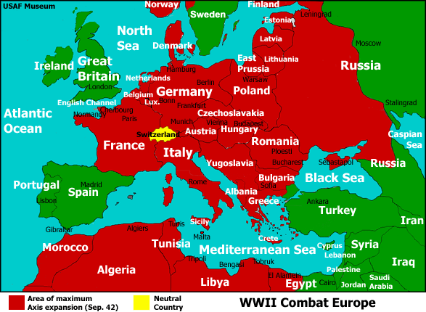
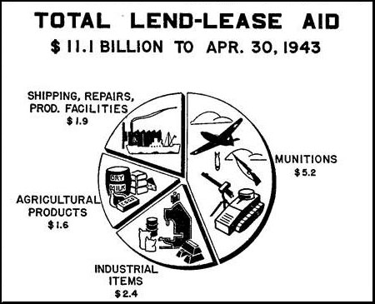

Slide 7
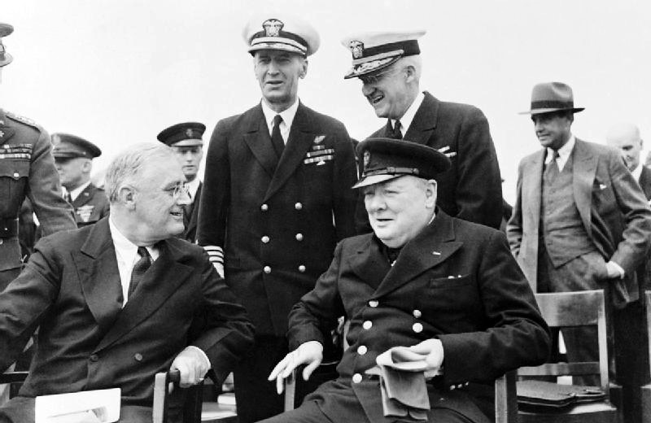
Atlantic Charter (8/41)
Agreement b/w Churchill & FDR
Goals for war & after war
“Shoot on sight” (9/41)
US ships can fire
Is the US neutral by late 1941?

Slide 8
What do you know about Pearl Harbor?
List as many things as you can on the LEFT

Slide 9
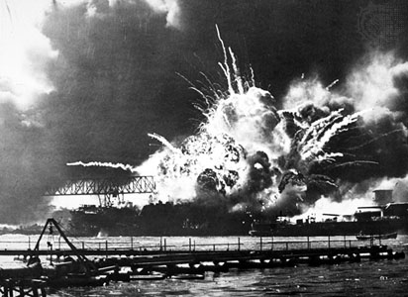

Slide 10
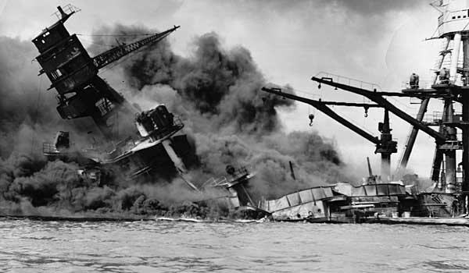

Slide 11
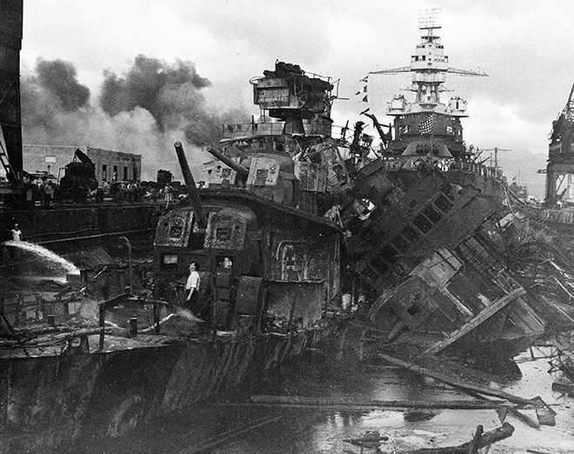

Slide 12
December 7, 1941
Sunday morning at 7:55
Pearl Harbor, Hawaii, a US Naval Base
Surprise attack by Japanese bombers
2,400 soldiers die
Destroy boats, planes, and other military supplies
1st attack on US soil since Civil War, worst attack until 9/11(kills 3,500 civilians)
“A date which will live in infamy”

Slide 13
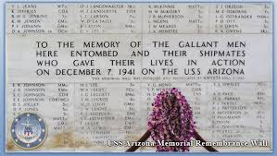
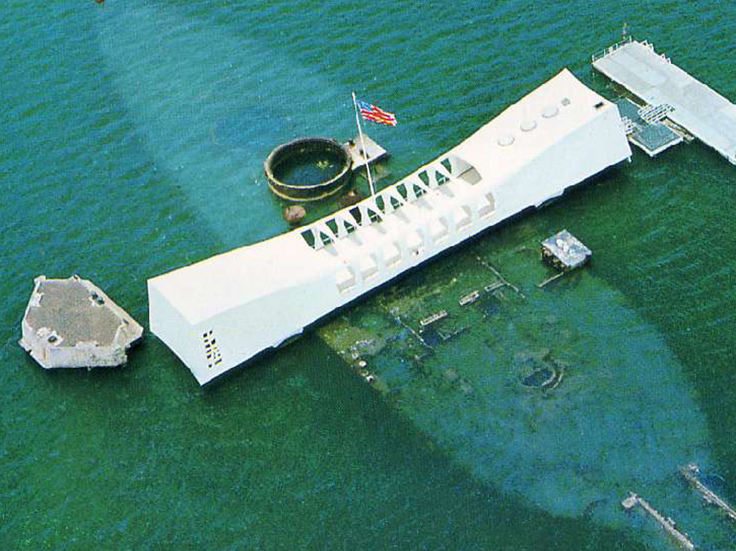

Slide 14
Compare & Contrast Pearl Harbor & 9/11/2001
Pearl Harbor
Similar
9/11

Slide 15
You have one suitcase.
What will you put in it?

Slide 16
For each document:
Evidence
Analysis: one per picture/letter on reading
Take notes on the document
Inferences (guesses, predictions)
Comparisons
Ask questions (why?)
Evaluate (was this the best way?)

Slide 17
Article
Pictures
12 word summary of what happened.
12 word reaction to what happened. (How did this affect Japanese people?)

Slide 18
Summary
Who, what, where, when, and why?

Slide 19
Pick one
Article
Journal
1 page (at least) description of what is happening to the Japanese on the West Coast.
Who, what, when, where, why, and how
Show both sides – Why was this order put in place? How are Japanese people reacting?
1 page (at least) description of what is happening to you as person of Japanese ancestry living in Santa Rosa, CA.
What was the order?
Where did you go?
What is life like in internment?
How do you feel?

