Slide 1
Answer on LEFT
Name 1 thing the Magna Carta did.
Who signed it?
Why were the nobles upset at the person who signed it?
Why does the document still matter 801 years later?
What is a revolution?

Slide 2
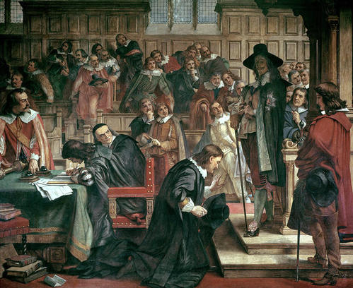
RofD #7: Glorious Revolution
Parliament
1295 – king needs money for a war w/France
  Asks nobles for consent, say yes!
  Begins idea of a Parliament: group that makes laws, gives out money & approves actions of the King

Slide 3
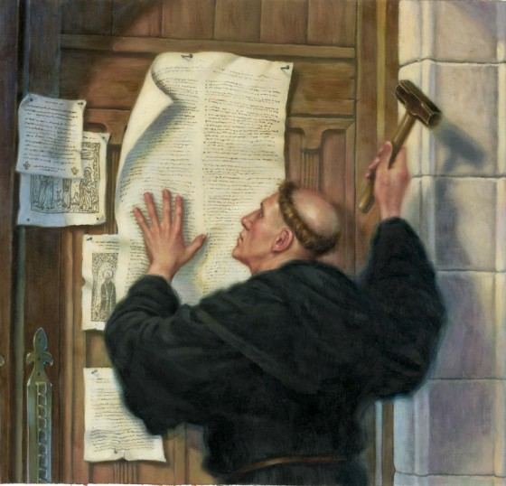
Catholic Church: Governed life across Europe
People who disobeyed – including kings – would be excommunicated : cut off from the Church
Reformation (reform Catholic Church)
  1500s – Martin Luther will criticize the Catholic Church
  Protestants (Protestors): leave Catholic Ch.
      Lead to many Christian groups – Lutherans

Slide 4
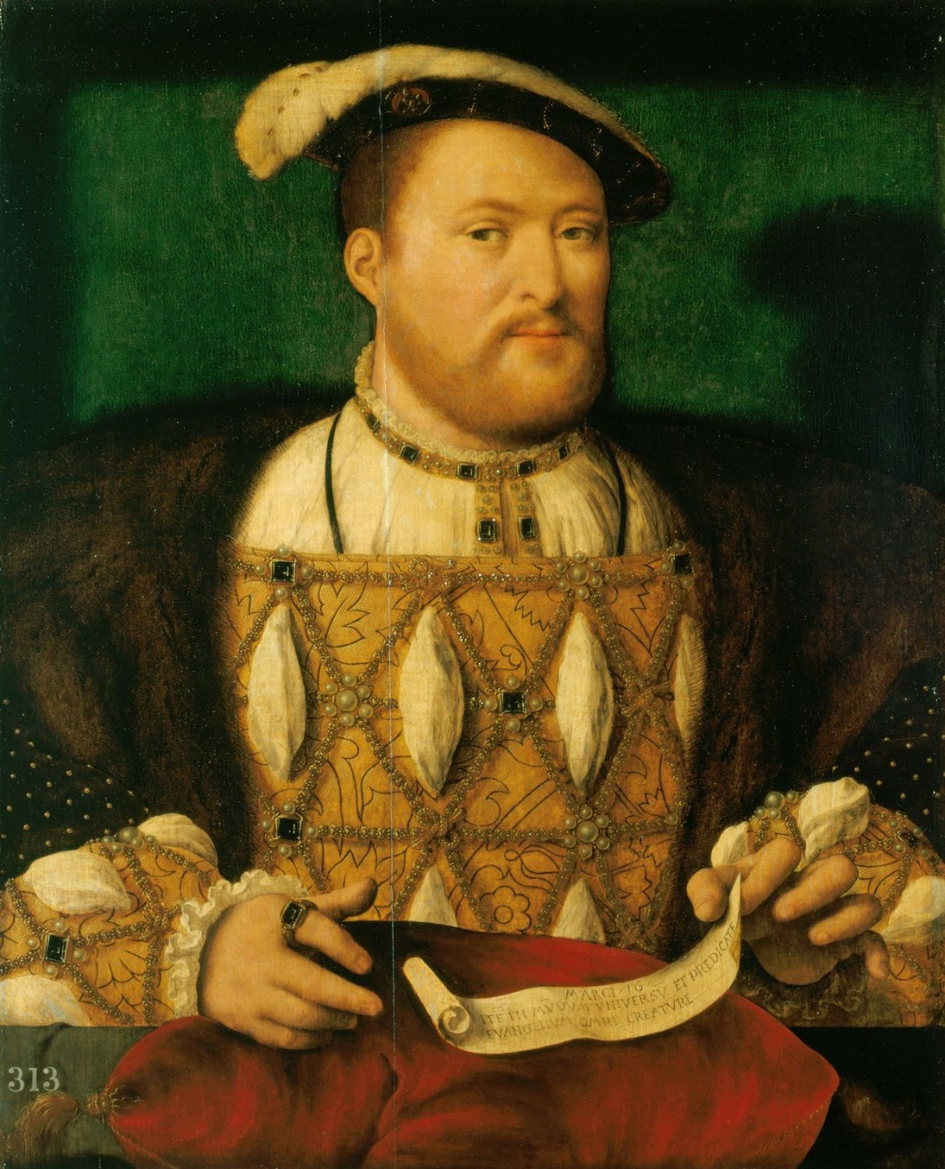
England
1500s – King Henry VIII (8)
  Asked Church to annul (end) his marriage – Pope said NO
  Started his own Protestant church
    Church of England or Anglican

Slide 5
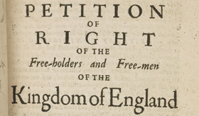
King Charles I (1620s)
Needed money for wars
  Parliament said – yes – IF you sign this:
    Petition of Right
      Can’t tax without Parliament’s consent
      Can’t imprison people illegally
      Cant force people to quarter (feed and house) soldiers

Slide 6
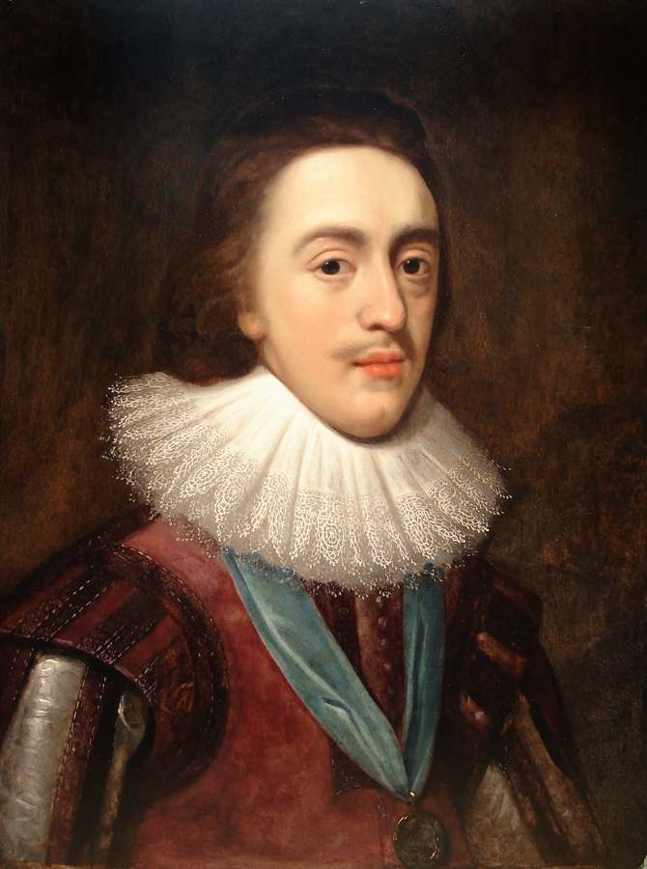
And then,
Charles ignores it, gets rid of Parliament, & taxes the people ☹
And then, he tries to get everyone to follow Anglican ways
Army is raised by Scottish (Catholic) and war is coming
English Civil War (1642-49)
  Charles will be tried & executed
  Monarchy will END!
  Popular new leader ---- who will turn into a dictator --- dies
    Monarchy returns

Slide 7
Restoration: bring back the King!
Things were so bad under the new leader who turned into a dictator, that people cheered with joy when the son of Charles I became the new king
But, Charles II had no son – who will be the next king?
  His brother – but his brother is a Catholic!

Slide 8
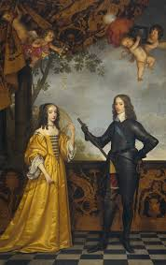
Royal Drama 1600s
Catholic king, James II, takes throne!
Protestants are worried SO Parliament offers throne to Protestants – daughter of the king married to a Dutch prince - IF they’ll obey their rules
  Would you take the deal?

Slide 9
Protestant couple – William & Mary – say YES!
  What should the James II do?
    Raise an army and fight
    Run away
    Give his daughter the throne nicely. Sharing is caring

Slide 10
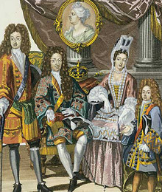
Glorious Revolution (1680s)
James II runs away – no war
“Bloodless Revolution” will create a new type of monarchy
  Constitutional or Limited Monarchy in England: powers of the king are restricted by laws of the country

Slide 11
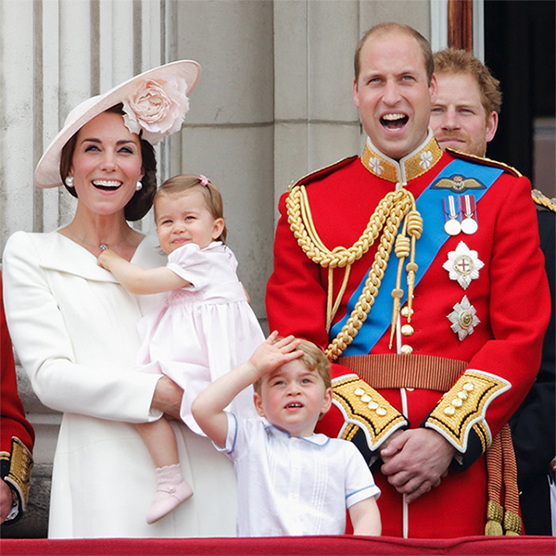
Monarchy is restricted by this new document:
English Bill of Rights: lists rights of people:
  Freedom of speech
  King can’t ignore laws
  No cruel & unusual punishment
British monarchy will be a limited
monarchy without a major war

Slide 12
On the left
Write 5 level one questions

