Slide 1
Storybook DUE WED 3/7
B/W Wars Quiz = 3/14
Test (approx.) 3/28

Slide 2
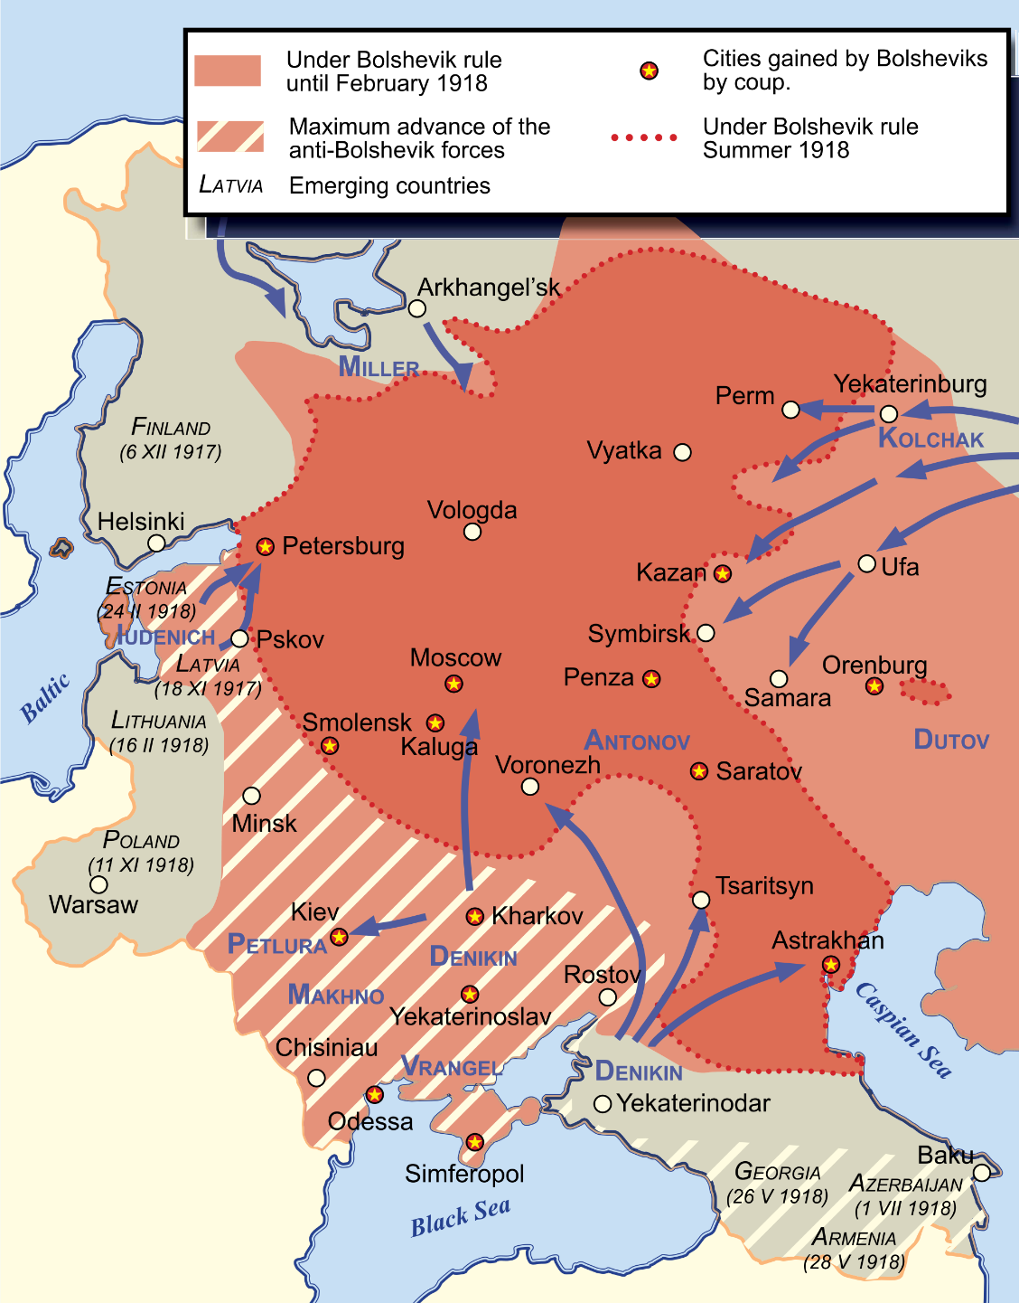
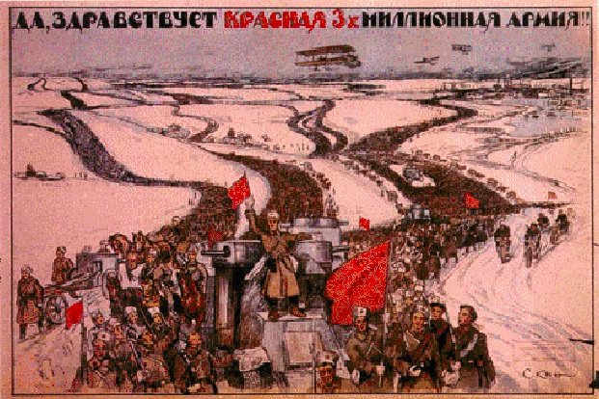
B/W Wars #4: Lenin and Economy War Communism
Drastic, communist measures taken by Lenin during the Civil War
All land is confiscated by the State (government) and redistributed (divided up) to all Russians.

Slide 3
Proclamation #1
Every Russian is ordered to serve as worker for the state.
Russians were essentially “drafted” into different jobs – not unlike the military

Slide 4
Proclamation #2
The State will produce everything. No one can produce anything without their permission.

Slide 5
Proclamation #3
“Bourgeoisie” were often executed – along with relatives, friends, any “supporters” OR sent to prison camps

Slide 6
Proclamation #4
Any extra food grown by the farmers will be taken by the state and redistributed.
Farmers were allowed to keep what they needed to survive and the rest was taken.

Slide 7
Proclamation #5
All food is rationed. It will distributed based on one’s job. Manual workers in dangerous jobs receive the most and those working in professional jobs receive the least.

Slide 8
Economic Advisors
What do you tell Lenin?
Keep doing what you’re doing. Communism is a success!
Make some minor changes. Communism is ok.
Make some major changes. Communism is a failure!

Slide 9
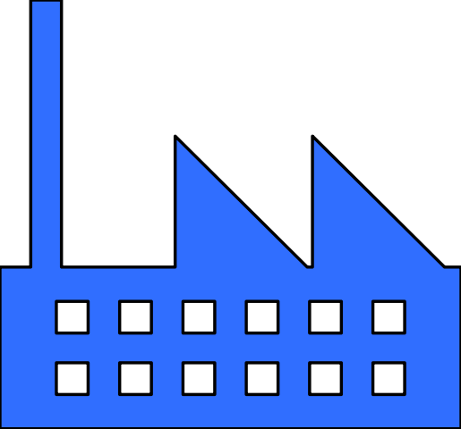
New Economic Policy: Lenin changes economic system
Farmers can keep much of their extra food & SELL it! (What does this sound like??)
Gov keeps control of major industries

Slide 10
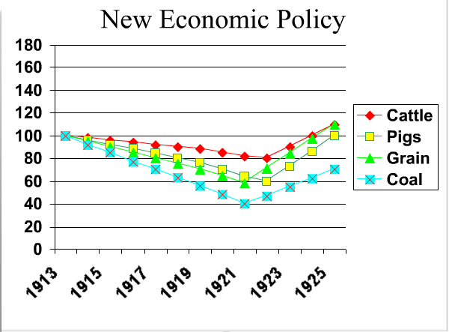
How did the NEP affect the economy?
What years have the lowest amount of production?
Which years have the highest production?
What is the overall trend seen in this graph?

Slide 11
Quiz your neighbor / Real Quiz ---- next T/W
Who was the last czar of Russia?
Describe Bloody Sunday. How does it start / end?
Describe February Revolution. How does it start / end?
Describe October/Bolshevik Revolution. How does it start / end?
What did Russia change its name to?

