Slide 1
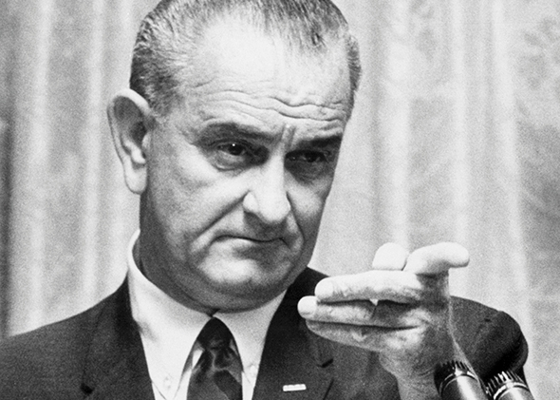
1960s #2 Great Society
**You will have class time on Thurs to work on rough draft of research paper / community service reflection **

Slide 2
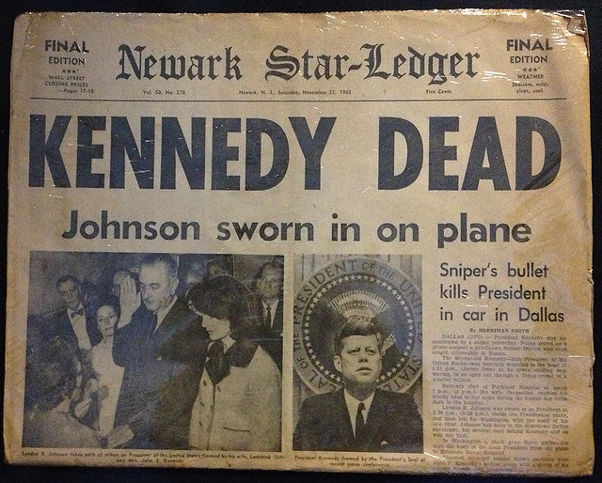
Who shot John F. Kennedy?

Slide 3
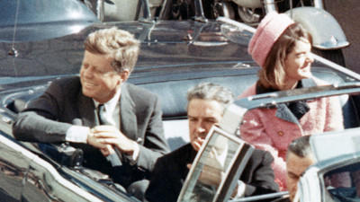
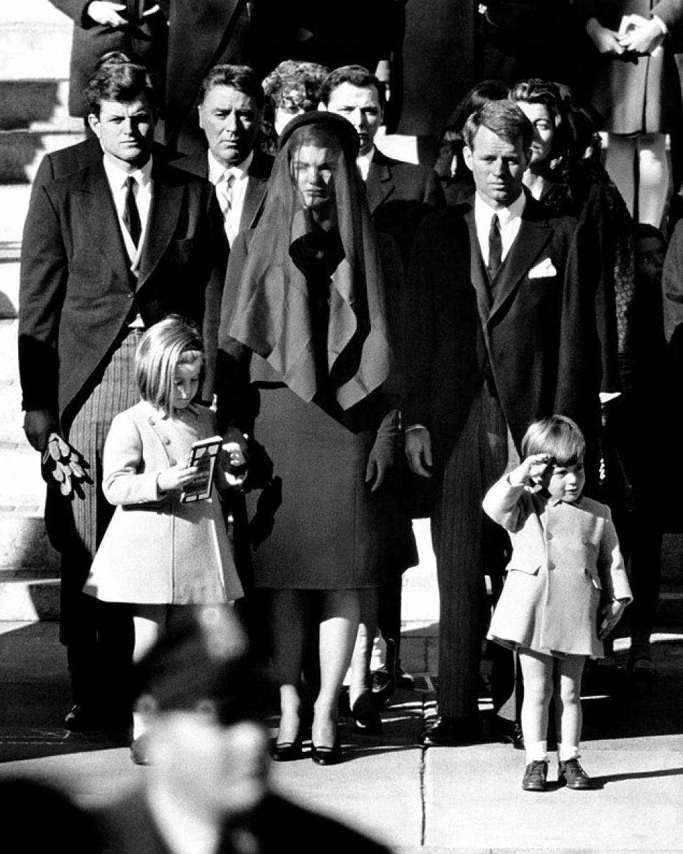
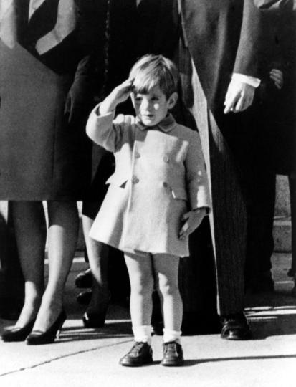
Death
Nov 22, 1963 - Dallas
Parades in a top down convertible
Shots fired – he dies
Lee Harvey Oswald is arrested
Shot & killed by Jack Ruby
Questions remain about his death

Slide 4
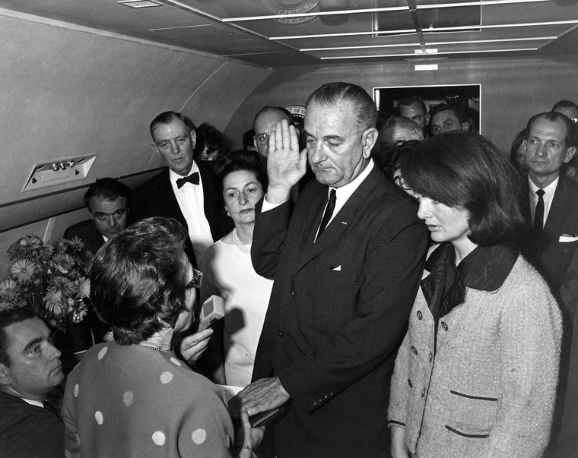
LBJ: Lyndon Baines Johnson

Slide 5
War on Poverty
Head Start: early education for low income kids
32 million served / 1 million a year
Tax Cut: individual top rate: 90 – 70%
Businesses: from 52 – 48%
Pushed through some of JFK’s agenda

Slide 6
Trump’s Tax Cut Corporate Tax Cut: 35 – 21% (Permanent)
Income Tax Rate Ends in 2025 |  | Income Levels for Those Filing As:
2017 | 2018-2025 | Single | Married-Joint
10% | 10% | $0-$9,525 | $0-$19,050
15% | 12% | $9,525-$38,700 | $19,050-$77,400
25% | 22% | $38,700-$82,500 | $77,400-$165,000
28% | 24% | $82,500-$157,500 | $165,000-$315,000
33% | 32% | $157,500-$200,000 | $315,000-$400,000
33%-35% | 35% | $200,000-$500,000 | $400,000-$600,000
39.6% | 37% | $500,000+ | $600,000+

Slide 7
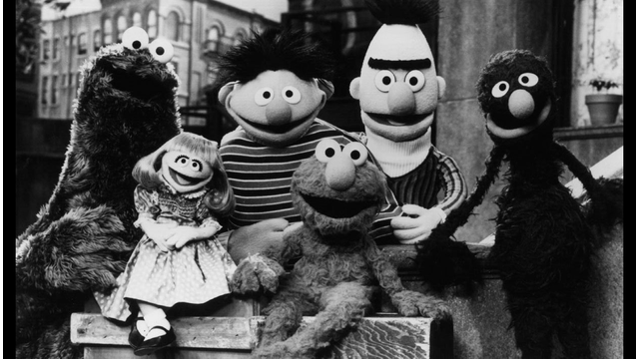
Great Society: LBJ’s term to improve US
Health care:
Medicare: heath insurance for elderly (pay into)
Medicaid: health insurance for low income
Gave $1 billion to schools
Nat’l Endowment for the Arts - $$$ to art & artists (dance, sculpture, etc)
PBS – supports educational TV
Sesame Street

Slide 8
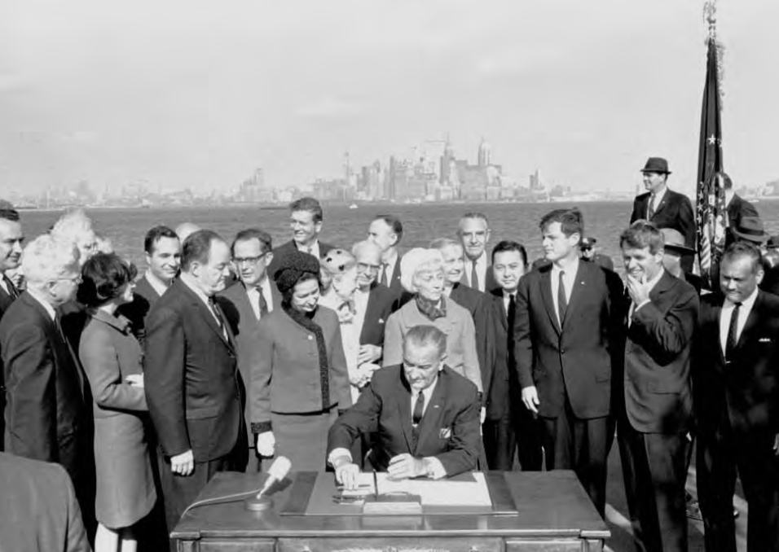
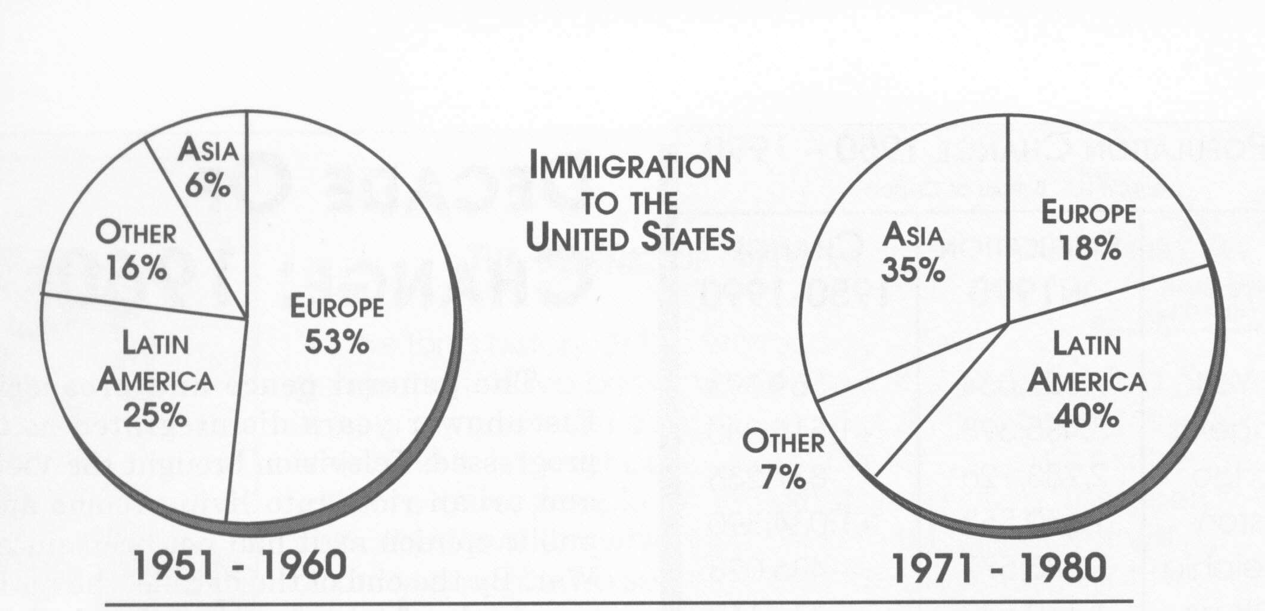
Immigration
Immigration Act of 1965-
Ended quotas based on nation of origin (set in 1920s)
Allows ppl from places other than Western Europe to immigrate
Allowed family to immigrate easier

Slide 9
“Chain Migration”
Family reunification was a goal of 1965’s Immigration Act – allows people to bring close relatives with them
Today, Trump would like to end what he calls “chain migration” and limit it to only spouses and children – not grandparents, etc.
Good idea?

Slide 10
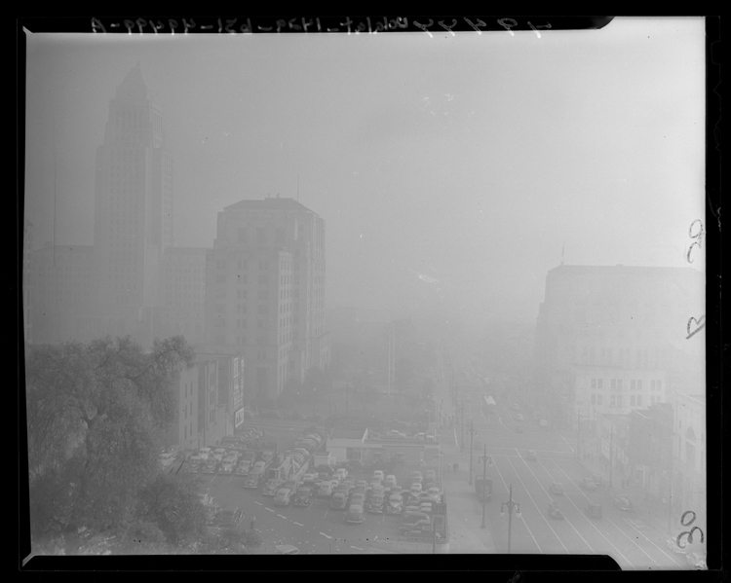
Environment
Rachel Carson’s Silent Spring
Air Quality Act: improve air / reduce pollution
Water Quality Act – clean up water
Clean Air Act – again, reduce pollution
Los Angeles in 1960s

Slide 11
On back:
Which two programs do you think are the most important? Explain why.
Which two programs do you think are the least important? Explain why.

Slide 12
Government Funding Speed Dating Pick 1 program (from today’s notes) that you think government should continue to fund or immediately defund.
Write an introductory paragraph explaining what program you are looking into and why it is important to you. You can use first person!
Write two persuasive paragraphs describing the importance to either fund or defund the program. Use at least one statistic from the charts given in class or google one of your own. If you google, include the source.
Include a chart or graph. (Be sure to include its title and source).
Write one closing paragraph thanking them for their time and asking one more time for them to act on your behalf.
PRINT!
You will present this to your classmates in a one-on-one speech in which you will try to convince them to vote for your position.
Be prepared to answer questions from the people you present to.

