Slide 1
DUE: 3 sources All Parts of Paper = 10% of grade
11/28 Today! | 11/29 Research on 3 sources DUE | 11/30 | 12/1 Thesis & Outline DUE | 12/2
12/5 | 12/6 Rough Draft & 2 Sources DUE | 12/7 | 12/8 1920s Quiz – DELETE | 12/9
12/12 | 12/13 Final Draft DUE | 12/14 | 12/15 | 12/16
12/19 Per 1-6 | 12/20 Finals 3 & 4 Release @ 12:22 | 12/21 Finals 5 & 6 | 12/22 Finals 1 & 2 | No School / End of First Semester

Slide 2
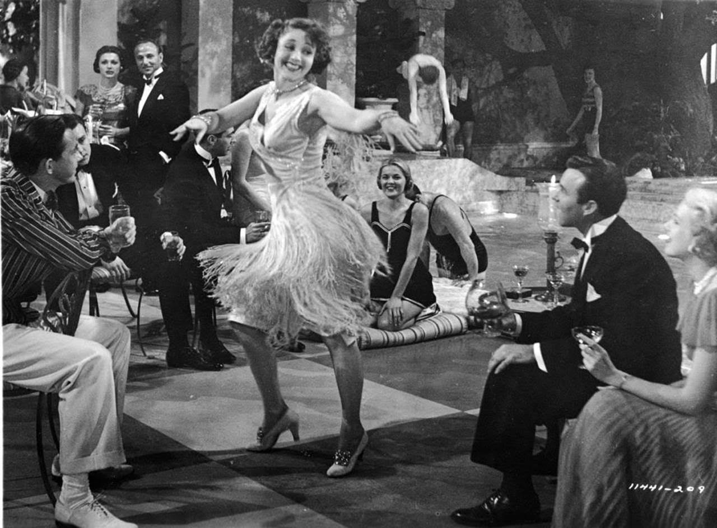
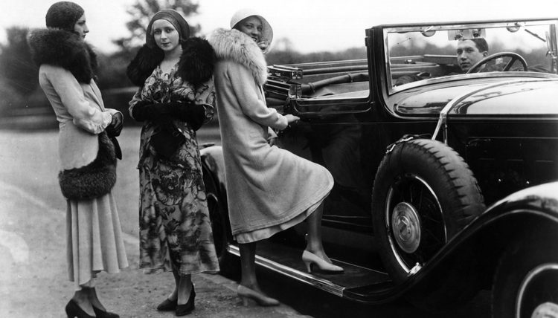
1920s #2: Normalcy
Are the 1920s roaring (modern, progressive, freeing) or restraining (limiting rights, holding people back)?

Slide 3
Roaring or Restraining?
Roaring
Restraining
IDK

Slide 4
Woodrow Wilson negotiated:
Treaty of Versailles:
Germany: pay reparations, limit military, claim war guilt
League of Nations: organization for countries negotiate problems & keep the peace
All treaties must be ratified (approved) by 2/3 of Senators
The LofN proved to be a sticking point

Slide 5
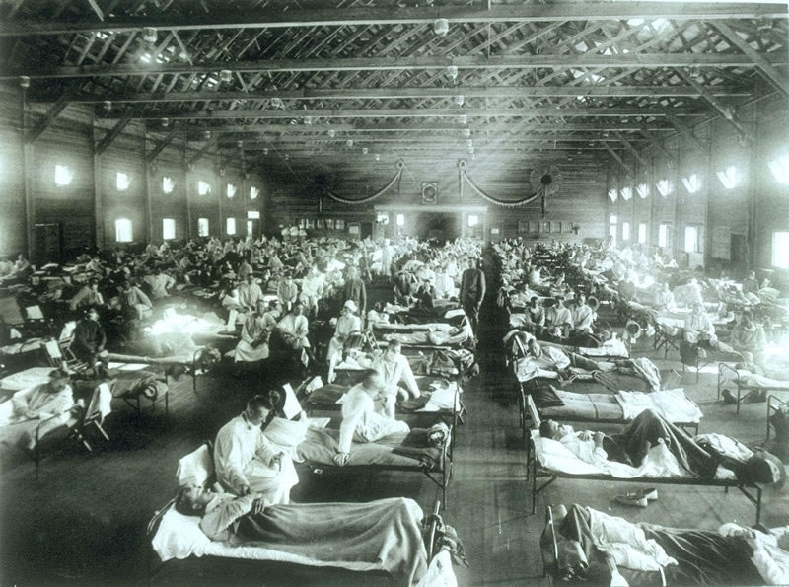
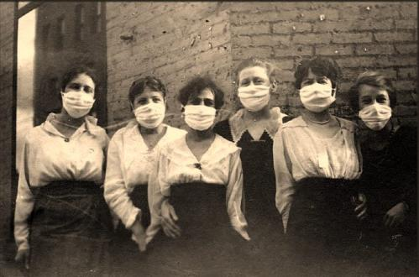
End of 1910s Flu Epidemic
1918 – 20 million world wide will die from the flu – more than in WW1
It spread fast and ended fast
In 1 day in 1 U.S. town = 1,000 died from the flu

Slide 6
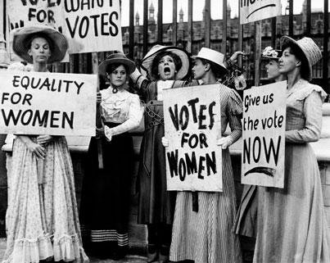
19th amendment (1920): women’s suffrage
State by state suffrage: Western states said YES
Const. Amendment –
Pushed during WW1
Hunger strikes in prison

Slide 7
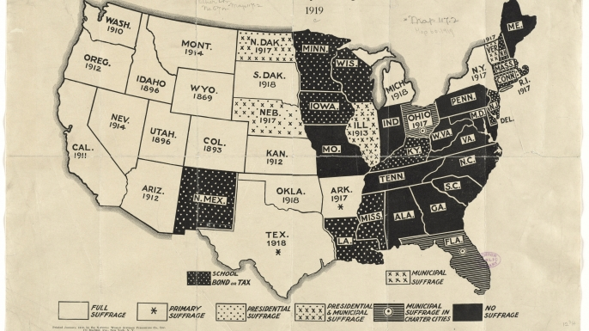

Slide 8
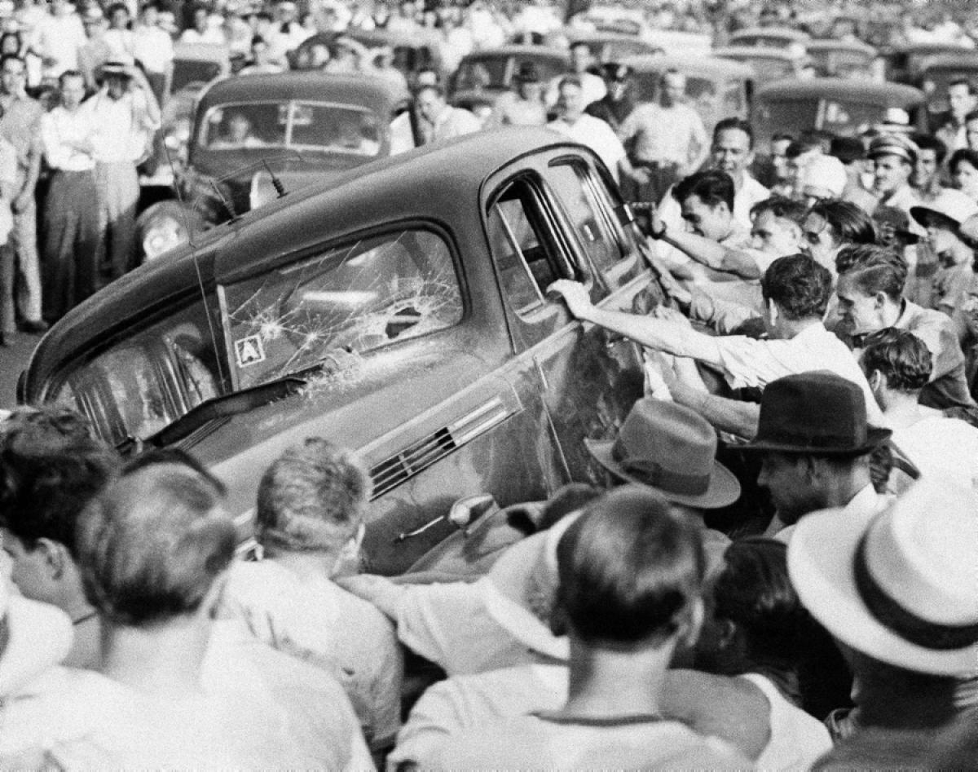
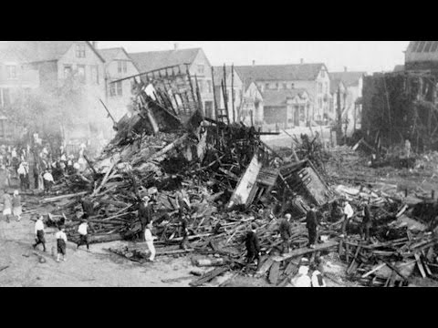
Riots
Men return – replace workers – women, immigrants, African Americans
Chicago Race Riots 1919:
17 year old Af Am swimming – drowned
Sets of days of riots & violence:
38 die
1000 Af Am homes destroyed

Slide 9
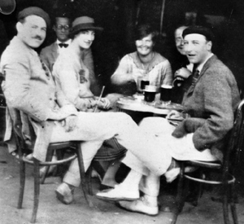
Disillusionment: disappointment that world isn’t what you thought
For many returning vets – how do go back to normal?
“Lost Generation” writers transformed by their war experiences – Hemingway, Fitzgerald, others
Expats: leave US, live in Europe, often Paris

Slide 10
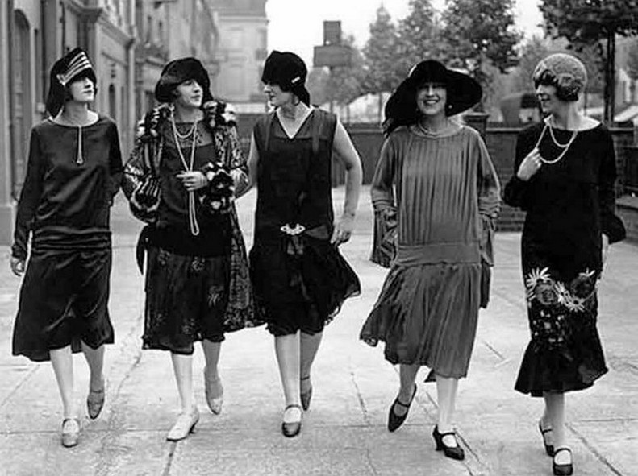
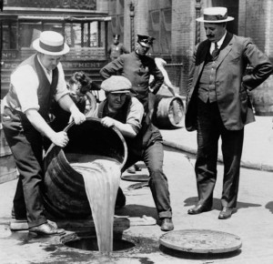
1920:
Warren G. Harding will run for Pres calling for “normalcy”: desire to return to regular life after WW1
But, the 20s will be anything but normal!

Slide 11
How do you return to normal after such a war? And, does everyone want to?

Slide 12
Tender is the Night by F. Scott Fitzgerald
“See that little stream — we could walk to it in two minutes. It took the British a month to walk to it — a whole empire walking very slowly, dying in front and pushing forward behind. And another empire walked very slowly backward a few inches a day, leaving the dead like a million bloody rugs. No Europeans will ever do that again in this generation.”
What is he saying? Paraphrase this quote.
What is the tone (emotion) of this piece?

Slide 13
Who’s right? Wilson or Lodge?
Pick a side and give 3 good arguments for your opinion.
You can use more modern day examples (things that happened after this time period).

Slide 14
Debate Rules
Listen.
Be open to changing your mind.
Be respectful.
Be critical of ideas, not people.
No name calling.

Slide 15
Debate Debrief
Who is right? When should the US get involved and when should it stay out? What arguments did you agree/disagree with or wanted to make but didn’t?

Slide 16
TofV
After the deadliest war of all time
US becomes isolationist: stays out of foreign affairs
US Senate rejects Treaty of Versailles
Does NOT join League of Nations

Slide 18
1920s #2: Changing Times
Topic: Use written words to guide you
What do you know about this topic?
What does this picture show you?
What questions does it leave you with?

