Slide 1
Great Dep. #3: Effects
When did the Depression start? Nickname for the date and exact date.
Name 2 long term causes.
What is this an example of :
$1 toy + 10 cent tax = 1.10
$1 toy + no tax = 1.00

Slide 2
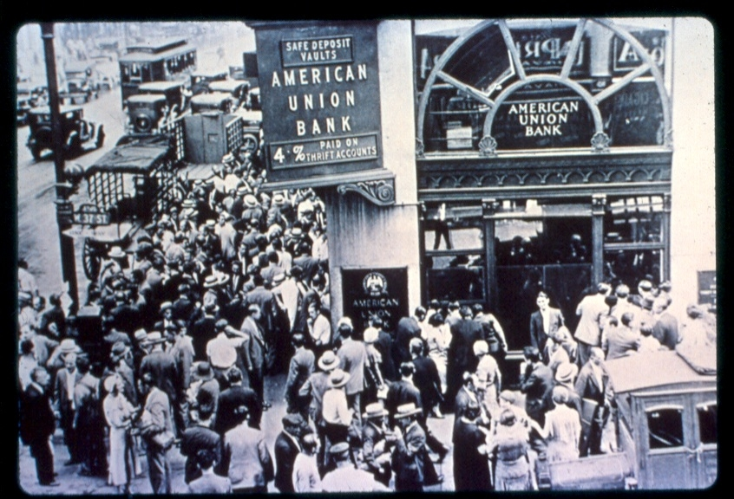
Immediate Effects
“Run on the Banks”
Banks invested in Stock Mkt
Over 40% failed =
9 million savings

Slide 3
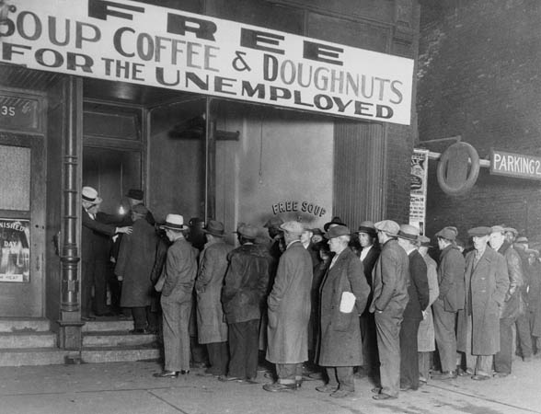
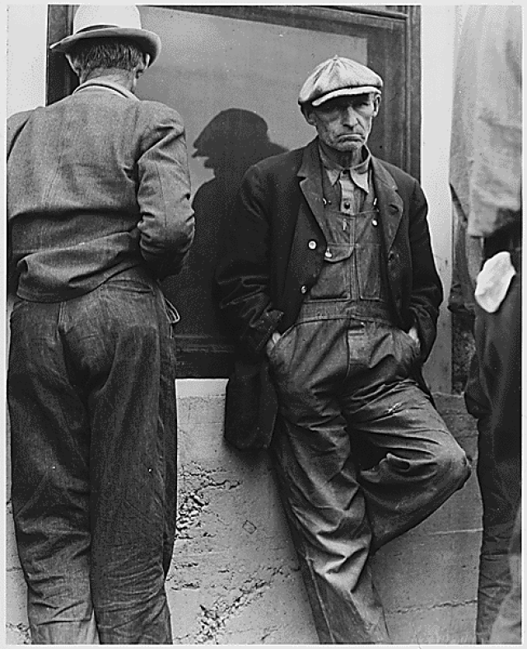
2. Businesses fail
Demand down – production down – decrease workers – decrease in demand – production decrease – decrease workers – cycle repeats – (how do you stop this cycle?)
3. Unemployment skyrockets to 25%

Slide 4
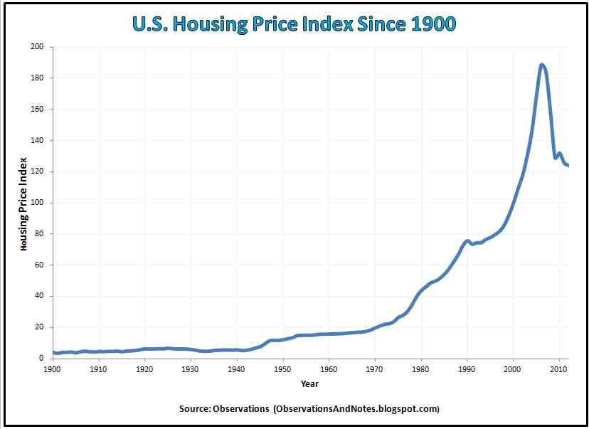
Trend or high /low?
What does this tell us?

Slide 5
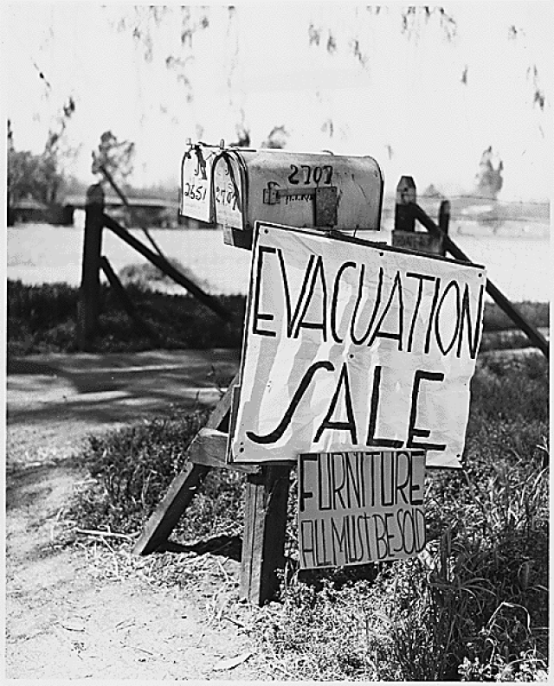
4. Homes
Foreclosure: bank takes house if can’t pay mortgage
Shantytowns : homeless camps

Slide 6
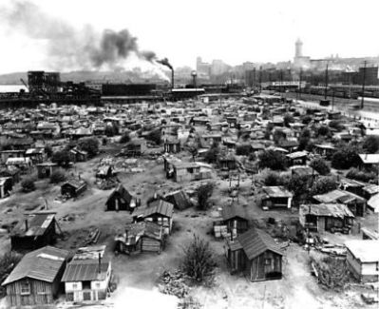

Slide 7
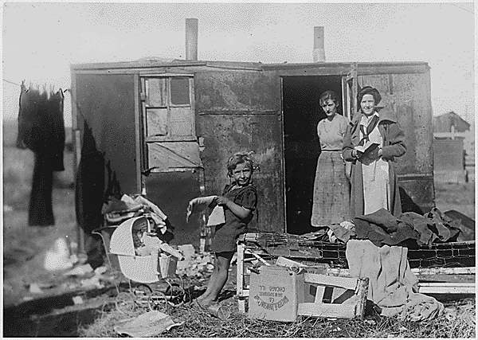

Slide 8
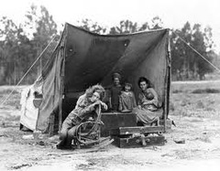
Describe shantytowns.

Slide 9
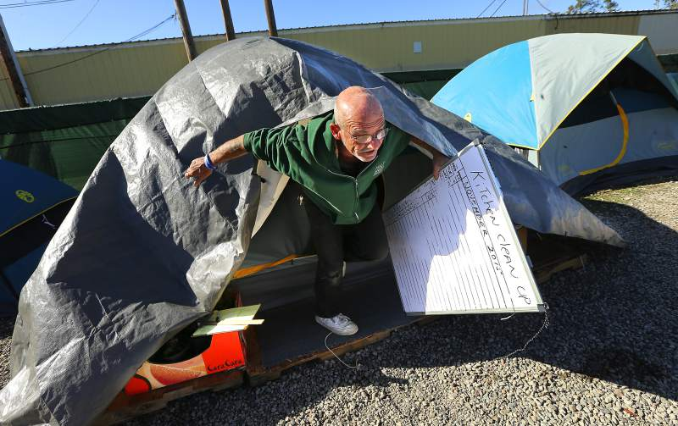
Camp Michela – Homeless camp in Roseland – trying to get help for homeless
Camp Michela

Slide 10
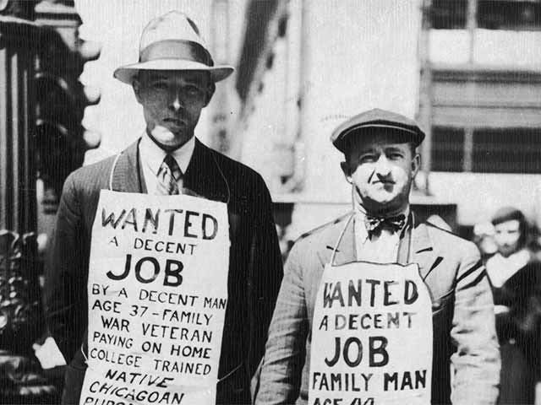
More effects of the Great D.
Kids went to work
Women / ethnic minorities – seen as “taking jobs”
Deported, pushed out, discrimination, lower pay
African Am unemployment was 50%
Increase in crime

Slide 11
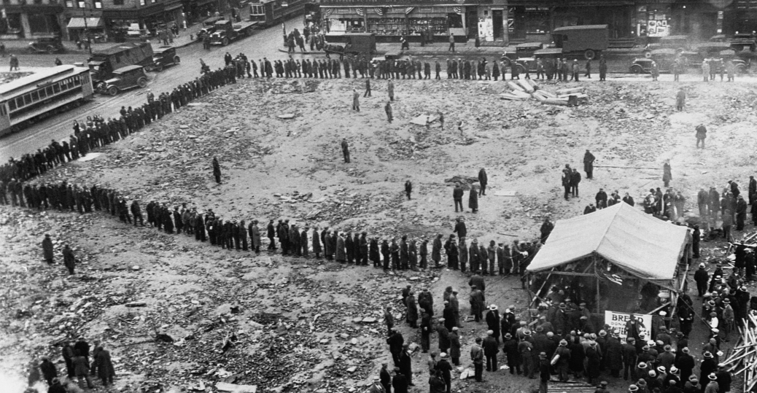
What do you do?
Bread Lines & Soup kitchens – ppl provide food for hungry
No direct relief

Slide 12
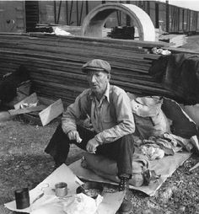
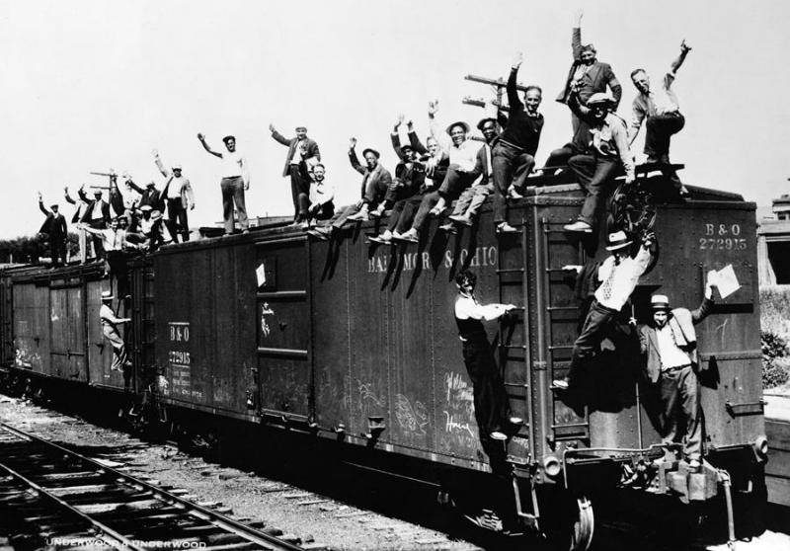
What do you do?
Migrate (move)
“Wild boys” – wanderer
–”Hobo”- Wanderer
*maybe ride the rails looking for a better place
*Nearly 25,000 people will DIE riding the rails

Slide 13
A PERSONAL VOICE: THOMAS WOLFE:
“ These were the wanderers from town to town, the riders of freight trains, the thumbers of rides on highways, the uprooted, unwanted male population of America. They . . . gathered in the big cities when winter came, hungry, defeated, empty, hopeless, restless . . . always on the move, looking everywhere for work, for the bare crumbs to support their miserable lives, and finding neither work nor crumbs.”

Slide 14
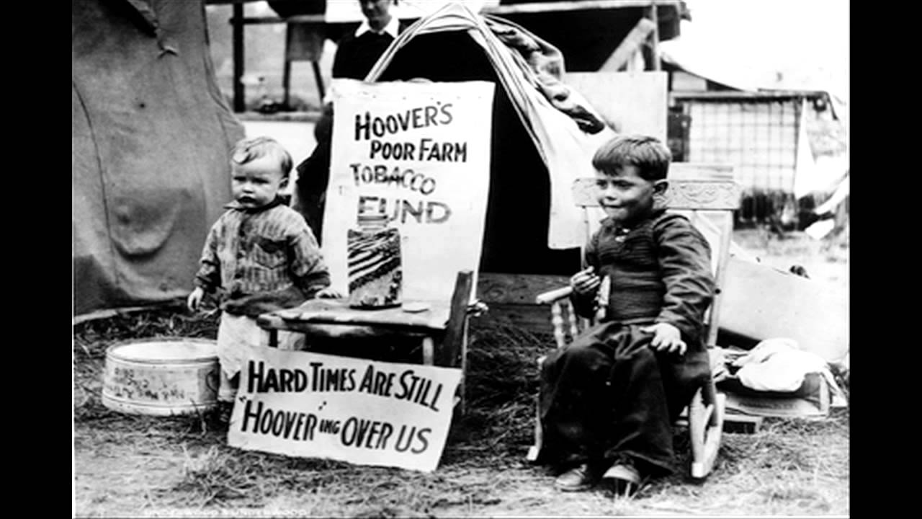
Look to Gov
Pres Herbert Hoover
“Rugged individualism”
Ppl felt like he just didn’t care! Blame him!

Slide 15
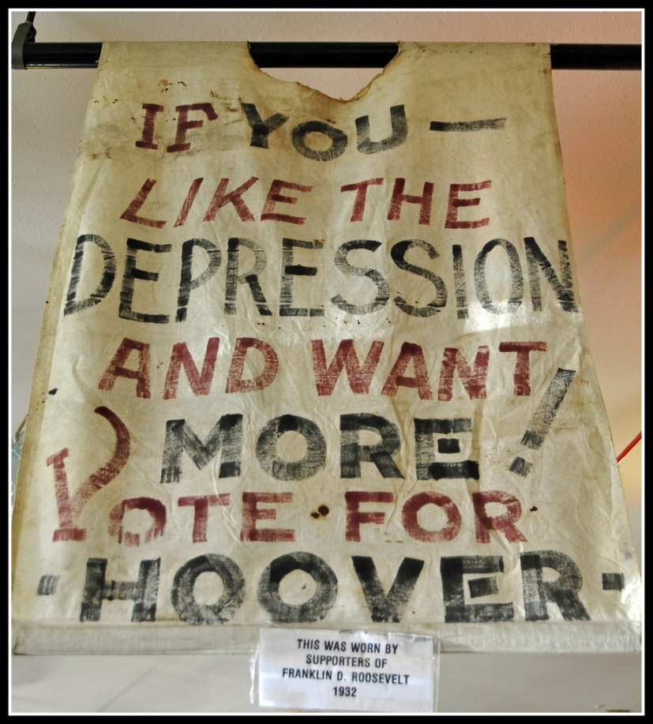
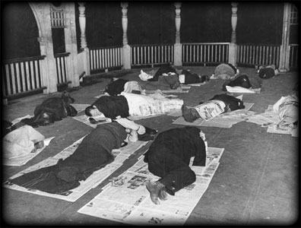
Renamed Shantytowns = Hoovervilles
Newspaper = Hoover blanket
Empty pocket = Hoover flag

Slide 16
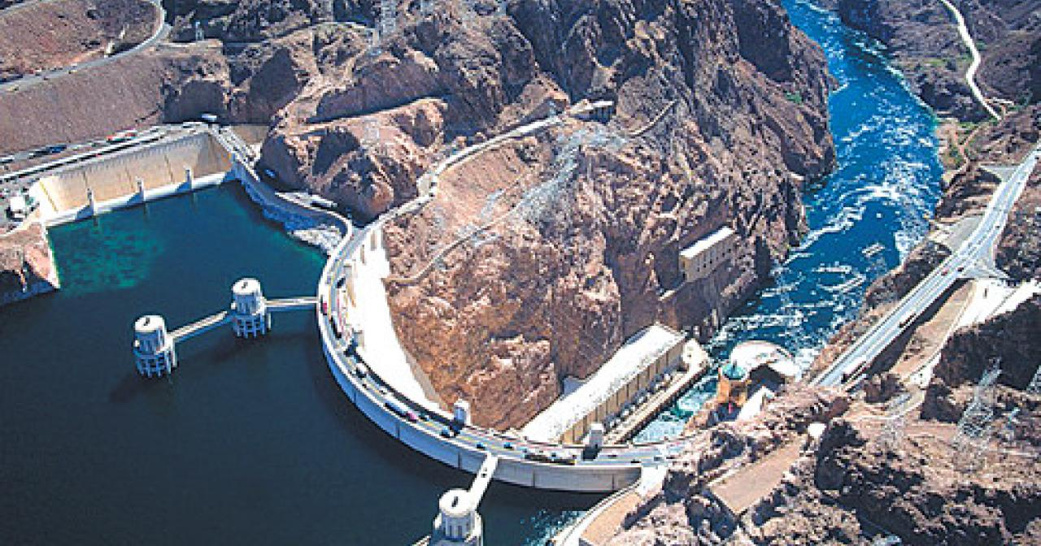
Did he do anything?
Boulder Dam aka Hoover Dam
Massive construction project in Nevada
Made a lot of JOBS!

Slide 17
Anything else??
Federal Home Loan Bank Act – allowed ppl to lower mortgages & keep homes
Reconstruction Finance Corporation – gave loans to big businesses – hope to keep them in business & keep hiring people
“Millionaire’s Dole”
**Will that work?**

Slide 18
Add 5 Level 1 questions
Forgot what level 1 means? Go to the front of your notebook

Slide 19
Discussion
Create 3 questions about the article
Can ask clarifying questions like – what do you think the author meant by….?
Ask at least 1 level 2 or level 3 questions
Put each question on a separate scratch paper and add your name to each

Slide 20
According to a recent Washington Post article…
The seven top characteristics of success at Google are all soft skills: being a good coach; communicating and listening well; possessing insights into others (including others different values and points of view); having empathy toward and being supportive of one’s colleagues; being a good critical thinker and problem solver; and being able to make connections across complex ideas.

Slide 21
On a separate sheet of paper
Write a paragraph defining the Great Depression and describing what you believe are the top 2 reasons for why it happened. Explain each reason that you choose and how it affected the Great Depression.
Attach this to article
Due today / Tuesday

Slide 22
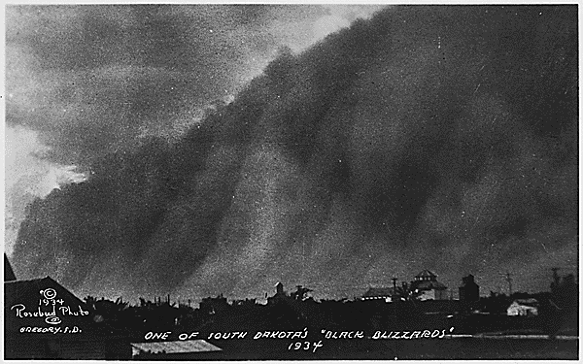
Great D #5: From Bad to Worse
Dust Bowl: when drought begins in Great Plains and winds pick up, dirt will blow threw the region for years
Black Blizzard

Slide 23
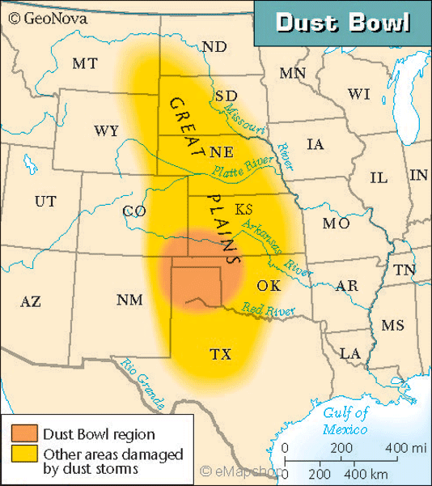
What states were affected by the dust storms?

Slide 24
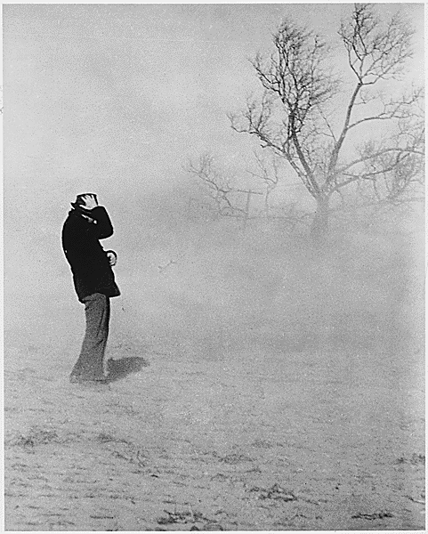
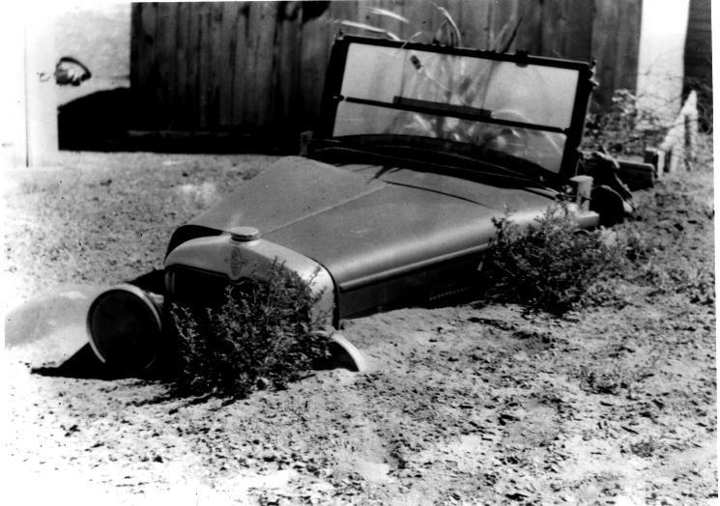
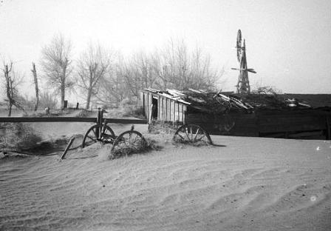

Slide 25
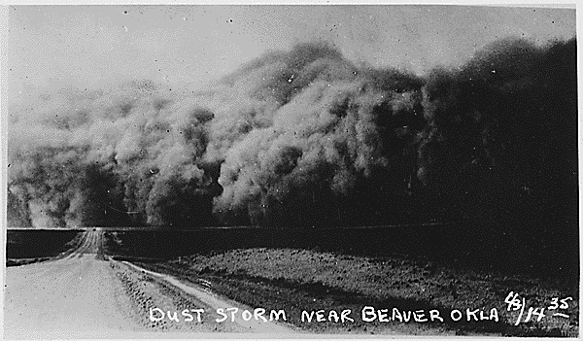

Slide 26
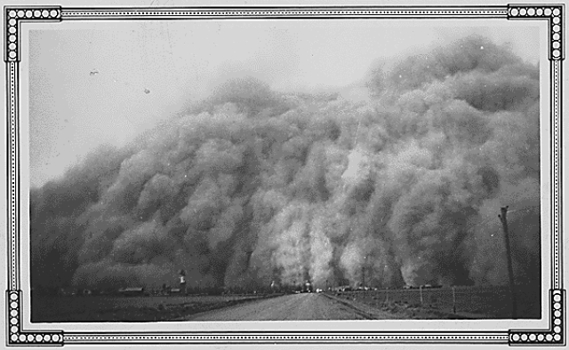
Describe the Dust Bowl.

Slide 27
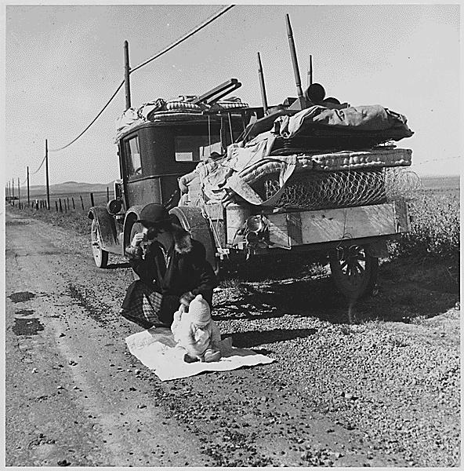
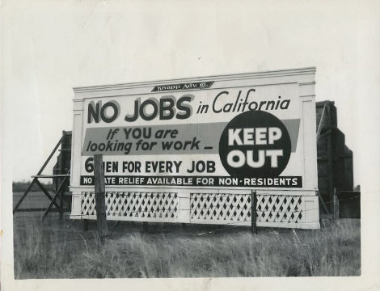
Can’t grow in sand w/o rain
“Oakies” (ppl leaving Dust Bowl) came to CA & elsewhere
Not welcome – no one wanted more competition for the very few jobs available

Slide 28
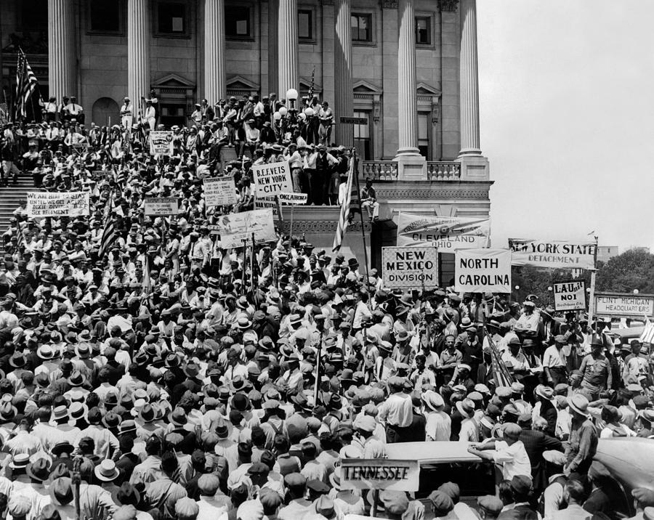
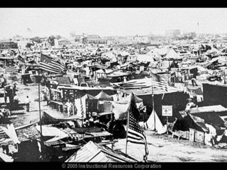
Protest!
Bonus Army March (1932)
WW1 Vets promised a “bonus” – in 1945!
Need it now!
Protest in Wash DC
20,000+ gathered for months!

Slide 29
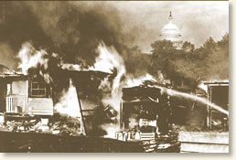
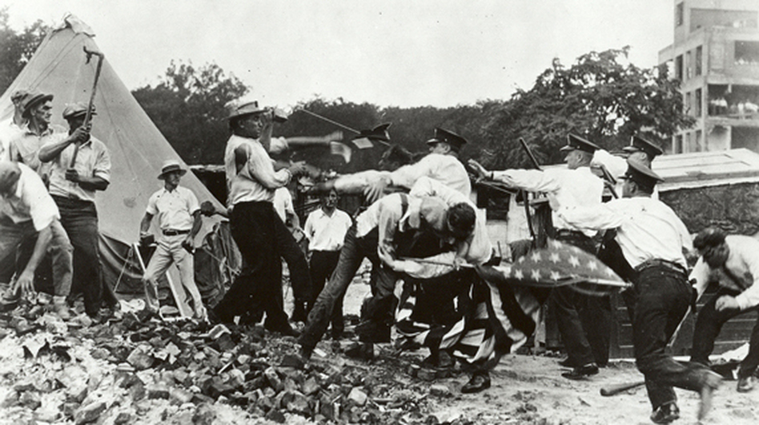
President Herbert Hoover orders men to evacuate
Violence – 3 deaths
Set camp on fire

Slide 30
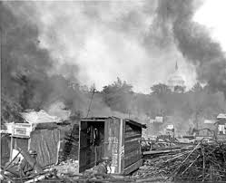
How will America react to this? On the side of the marchers or the government?

Slide 31
What are the 5 biggest problems and how do you fix them?
Problem
Solutions

