Slide 1
Which of these jobs did women perform during WW2?
physicist
pilot
postal carrier
radio engineer
riveter
scientist
shell assembler
shipfitter
taxi driver
telegraph
traffic cop
train porter
aerodynamic engineer
aircraft spotter
architect
Astronomer
barber
baseball player
bus driver
butcher cargo
Loader
chemist
crane operator
draftsman drawbridge
Electrician
fire fighter
flash welder
garbage collector
geologist
lumberjack
maintenance worker
mathematician
mechanic
messenger
meteorologist
milkman

Slide 2
Volunteer or Paper?
Volunteer ideas – see Ms. Moreno in CCC

Slide 3
WW2 #5 Total War
Final draft of your essay is due to turnitin.com by 11:59 pm

Slide 4
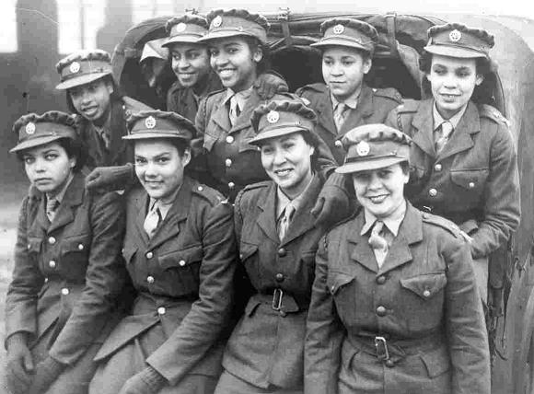
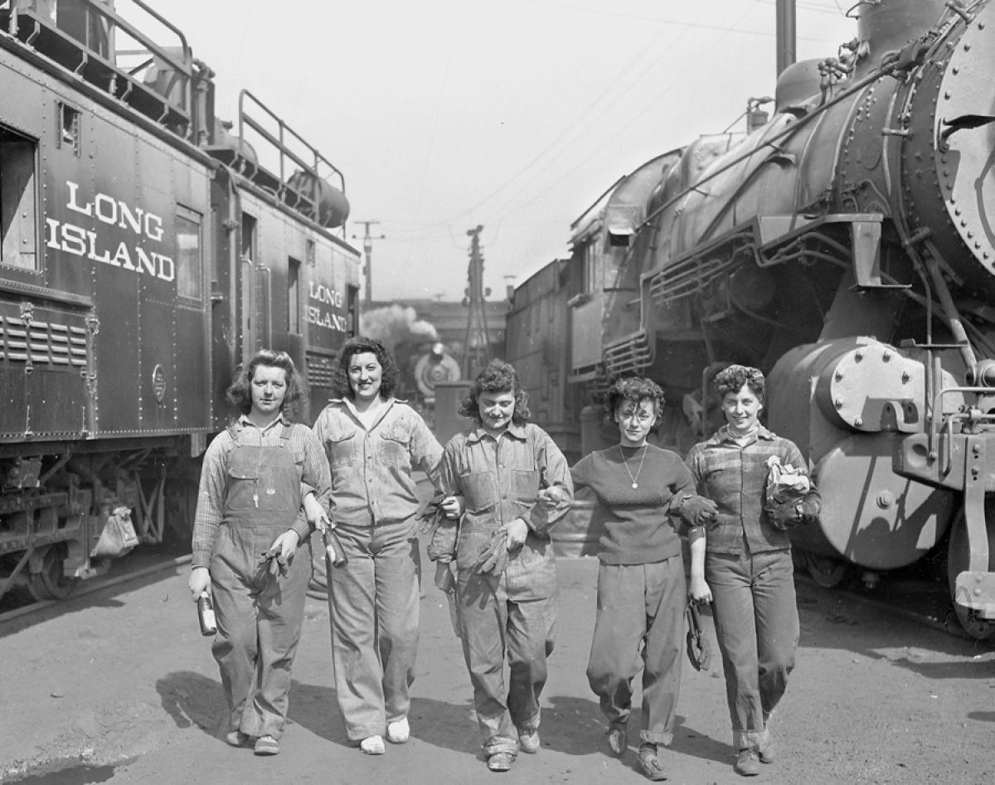
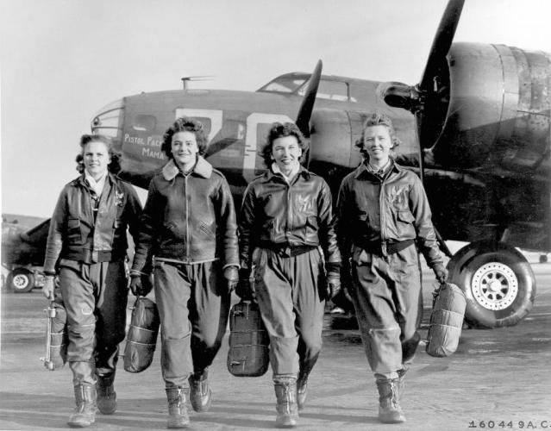
Build an Army Men
Conscription:
16 million serve
Women:
Enlisted (350,000)
WAC’s: Women’s Army Corp
WAVES: Navy
WASPS: Air Force
Separate m/f military until 1978

Slide 5
Total War: every resource is used to fight
“Production Miracle”

Slide 6
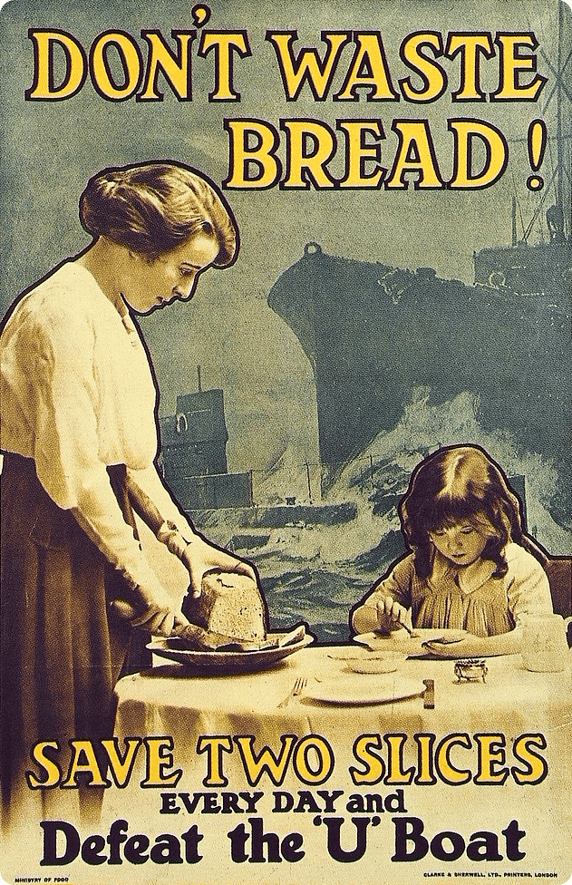
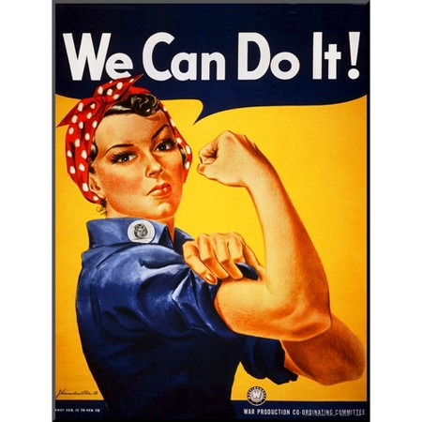
WW1 Versus WW2

Slide 7
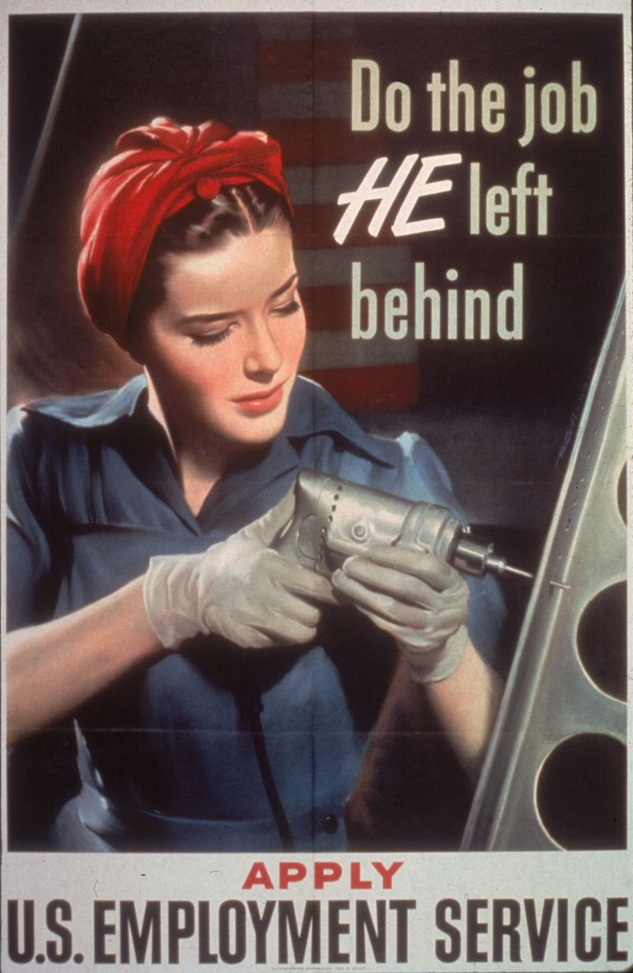
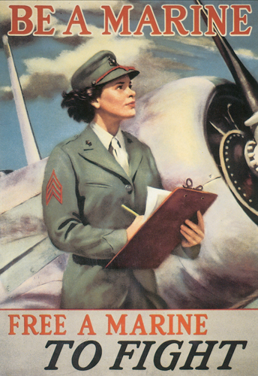
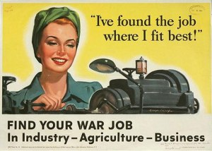
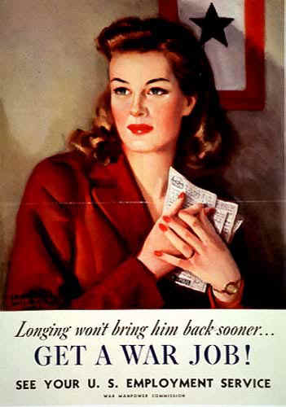
Women @ Home
Millions went to work
Earn 60% of men
1/3 of labor force
“Rosie the Riveter”

Slide 8
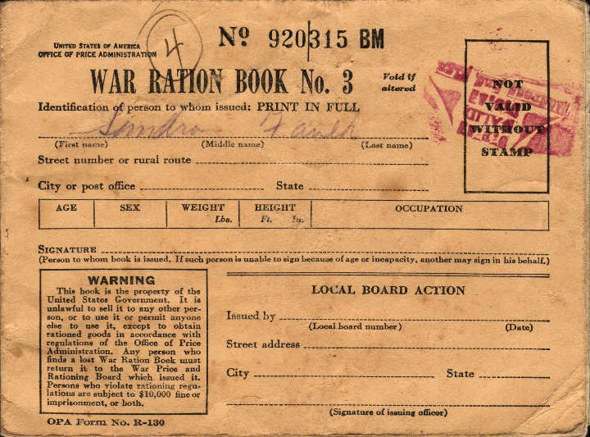
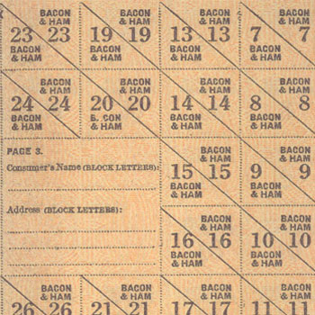
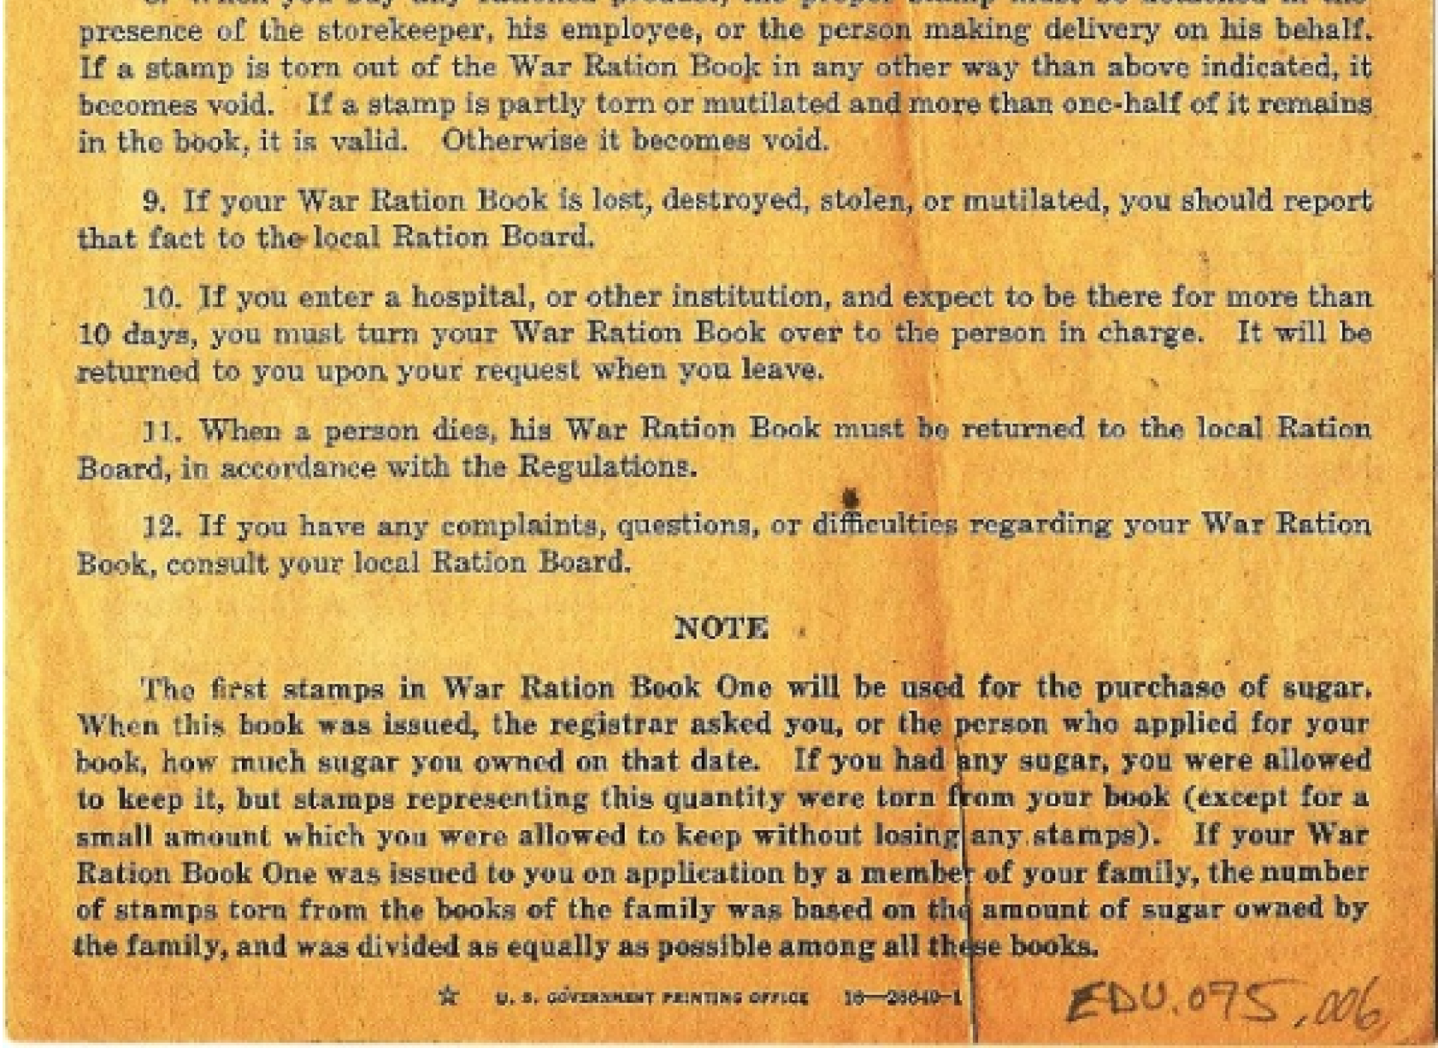
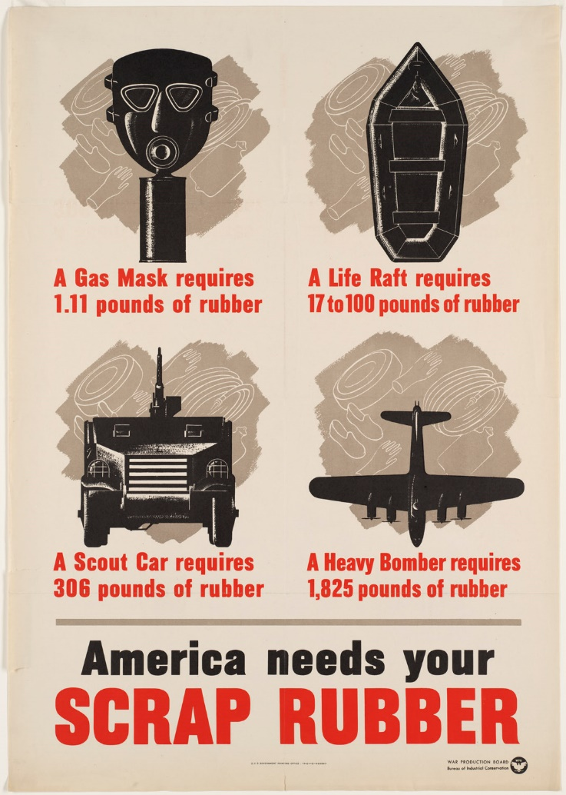
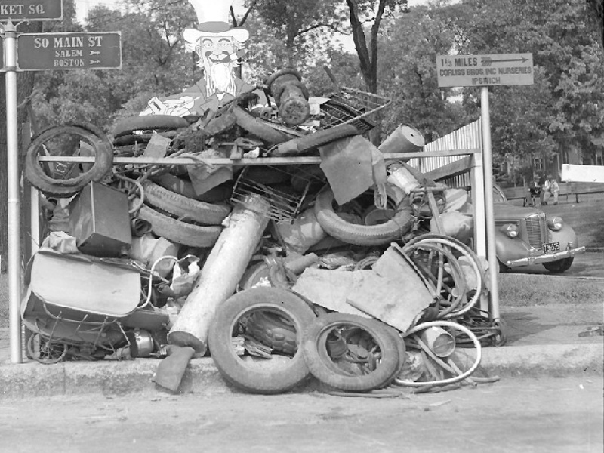
Everyone:
Rationing:
Sugar, meat, gas
Recycling:

Slide 9
Women @ War: Answer these questions for the documents that do NOT have other questions attached.
What sacrifices were made to fight the war?
What did the government expect of women?
What opportunities did this create for women?
How did women feel about their roles in the war?
How did women change during this time period?
What problems did this create?
What did NOT change? Did stereotypes, double standards, and sexism remain?
What happened to them when the war was over?

Slide 10
Overall:
How did WW2 change the lives of American women? Include at least 3 specific examples from the documents you have seen. 5-7 sentences

Slide 11
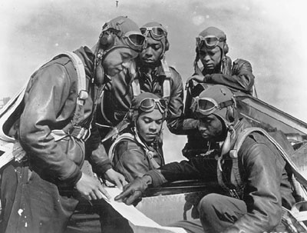
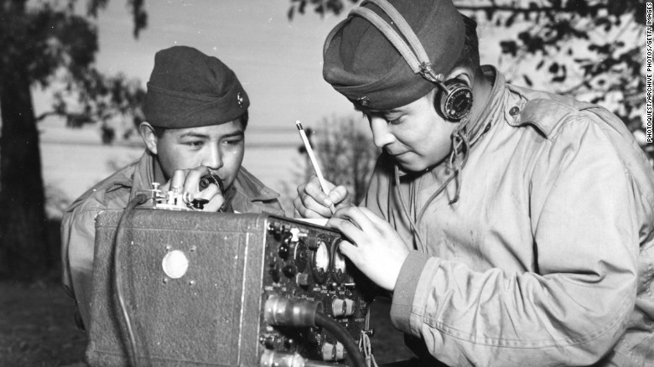
Should minority groups fight when they are discriminated against at home?
Many say yes – even 33,000 Japanese
Often segregated in military
African Americans denied combat until 1943
Tuskegee Experiment
Navajo Indians use their language as code

Slide 12
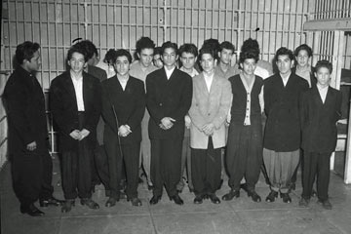
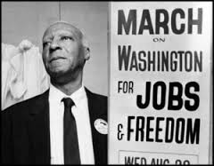
At home:
“Negroes will be considered only as janitors,” declared the general manager of North American Aviation. “It is the company policy not to employ them as mechanics and aircraft workers.”
A. Philip Randolph hold a march to protest unfair working conditions
FDR did NOT want a disruption
Executive Order: Defense industries can NOT discriminate based on race
“Double V”
Riots
Zoot Suit – LA
Detroit

Slide 13
Did WW2 provide challenges or opportunities to women?
Each person will read 1 source.
Annotate for challenges and opportunities and look for the following:
What did the government expect of women?
What were the stereotypes and double standards applied to women?
How did women feel about their roles in the war?
How did women change during this time period?
What happened to them when the war was over?
Decide if you think more challenges or opportunities were presented
Star your top 3 reasons

Slide 14
Did WW2 provide challenges or opportunities to women?
As a group, discuss your evidence.
Develop a thesis.
Pick 5 pieces of evidence to back your claim using at least 1 from each source.
On poster:
Write thesis
Write evidence – each person should do at least one. Cite source.
Have a picture for each piece of evidence (5 total)
BONUS: write a 2-5 word caption for each piece of evidence
Be ready to present

Slide 15
Women’s roles thesis
“Women were .sdjfl adlkfja; sdkfjladjfakjd” (Last name of source)
“She decided to alsdkjf asldkfjas;ldfjadfkjd;” (Modern GCSE school textbook)
Cite your source: Use last name of author if there is one or use the given description

Slide 16
One: closest to cabinets and door
Two: closest to whiteboards and windows
Say hi, name, and best/worst part of Valentine’s Day and/or weekend
Define total war.
Four: closest to cabinets and screen
Three: closest to whiteboards and screen

Slide 17
WW2#5: Rationing
Why was rubber a vital commodity?
List the top 5 ways WW2 changed Christmas.

Slide 18
WW2 #6: Double Victory
What contributions did this group make?
What kinds of discrimination / problems did this group face?
How did WW2 “plant the seeds of change” for the future?

Slide 19
With your elbow partner:
Did WW2 provide more opportunities or challenges for your group?
Star your top 3 pieces of evidence on the paper.
With your table,
Share your above results (#1 and 2)

Slide 20
1. Compare and contrast the overall experiences of Latinos and African Americans during WW2.
Latino Experience
Similarities
African American Experience
Differences
Differences
2. Overall, did WW2 provide more challenges or opportunities for minority groups? Use 2-3 specific pieces of evidence given in the readings.

Slide 21
Scrapbook
Pick your character! Choose from list or make up your own (get it approved by me)
Write a journal about Pearl Harbor
What did you hear in the news about Pearl Harbor? One paragraph
Describe your reaction. Will you sign up for the military? Go work in a shipyard? One paragraph
Who are you? Where are you living? What are you doing – in school, working, etc? Who is in your family? Integrate these answers into the above paragraphs.
This should be one page + handwritten. Do NOT answer these questions in this order but be sure to include an answer somewhere in your journal.
What 5 events will you include? What will be relevant to your character?

Slide 22
December 7, 1941 (use your real name)
Today, I turned on the radio to hear ….. Describe events of PH….
I was sitting with my family….
My father/wife/sister/brother says s/he will…
Living in California,
As a high school student,

Slide 23
Timeline key:
Treaty of Versailles: harshly punished Germany, made many Germans want revenge / seek power
Rhineland: demilitarized zone of Germany, Hitler puts troops in, League of Nations does nothing
Austria: Ger annexes (takes over), LofN does nothing
Sudetenland / Munich Conference: part of Czechoslovakia, Ger says it’s going to take it, @ Munich – Britain say ok have it – but nothing else! Hitler takes rest of Czech few months later
Nazi-Soviet Pact: USSR & Ger promise NOT to fight & to split up Poland, Ger will invade USSR anyway
Invasion of Poland: begins WW2 – France & GB (Allies) declare war on Axis (Ger, It, Japan)

