Slide 1
20s #7: Roaring 20s!

Slide 2
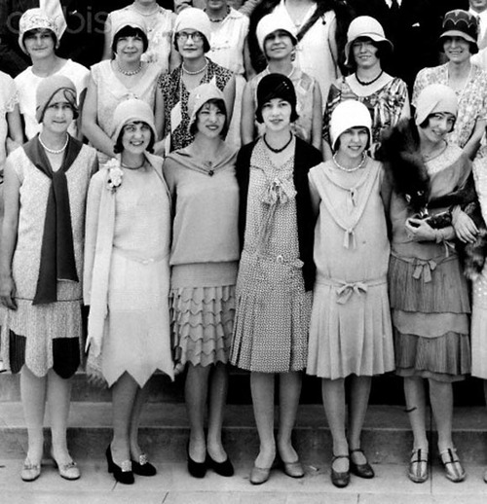
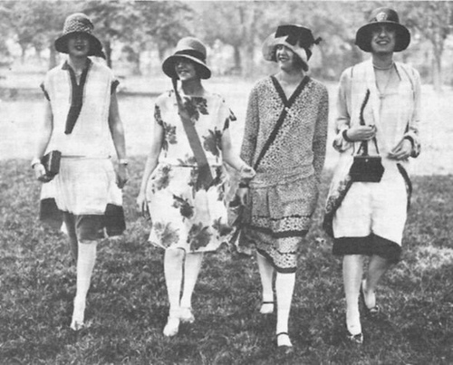
Women
Growing freedom for women
More women & men going to college
More careers for women
Single woman – worked, dated, had fun

Slide 3
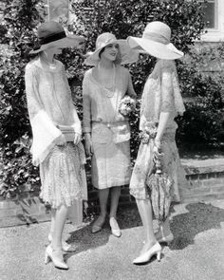
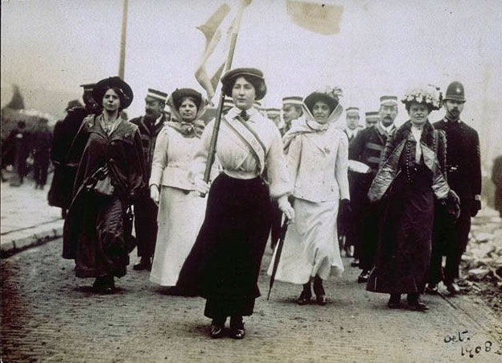
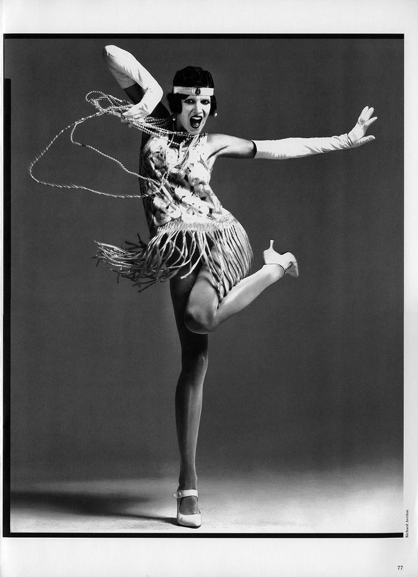
Women
Flappers: women who usually cut their hair into a “bob”, wore short dresses, & partied
Versus

Slide 4
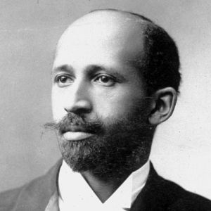
African American Community
Our mission is to ensure the political, educational, social, and economic equality of rights of all persons and to eliminate race-based discrimination. And we’ve been doing it since 1909.
NAACP:
Led by W.E.B. DuBois
Protect rights of minorities
Supports federal anti-lynching laws – which never pass

Slide 5
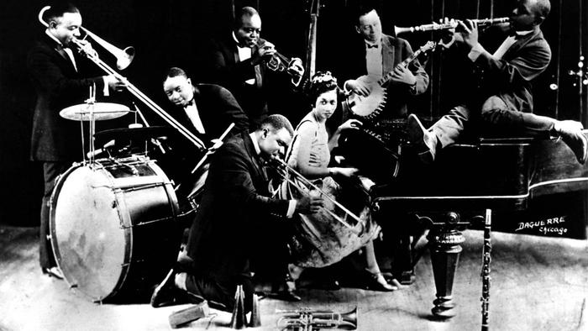
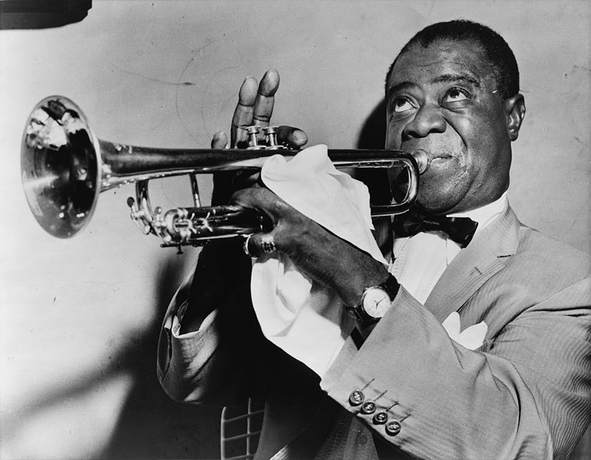
Harlem Renaissance
Rebirth of African culture – art, music, poetry, etc.
Duke Ellington
Bessie Smith
Langston Hughes
Zora Neale Hurston
Louis Armstrong

