Slide 1
Was the New Deal a good deal for the American people?
When done, return Chromebook and grab a reading on the WPA.
Annotate reading. Look for answer to above question.
Answer questions at the end (on back of paper or separate sheet of paper).
Add 2 level 2 and/or 3 questions and answer each one.

Slide 2
Great D #5: FDR
Who did Americans begin to blame for not doing enough to help this economic crisis?

Slide 3
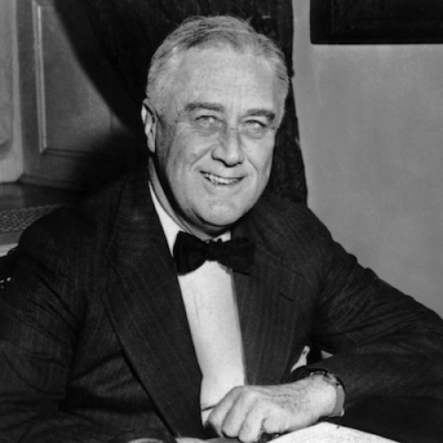
Franklin D Roosevelt (FDR)
Democrat
Promises a “New Deal” for the American people
Econ Relief
Economic Recovery
Financial Reform
Wins 1932 election
Dem’s also win in Congress

Slide 4
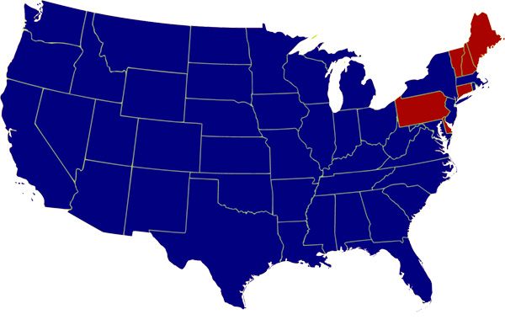
Blue = state won by Democrat
Red = state won by Republican

Slide 5
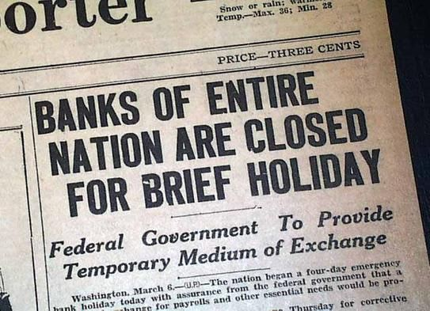
100 Days: 1st 100 days FDR passes many laws
1. Financial Reform
A. Closed all banks – did a financial checkup
Failed – closed permanently
Re-opened – financially sound
*Restored confidence in banks

Slide 6
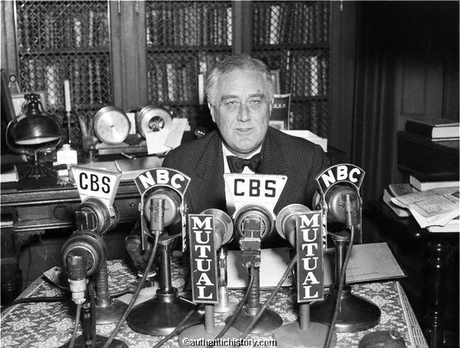
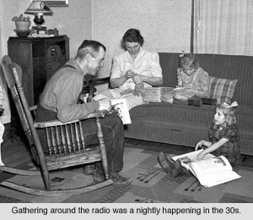
Fireside Chats
Speak to Americans on radio
Encouraged ppl to put money back in the banks & it worked!
If everyone tries to take out their money all at once – even a strong bank will fail

Slide 7
More Financial Reforms
B. FDIC: Federal Deposit Insurance Corporation: gov guaranteed money in banks up to $5000
Today it’s $250,000
C. Federal Securities Act: regulates the stock market, companies have to accurately inform customers of their finances
D. Brings back alcohol – for the taxes

Slide 8
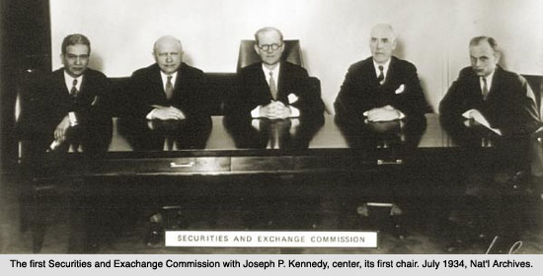
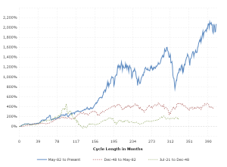
E. Securities & Exchange Commission (1934)
Agency regulates stock market

Slide 9
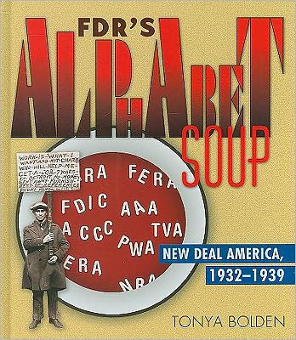
2. Helping the People
A. Rural Areas:
AAA: Agricultural Adjustment Act: 1933
Paid farmers to destroy crops & livestock / farm less --- less supply, increase prices
Controversial

Slide 10
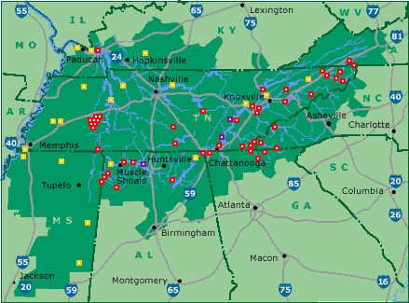
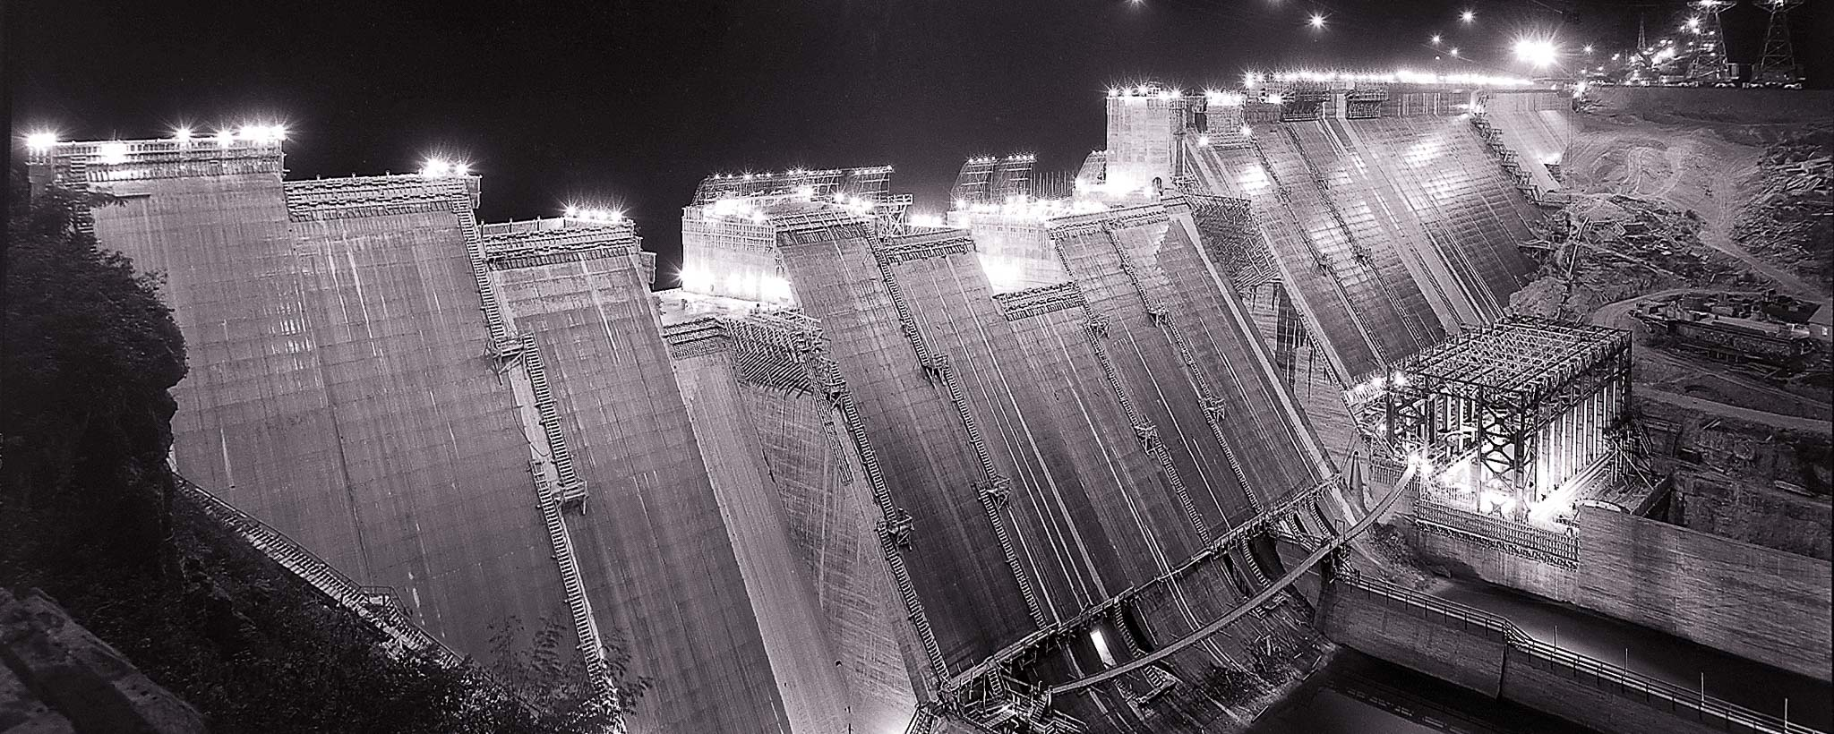
TVA: Tennessee Valley Authority: (1933)
Created dams, hydroelectric power for a poor area
Gov run company
Cheaper ---
Fair?

Slide 11
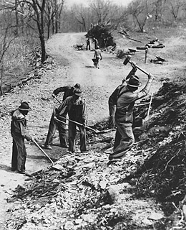
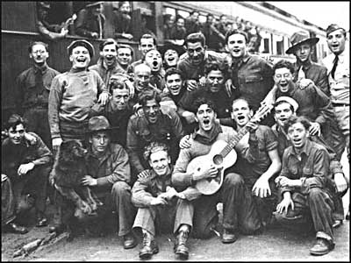
B. Jobs
CCC: Civilian Conservation Corps
Jobs for 18-25 men
Made parks, etc
Free room & board + small pay
CWA: Civil Works Administration
Built schools, roads
Expires
WPA: Works Progress Admin
1935-43, $11 billion

Slide 12
Americans feel like their president is doing something! Glimmer of hope!
Add 5 Level 1 questions to your notes

Slide 13
Great D #6: WPA
5-7 Level 1 Questions
At least one summary point per paragraph
Answer 4 questions at end

