Slide 1
1920’s #9: Changing Culture
Besides suffrage, how else did women’s lives change in the 1920s?
What disease killed millions at the end of the 1910s?
What is the name for people who illegally sold alcohol in the 20’s?
What was the name for the secret clubs during Prohibition?

Slide 2
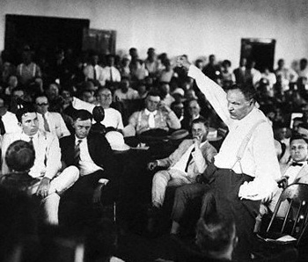
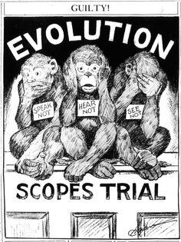
Scopes “Monkey” Trial
1925: Tennessee outlawed teaching evolution
John T. Scopes – teaches it (on purpose)
Trial
  Wm Jennings Bryan: defends TN law / creationism
  Clarence Darrow and ACLU (American Civil Liberties Union) defends Scopes
Scopes loses / SC overturns Scopes conviction
Law will stand

Slide 3
Cars on the Road
1919 | 1.9 million | 6.7 million
1929 | 5.6 million | 27 million
Sales of Radios
1922 | $60 million
1929 | $842.6 million
Wage Levels and the Price of a Ford Model T
 | Average Earnings | Price of a Model T
1912 | $592 | $600
1914 | $627 | $490
1916 | $708 | $360
1924 | $1,303 | $290
Number of Radios
1900 | 18 per 1,000 people
1910 | 82 per 1,000 people
1920 | 123 per 1,000 people
1930 | 163 per 1,000 people

Slide 4
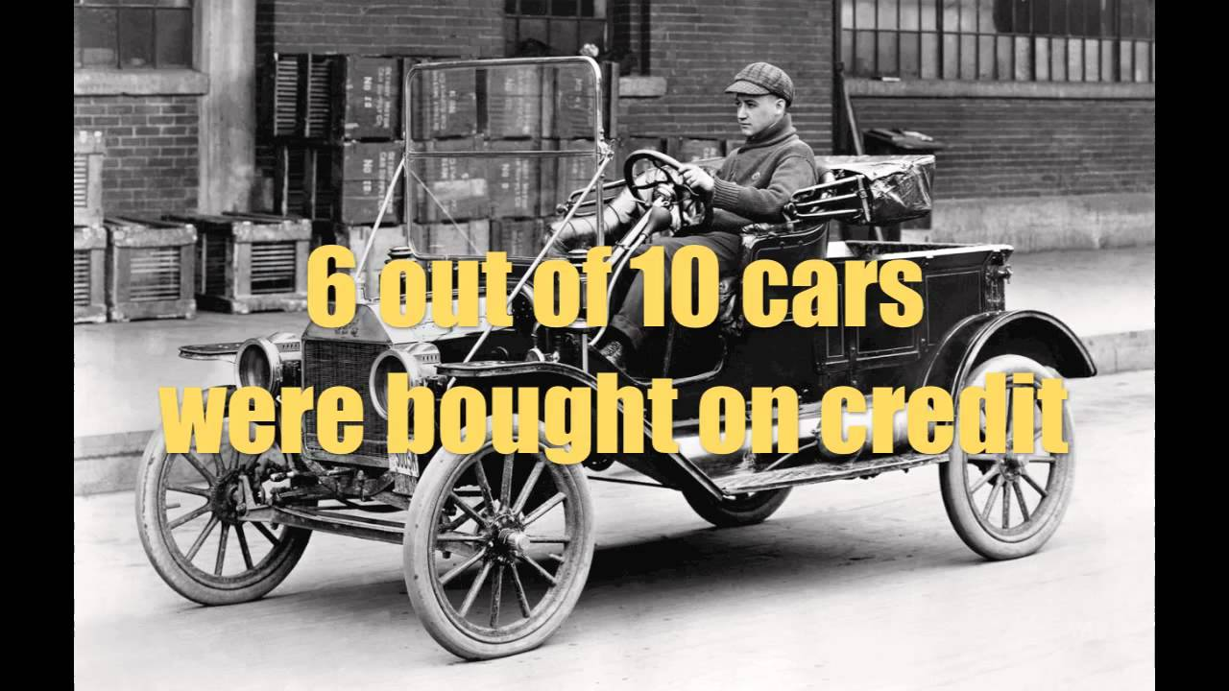
Booming Economy!
20s = prosperous, incomes go up
To pay for new consumer goods, often ppl put it on credit: buy now, pay later
  What can be the problem with credit?
“Business of America is business” = Pres Calvin Coolidge

Slide 5
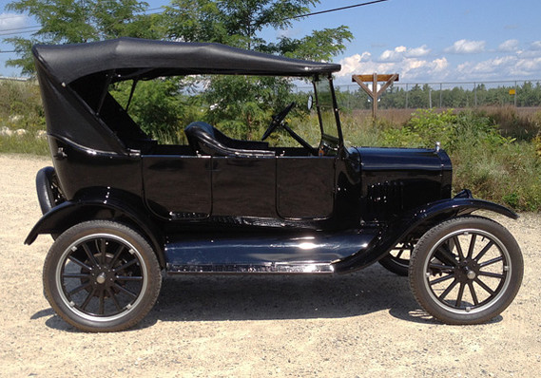
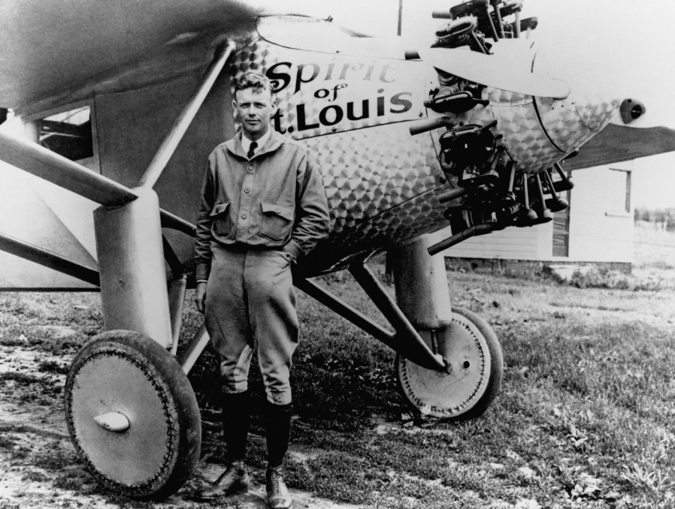
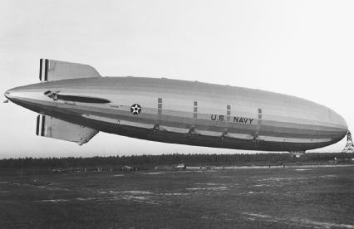
Modern Transportation
Cars became cheaper
Planes develop
  Charles Lindbergh
  Amelia Earhart
$290 in 1924
"Americans can have any kind of car they want, and any color they want, as long as it's a Ford, and as long as it's black.”
-Henry Ford

Slide 6
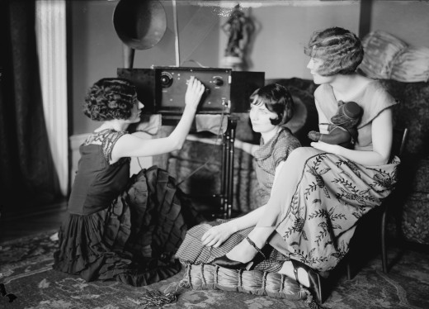
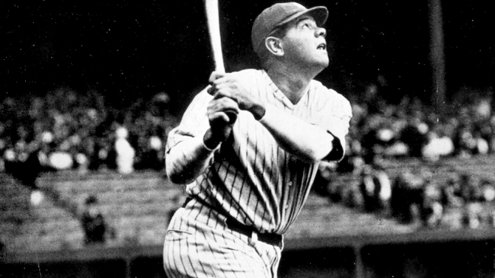
Mass entertainment:
Radio invented
  “Shows” – soap operas, etc.
Movies:
  1927: “Talkies” : movies with sound
Sports:
  Baseball, Football
How would these things change lives?
Do we still use these things today?

Slide 7

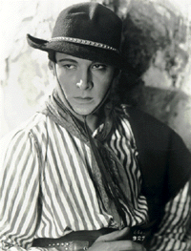
Pop Culture
Americans tuned into same shows
It created heroes, movie stars, radio legends, etc. = Pop Culture
Rudolph Valentino, silent film star

Slide 8
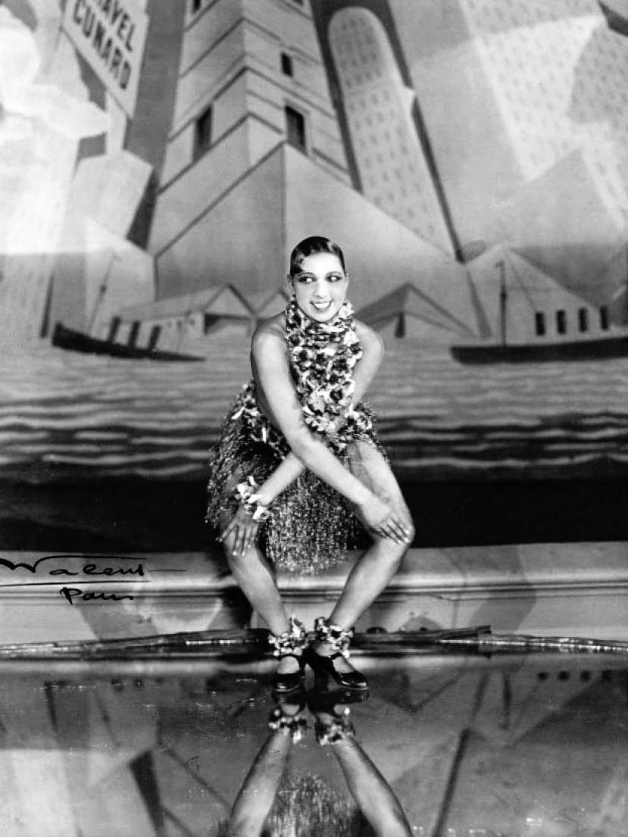
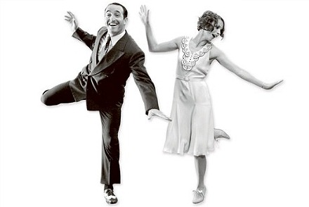
Music
Jazz Age:
  New dances:
    Charleston

Slide 9
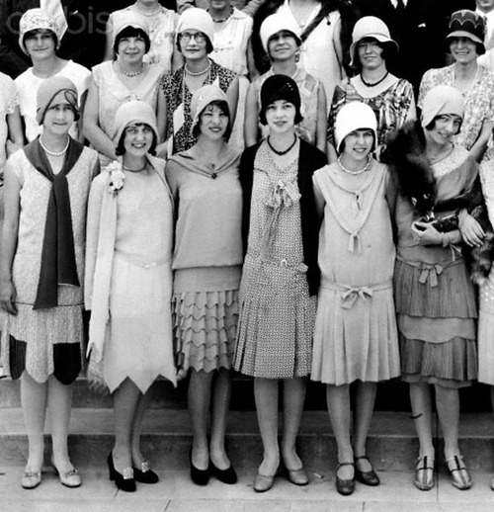
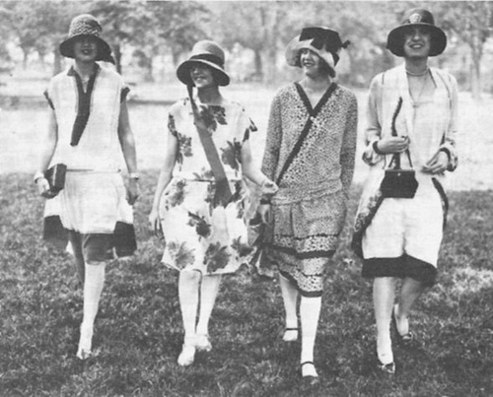
Women
Growing freedom for women
More women & men going to college
  More careers for women
  Not just daughter – wife – mother
  Single woman – worked, dated, had fun

Slide 10
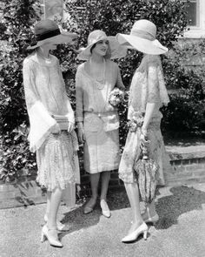
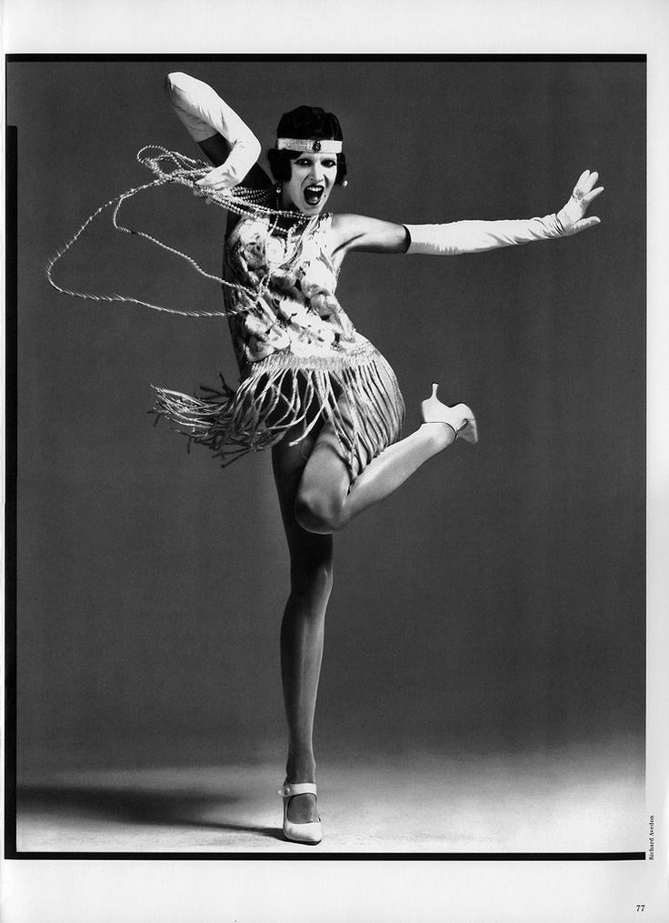
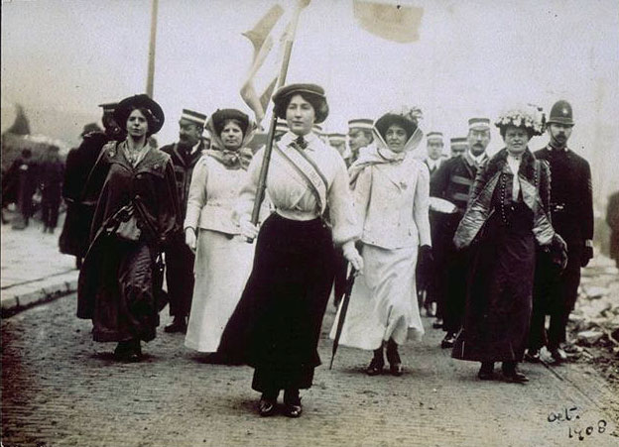
Women
Flappers: women who usually cut their hair into a “bob”, wore short dresses, & partied
Versus

Slide 11
20’s #6: Women – pg 441
The Flapper: Describe a flapper. What did she wear, do her hair, etc?
Double Stand: Were young people as rebellious as it appeared?
How did dating change in the 1920s?
New Work…(pg 442): What kind of jobs were women getting? List 3-4
How did they break some stereotypes?
What jobs were they NOT getting?
Describe women’s pay.
Changing Family: How did the birthrate change?
How was modern life more convenient?
Answer question #4 on pg. 443.
Fill in the “flaps”: movies and books (see page 450-451)
On back of flaps answer: 1. How did life change for women in 1920s? 2. How are things the same today as in the 1920s and how are they different?

Slide 12
Hall of Fame Nominees
Charles Lindbergh (pilot)
Amelia Earhart (pilot)
Flapper
Babe Ruth (baseball)
Jack Dempsey (boxing)
Charlie Chaplin (actor)
Henry Ford (car)
Langston Hughes (poet)
F. Scott Fitzgerald
Earnest Hemingway
Georgia O’Keefe (artist)
Duke Ellington (musician)
Bessie Smith (musician)
Louis Armstrong (musician)
William Johnson (artist)
Warren Harding (president)
Calvin Coolidge (president)
Sacco and Vanzetti
Williams Jennings Bryan (Scopes Trial)
Clarence Darrow (Scopes Trial)

Slide 13
1920s Hall of Fame
Who is the most important person from the 1920s?
Create a piece of art in their honor:
Poem
Song (preferably jazz)
A radio ad (only talking)
A silent movie (no talking!)
For your piece of art:
Write the poem, song, or a script.
One paragraph on why this important is the most important and deserves to be in our hall of fame.

Slide 14
Balderdash!
Goal: to correctly guess the definition of a 1920s slang word
Points earned for each correct definition
Most points = winner
Scorecard: put each player’s name on a paper and tally points for each round

Slide 15
Balderdash!
1 person will pick a term and look at the definition. Do NOT let anyone else see the definition! You will write down the correct definition on a card.
Everyone else will guess at what the definition is and write it down on a card.
Put cards in middle & shuffle.
Person who knows the definition will read all of them.
Everyone else will decide which answer is correct
Anyone who guesses the correct definition wins a point.
Repeat!

Slide 16
Bump off
Something great
Murder
Run away
A flapper

