Slide 1
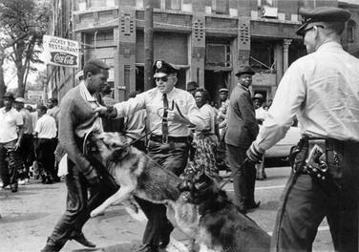

Slide 2
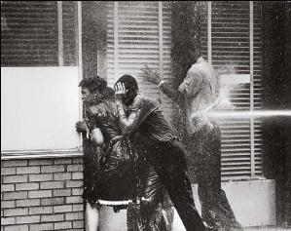

Slide 3
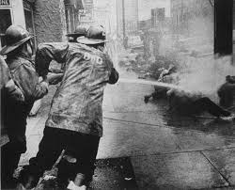

Slide 4
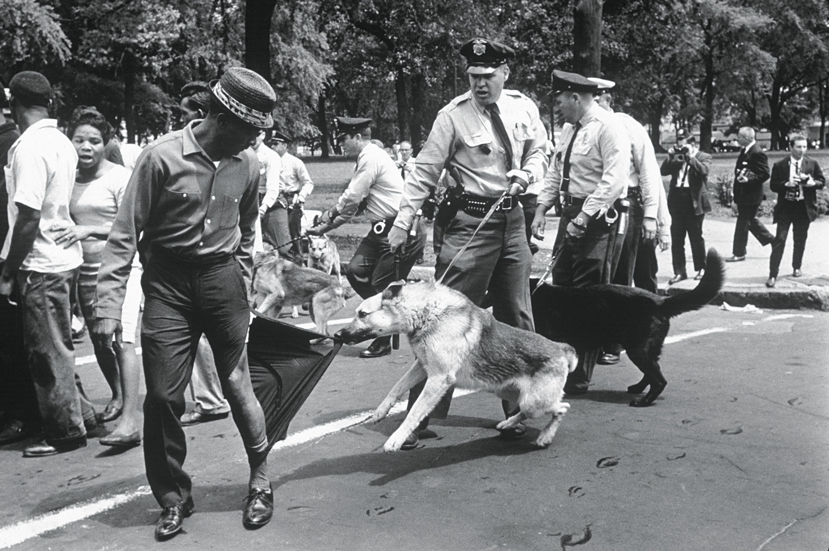

Slide 5
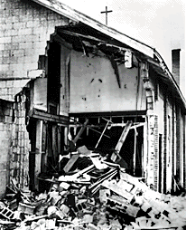
1960s #3: Civil Rights 1960s
Step-by-step changes
  Desegregate schools – buses - bus stations
Non-violent protests met with:
  Arrests
  Dogs, fire hoses
  Violence
  Bombing of Birmingham Church – kills 4 girls (1963)
March on Washington

Slide 6
Civil Rights Act of 1964
Prohibits discrimination in public places, schools, and work based on race, religion, gender, national origin
Pushed through by LBJ

Slide 7
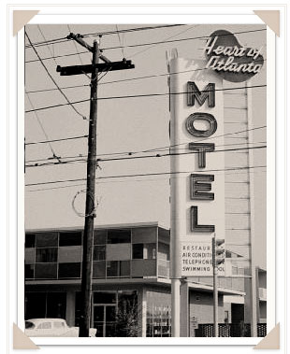
Heart of Atlanta Motel vs. US
Refuses to give rooms to African Americans
NOW, must serve everyone!
Motel sues
Motel loses – no right to refuse service based on race
This changes everything!

Slide 8
Pop Quiz
Which of the following is a right guaranteed by the Bill of Rights: public education, employment, trial by jury, voting
The federal census of population taken every five years: True or False
If a person is indicted for a crime, name 2 rights he has:
A US Senator elected at the general election in November takes offices the following year on what date?

Slide 9
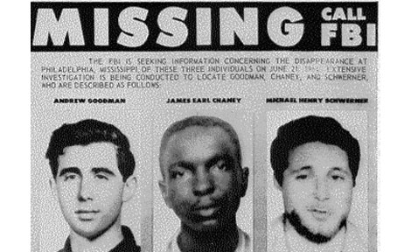
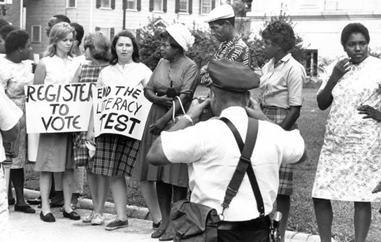
Right to Vote
Freedom Summer of 1964
  3 Civil Rights workers coming from N – found dead in Mississippi
  None convicted for crimes

Slide 10
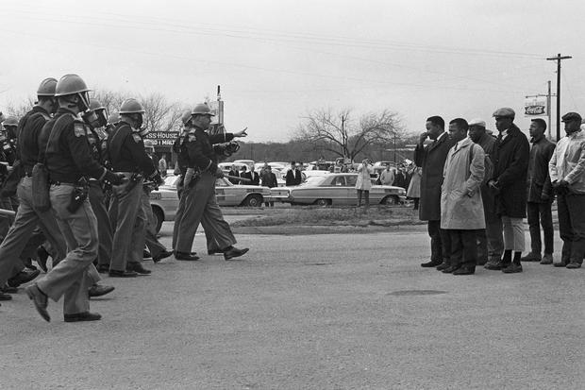
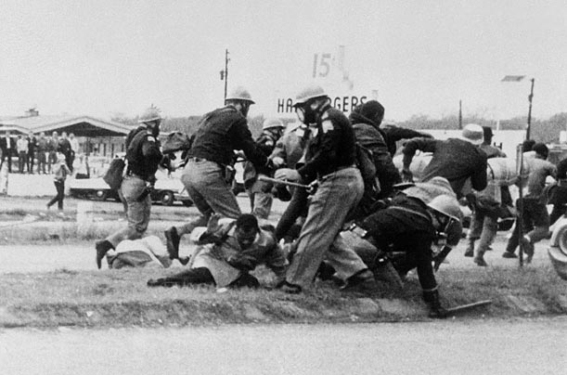
March from Selma to Montgomery 1965
MLK organizes march
Attacked, stop: “Bloody Sunday”
On TV

Slide 11
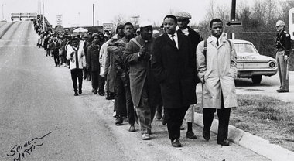
March Continues
2 days later: try again unsuccessfully
  Man killed that night
LBJ announces support / send troops to protect march
What role have presidents played in the Civil Rights Movement? What if they choose to ignore these issues?

Slide 12
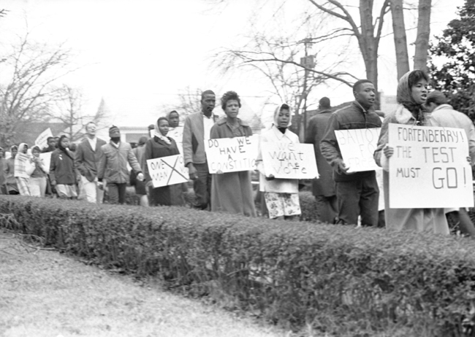
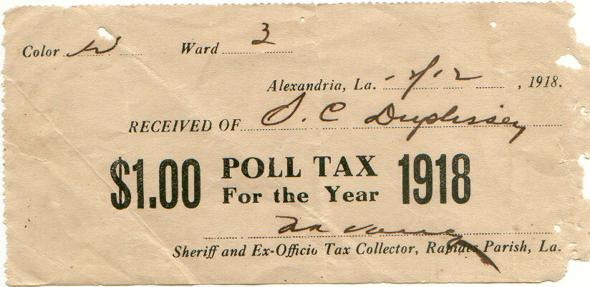
Constitutional Amendment
24th Amendment: ends poll tax

Slide 13
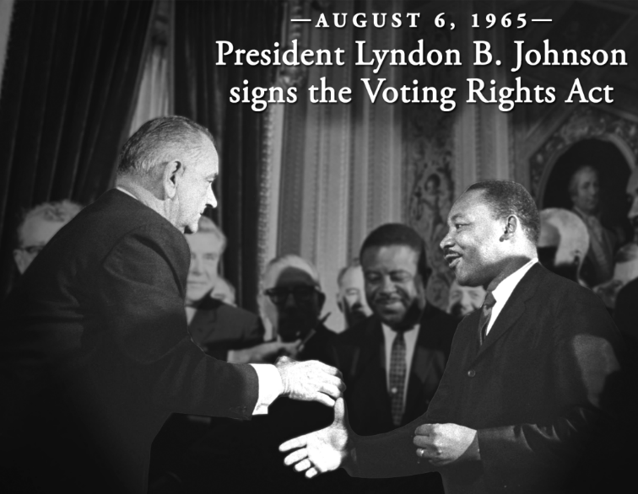
Voting Rights Act of 1965: Ensured that everyone voted by:
  Federal (National) Inspectors ensure that all people have the opportunity to vote
  Outlawed literacy test
    Today ballots come in many languages

Slide 14
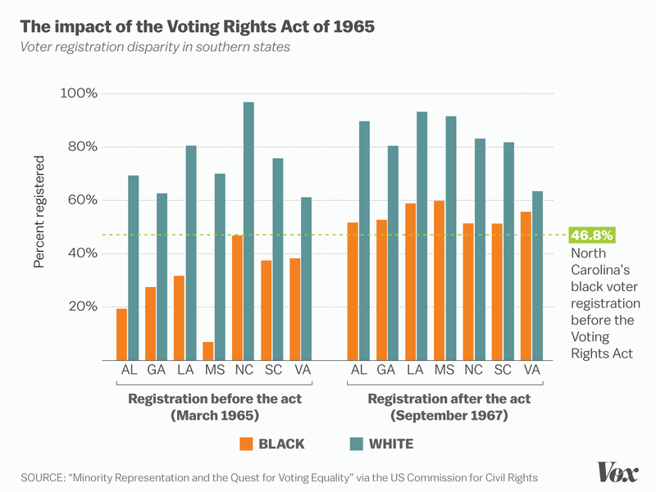
What are highs/lows/trends?
What does this tell us?

Slide 15
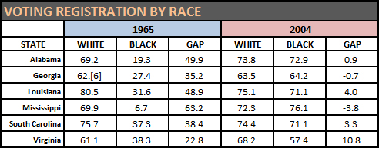

Slide 16
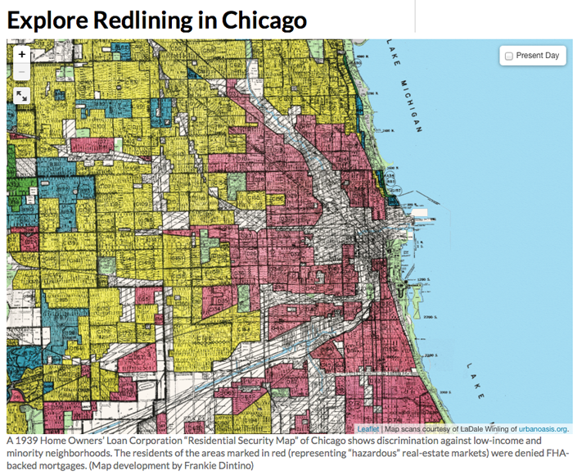

Slide 17
Fair Housing Act, 1968
“the tenant agrees not to permit the premises to be sued or occupied by any person other than members of the Caucasian race.” from Levittown contract
FHA would NOT give out loans to ethnic minorities
Outlaws discrimination based on race, religion, national origin in renting or purchasing houses

Slide 18
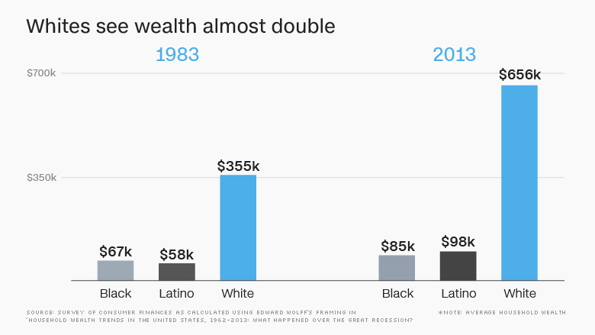

Slide 19
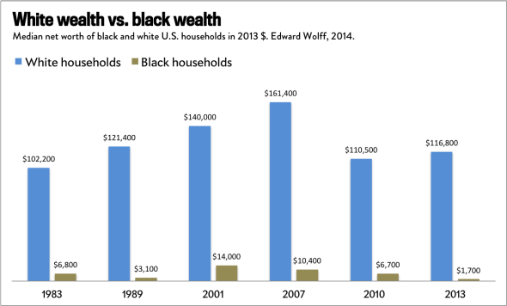

Slide 20
In a 2013 Supreme Court case, the court threw out the need for “preclearance.” Why did they do this? Explain their rationale. See chart below.
Do you think that getting a “preclearance” was an unnecessary burden or a necessary precaution against voter suppression (stopping people from voting).
Today, there are many states making laws that require a picture ID to vote. Is this an unnecessary burden or a protection against voter fraud? (Voter fraud = people voting illegally)

Slide 21
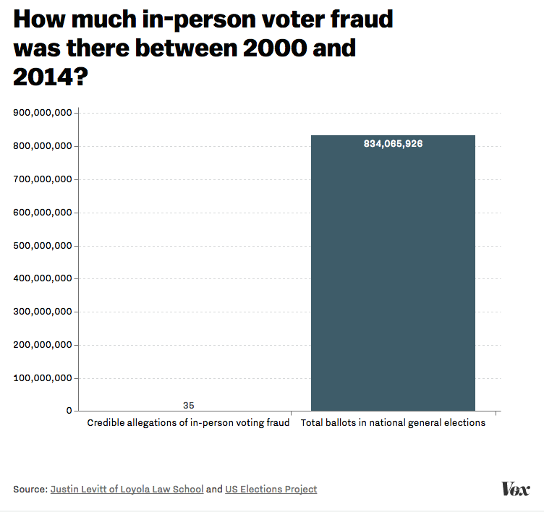

Slide 22
On left: How did each group help transform society in the 1950-60s?
Congress
President
Supreme Court / courts
Large groups of people
Individual Leaders
Media
**Which group had the most transformative effect? Which group had the least?
Leave some room between each

