Slide 1
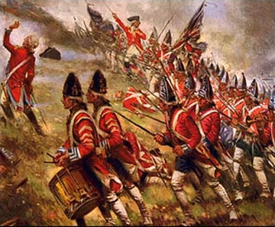
Foundations #2 War is Brewing
Causes of the American Revolution: war grants American independence from Britain

Slide 2
Get out your notebook
What is mercantilism?
HW due T/W: Finish Stamp Act
HW due Th/F: Quiz on Western US (#1-25)

Slide 3
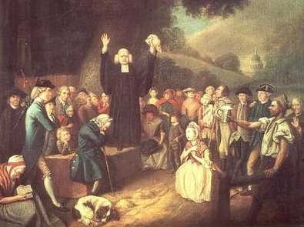
1. Great Awakening (1730-40s)
Renewed interest in religion
Formed NEW religions
Emphasis on individual’s role w/God

Slide 4
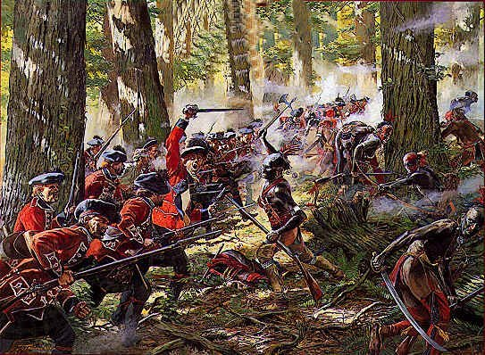
2. French-Indian War (1750s)
War b/w French & British over Ohio Valley
Br – losing (G. Washington)
Br wins & dominates N. Am
Gives Am military expertise / experience
Conflict b/w British officers & Am soldiers
Opens Am up to new territory in Ohio

Slide 5
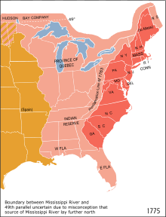
3. Proclamation of 1763
Colonists could NOT move into new territory in Ohio
Am = ☹

Slide 6
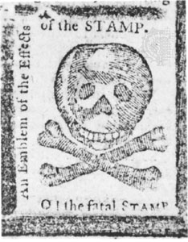
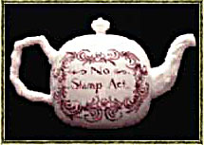
4. Stamp Act
To pay for the war, Parliament raised taxes by Stamp Act –tax on ALL paper goods
Newspapers, wills, legal document, etc.

Slide 7
Stamp Act continued
Colonists had no representatives in Parliament – so Americans could not give consent (agreement)
War cry was “No Taxation Without Representation”
Boycott (stop buying) Br goods
Women made their own cloth
Got many Am’s involved ---turning point in Br/Am

Slide 8
So far, are these good enough reasons to go to war?

Slide 9
ON Back on notes (left side) :
List 5 Level 1 Questions (Who, What, When, Where, Why, How, Describe, List)
Fill in your chart (economic or principles?)

Slide 10
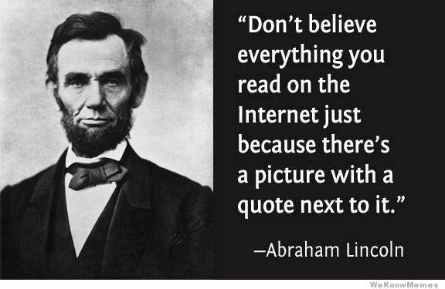

Slide 11
Which is a more credible – reliable, believable – source?
Your account of what happened when Maya DiRado came to our school.
The Press Democrat’s newspaper article on what happened when Maya DiRado came to our school.

Slide 12
Primary vs. Secondary Sources
Secondary: created after event by someone who did NOT participate
Primary: original accounts by people who participated in event
Piece of pottery with the name of someone who is to be exiled from ancient Greece
Book written by a college professor on ancient Greece
Your textbook
Quote from Plato in your textbook
Picture from the 1800s
Letter written by a President

