Slide 1
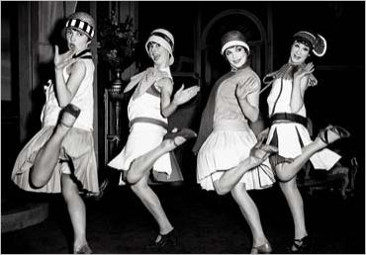
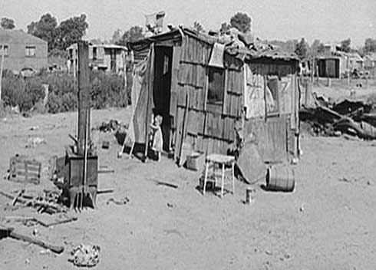
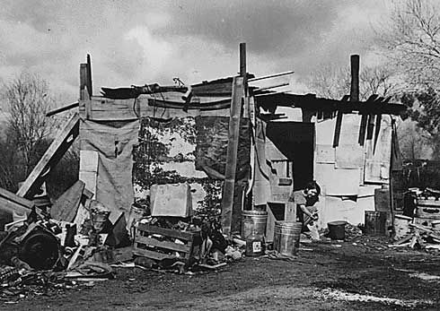
Great Depression #2: Causes

Slide 2
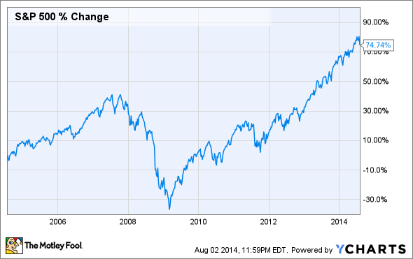
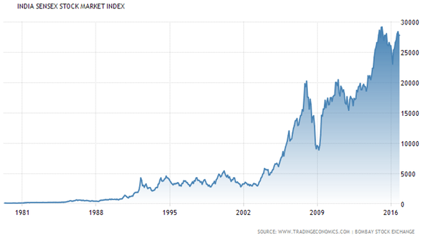

Slide 3
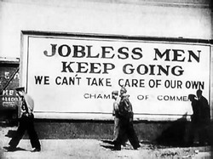
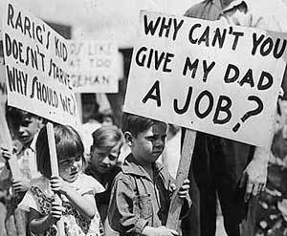
Great Depression:
1929-1940
Severe economic downturn
Roaring 20’s come to a crashing halt!!

Slide 4
What caused the Great D – how do we avoid it? How did the Great D affect Americans? If the US enters an economic downturn – what can be done?

Slide 5
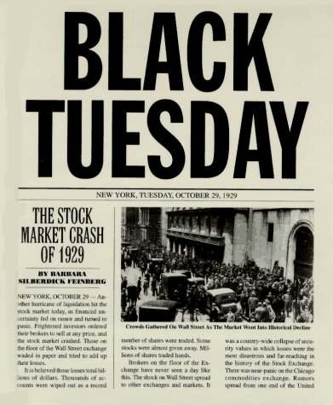
Event triggers GD:
Black Tuesday – October 29, 1929 – Stock market crashes
Ppl sold stocks – prices drop – ppl sold more – prices dropped more
Major PANIC as ppl lost $$$
By mid-Nov lost $16 billion = to spending on WW1

Slide 6
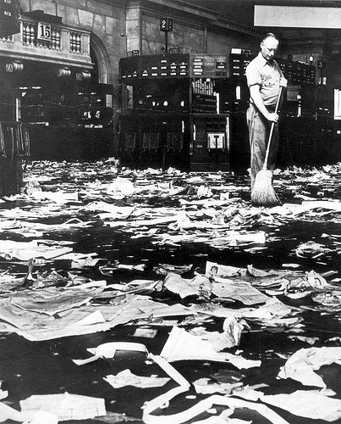
Buying on margin: ppl took out loans to buy stocks that must be paid back
EX: I take out a loan for $100 to buy 10 stocks at $10 each
IF value of stock goes up to $20 – I sell, get $200 and pay back $100 loan
IF value goes down to $5 – I owe $50, that I probably do NOT have

Slide 7
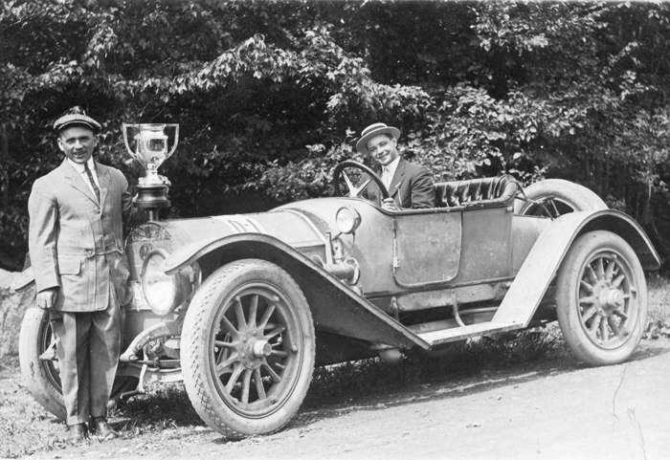
This crash is made worse by long term causes:
1. Income Gap
70% less than $2,500 / year
New clothes once a year, 1/10 had a fridge, half had electricity

Slide 8
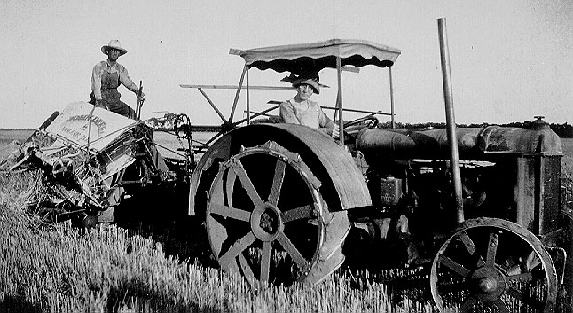
2. Farming issues
Farmers
WW1
Prices 40% drop
Price supports
Gov’t guarantees a certain price for certain products

Slide 9
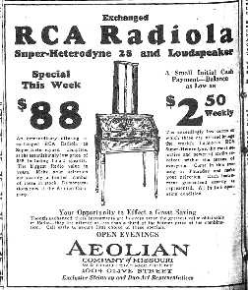
3. Credit
Buying on installment
Debt
Forced ppl to cut back on spending
Crash occurs, can’t pay back / keep up

Slide 10
Tariffs…how do they work?
Add tariff (tax) to imports (items coming into US)
Imports:
$100 item + tariff of $2 = $102
Domestic products (made in US)
$100 item + $0 in tariffs = $100
Which item will most people buy?
Good for
Bad for

Slide 11
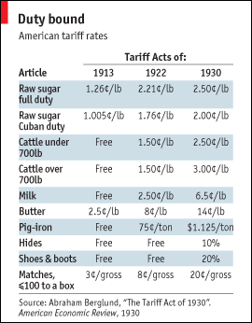
4. Industrial Production
RR, coal, and others weakened by new inventions (car, natural gas) and reduced demand by 20s end
To fix it, Congress passes
Hawley-Smoot Tariff
Tariff – puts tax on imports
US products
Foreign products
Reaction:
Result:

Slide 12
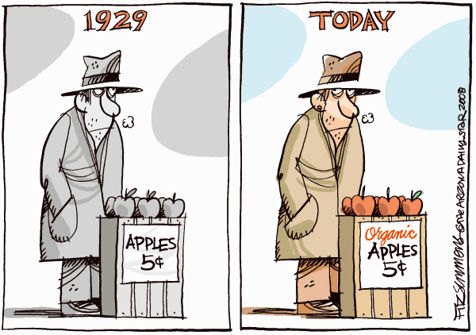
Does any of this sound like economic issues we have today?

Slide 13
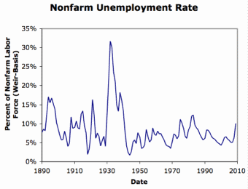
When is the highest/lowest % of unemployed?
What period was the worst? By how much (approx.)?

Slide 14
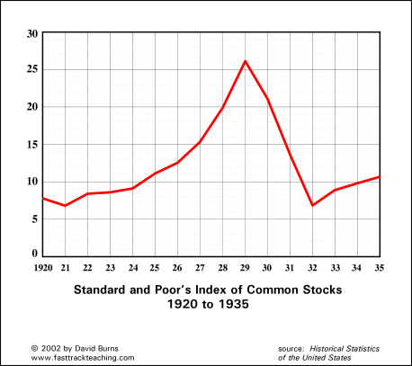
Name 2 trends you see on this chart.
What does this tell you?

Slide 15
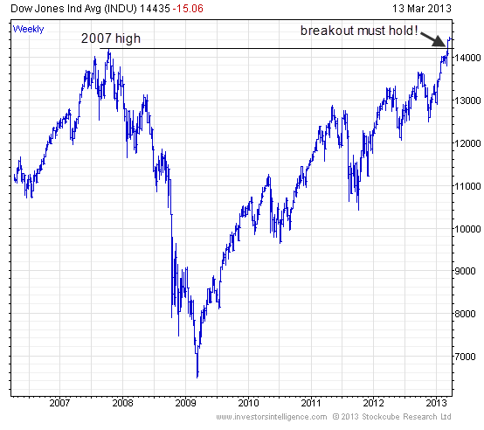
Name 2 trends you see on this chart.
What does this tell you?

Slide 16
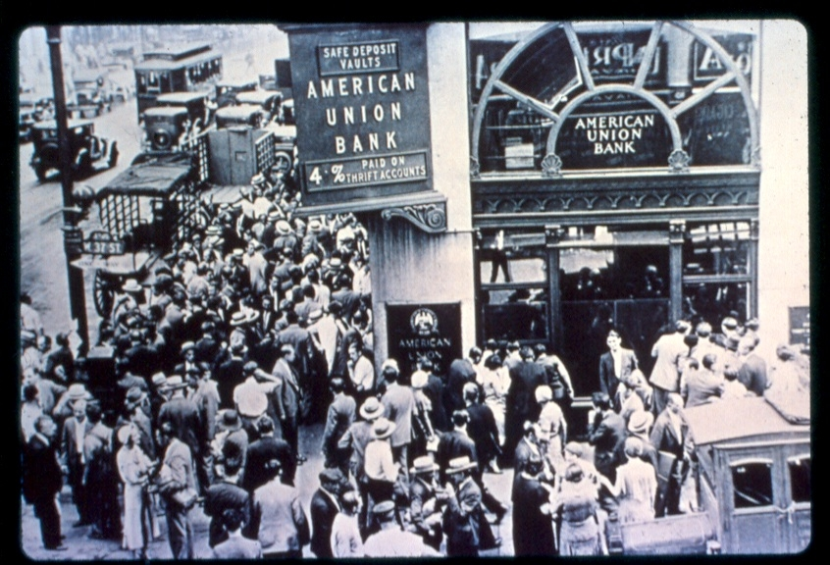
Immediate Effects
“Run on the Banks”
Banks invested in Stock Mkt
Over 40% failed =
9 million savings

Slide 17
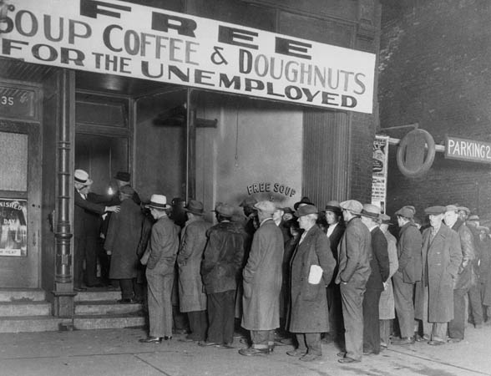
2. Businesses fail
Demand down – production down – decrease workers – decrease in demand – production decrease – decrease workers – cycle repeats – (how do you stop this cycle?)
3. Unemployment skyrockets to 25%

Slide 18
GD #3: Stories Hard Times
Quotes
Reaction: What does this tell you about the problems at the time and/or their ways of coping with them?
Pick 3 meaningful quotes from the text that show the IMPACT of the Great Depression

Slide 19
Make & Answer 2 Level 2 or 3 Questions about readings
Level 2: Compare, contrast, advantages, disadvantages, infer
Level 3: Analyze, judge, evaluate, predict

Slide 20
Pick 3 Questions from the “Details” and answer each. Label them D1,D2, etc (don’t have to copy question / do give an echo answer)

