Slide 1
WW1 #8: Major Battles
What is a stalemate?
Who are the Allies?
Who are the Central Powers?
Why is the Battle of the Marne significant?
Whose death began WW1?
Who gave Austria-Hungary a “blank check”?
Which neutral country did Germany invade?

Slide 2
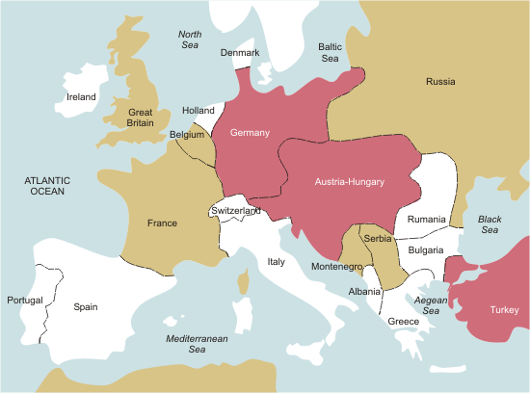
If you are Great Britain & want to get supplies to Russia, where do you go?

Slide 3
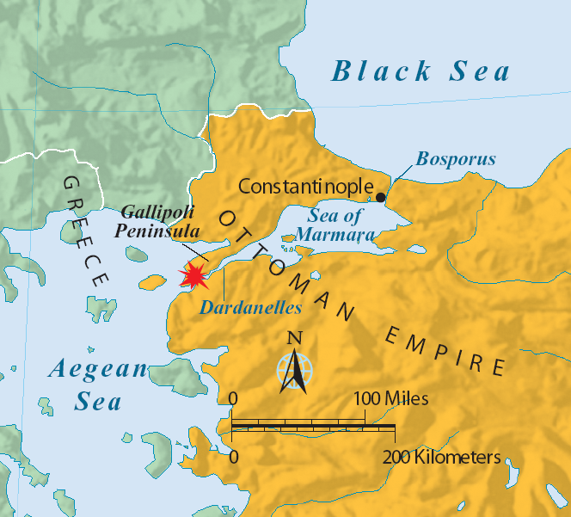
Gallipoli (Feb - Dec 1915)
Russia
Allies attempt to capture the Dardanelles (water passage) in Ottoman Empire
Goal: get supplies to Russians & defeat Otto.
Allies LOSE! (British, Australian, French, and New Zealanders)

Slide 4
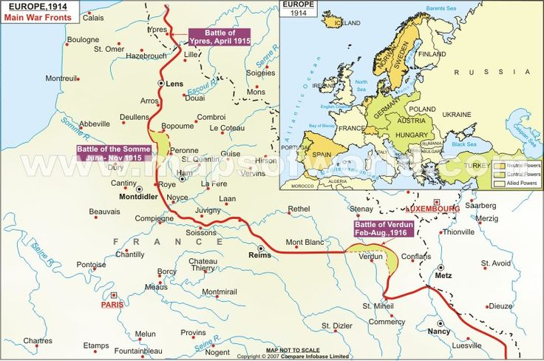
The Western Front: Battle of Verdun
Feb-Dec 1916 (longest battle)
Significance: Germany attack France in a symbolically important location
Ger gain some land but not what they wanted so French win …but not really
700,000 total deaths
*Russians help by a surprise attack in east requiring Germany soldiers to be diverted to east

Slide 5
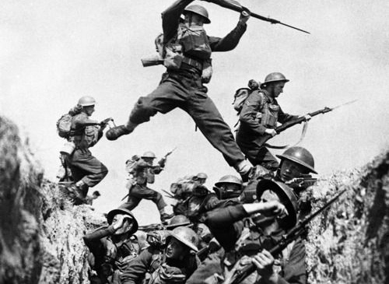
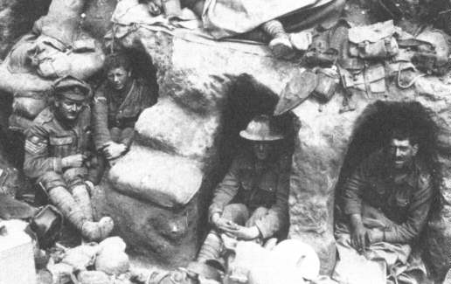
Battle of the Somme
July – Nov 1916
Somme River in France
British/French try to push Germans back & take German soldiers away from Verdun
British gain 5 miles so win…but not really
1 + million deaths total

Slide 6
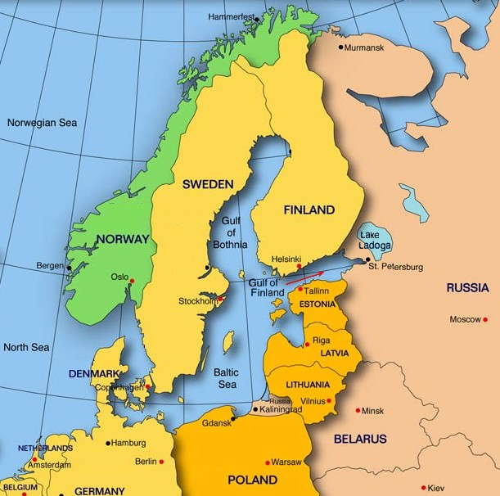
Eastern Front: Russia struggles
Weaknesses
1.) Russia NOT industrialized: Fewer resources (food, guns, clothes, etc)
2. Allies couldn’t ship supplies to Russia b/c Ger controlled the Baltic Sea & Black Sea
Strengths
1. Russia’s #1 advantage—it’s large population.

Slide 7
One historian has said,
“If, after the Marne in 1914, or even later, she [Germany] had adopted a war policy of defense in the West, offence in the East, the issue of the war might well have been different.” (Liddell­Hart, p. 189)
What does this historian suggest Germany should have done and what might have been the result?

Slide 8
The stalemate continues!
Add 5 Level 1 Questions
(Who, what, why, how?)

Slide 9
Other ideas….
Causes of war
Schlieffen Plan
Battles: Somme, Gallipoli, Verdun, Tannenberg, other
How does war end – Why do Allies win? Why did Germany lose?
Unrestricted submarine warfare / u-boats
Eastern Front
Opposition to war

Slide 10
Research
On a piece of paper (typed or handwritten):
Write down the name of your source
Save websites on your Google Docs
Take notes
DUE on Monday: Notes on your topic from 2 sources
Due on Monday: notes
Each individual must turn in notes on 2 sources

